Slide 1

DEEP
DIG EVALUATE ESTIMATE PROVE YOURSELF
Association Karpen 2010

Slide 2
About us
Our association has the responsibility to educate his trainers and mentors to insure a good education to the stakeholders and the local community.
The Karpen 2010 Association trains constantly the teachers involved in the education process from the local schools, especially the College NV-Karpen.
Outside this our NGO had a moral responsibility to be together with the local community during the years of the pandemic. During this process we observe a alarming need from the parents, teachers and others stakeholders of managing the emotions, the stress and decisions that they take each day.
When you had the opportunity to participate in this kind of project that tackles these needs, of stress management, resilience, mindfulness, psychological stress and other problems, we decided that it will be a great chance to develop our skills and abilities that you can transfer the concepts to your direct and indirect beneficiary.

Slide 3
TPM1
Fara San Martino, Italy,
7 – 10 OF JUNE 2022

Slide 4
TPM1
We identify the needs of your staff by questioners.
We selected our staff that is well suited to participate in this project and disseminate the results.
We made a training for the staff of our organization to participate effectively in the project.
We participated in the first TPM in Fara San Martino in Italy where we established the methods of implementing the project, the calendar of the activities and the budget of the project.

Slide 6
TC
Konya, Turkey,
24 - 30 OF JUNE 2022

Slide 7
TC
We participated with a group formed by the manager of the project together with other 5 teachers in the training course in Konya, Turkey at KTO Karatay University. We learn key concepts about mindfulness, stress resilience and other techniques related to the project.
We disseminated the content of the training course in our association and college.
We provided dissemination materials.

Slide 8
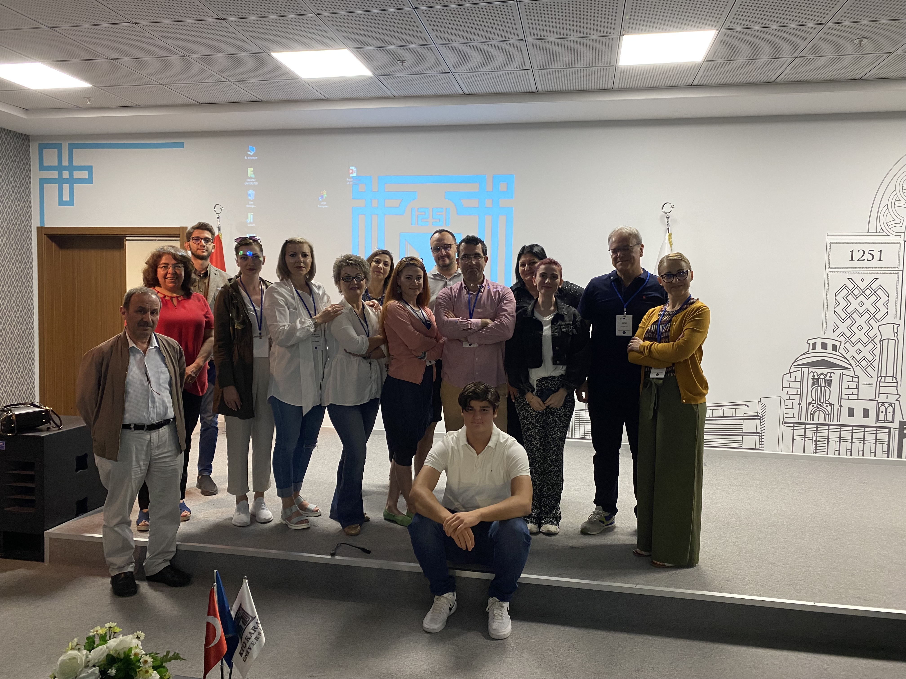
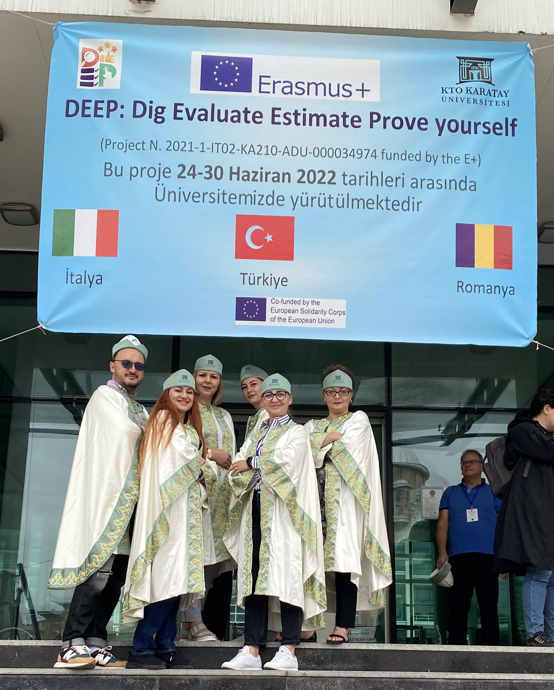
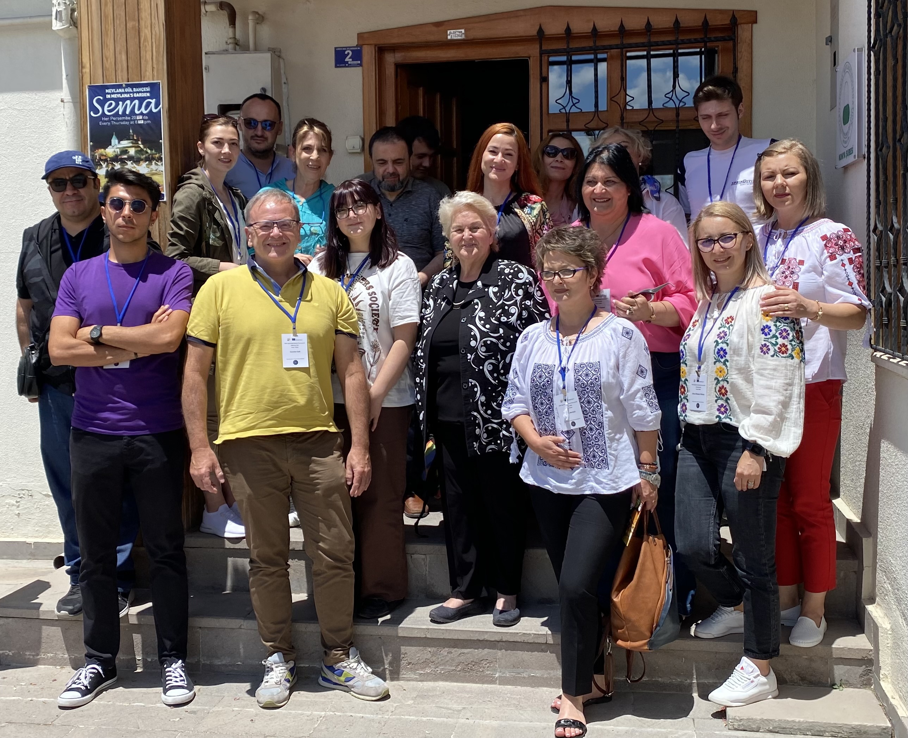
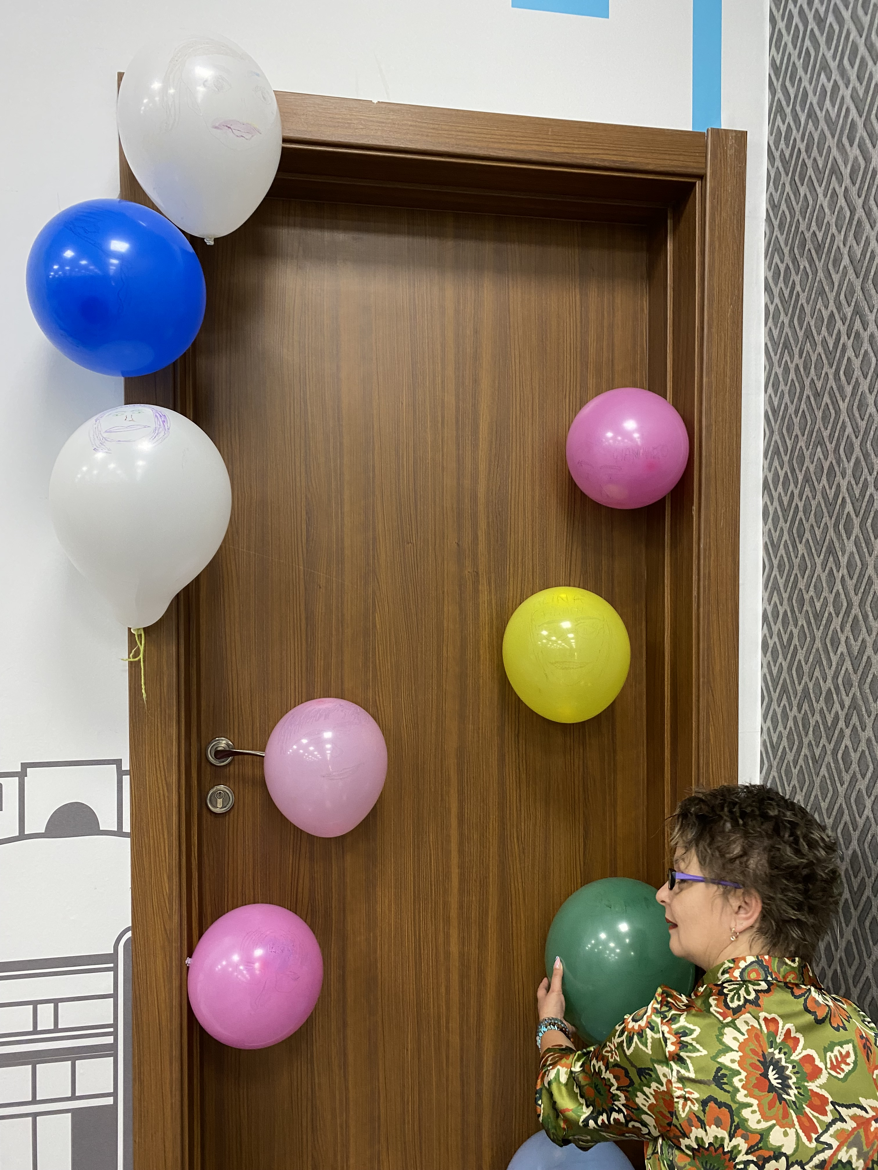
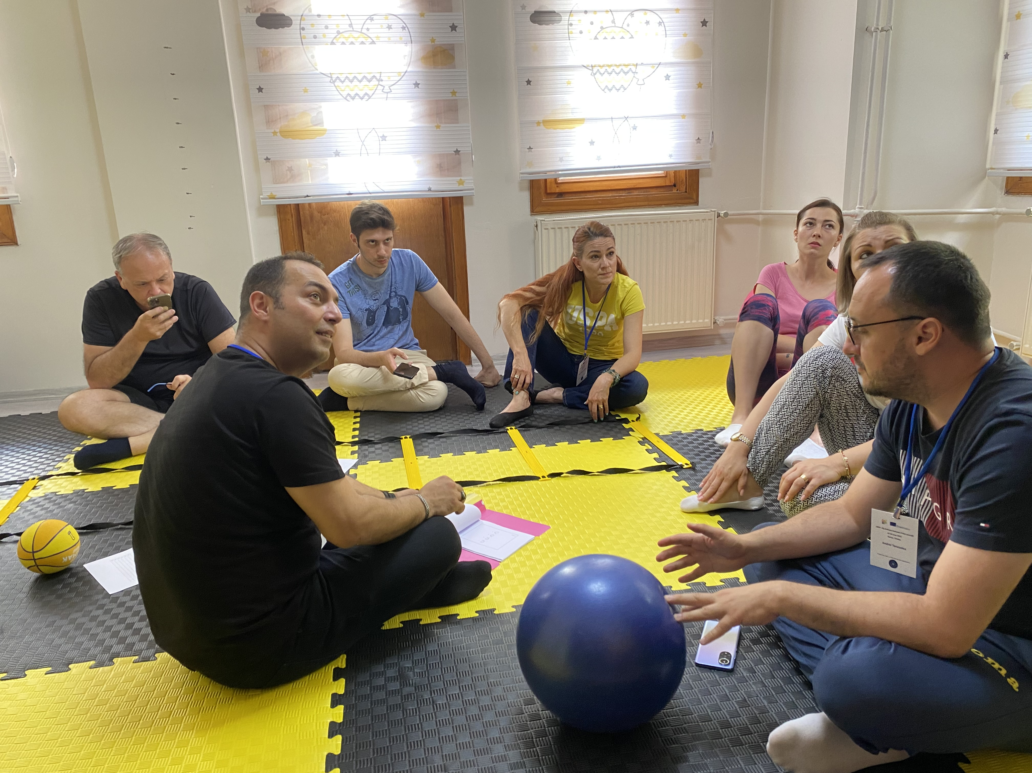
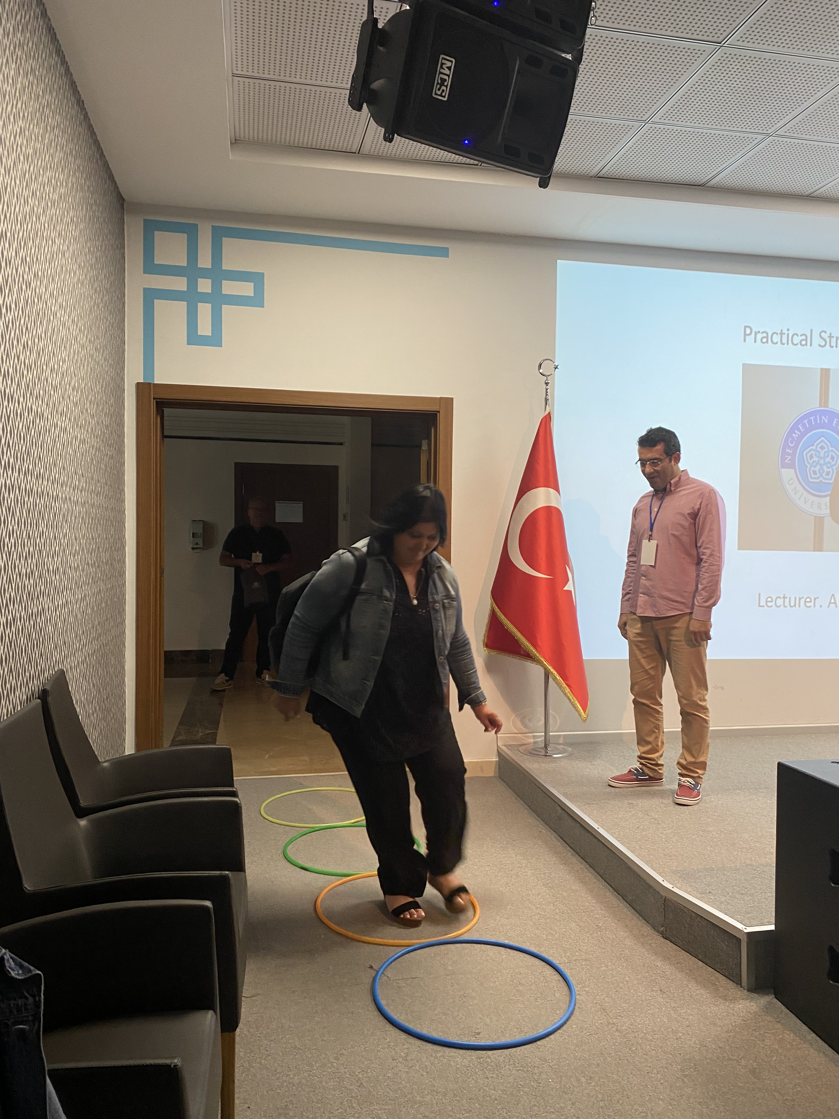
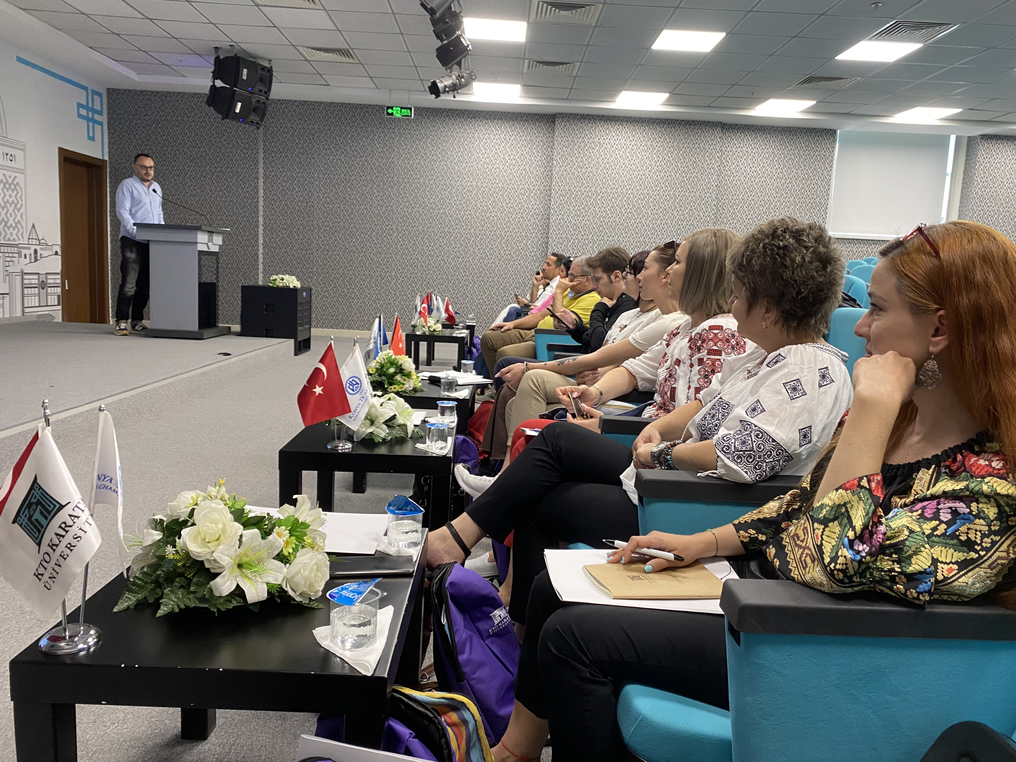
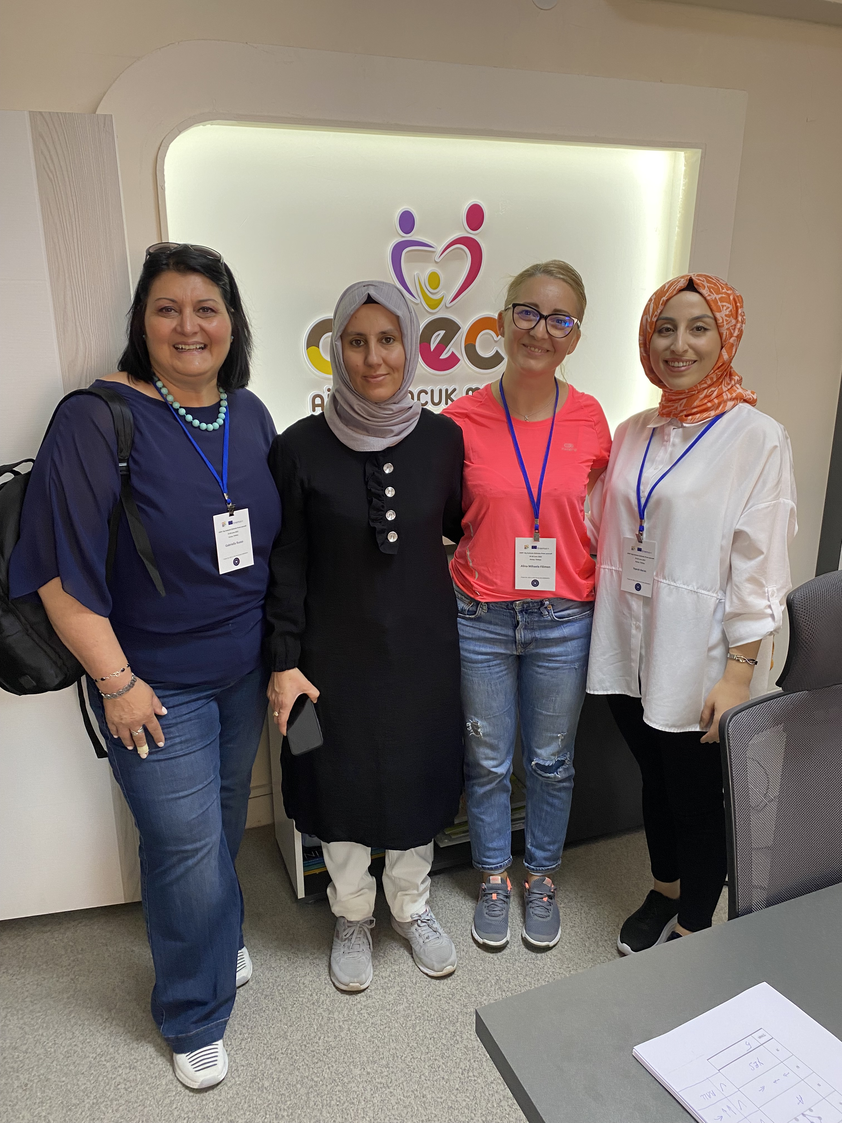
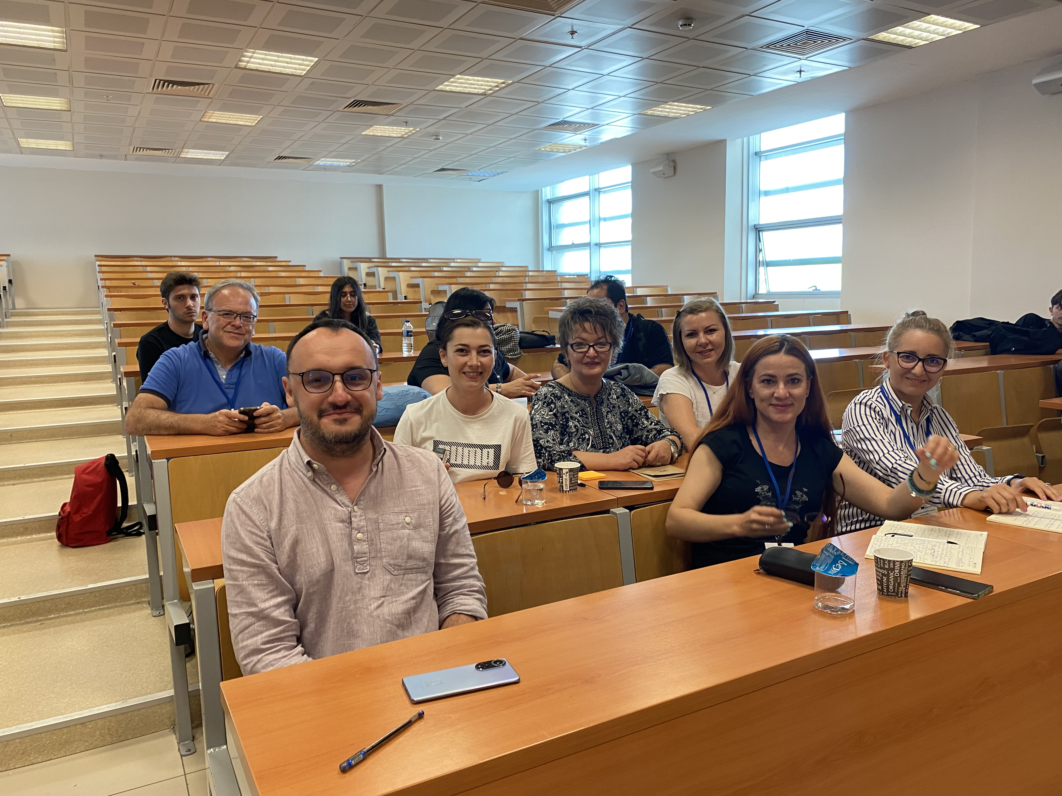

Slide 9
WORKSHOP
ROMANIA, 30TH OF AUGUST 2022

Slide 10
WORKSHOP
1. We organized a workshop on the topic Dyslexia with the expert and 12 participants from the NV-Karpen College and other colleges in Bacau. The workshop was transmitted live to the other partners of the project and it was realised using diverse techniques and methods.
2. The participants at the workshop disseminate the information in the framework of their schools

Slide 11
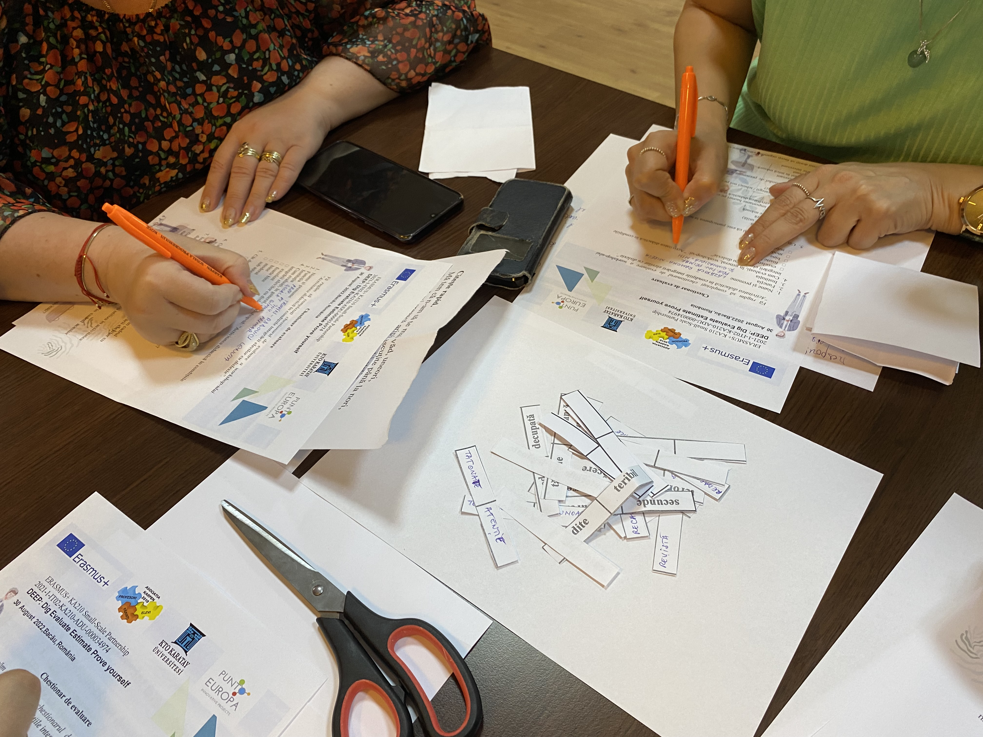
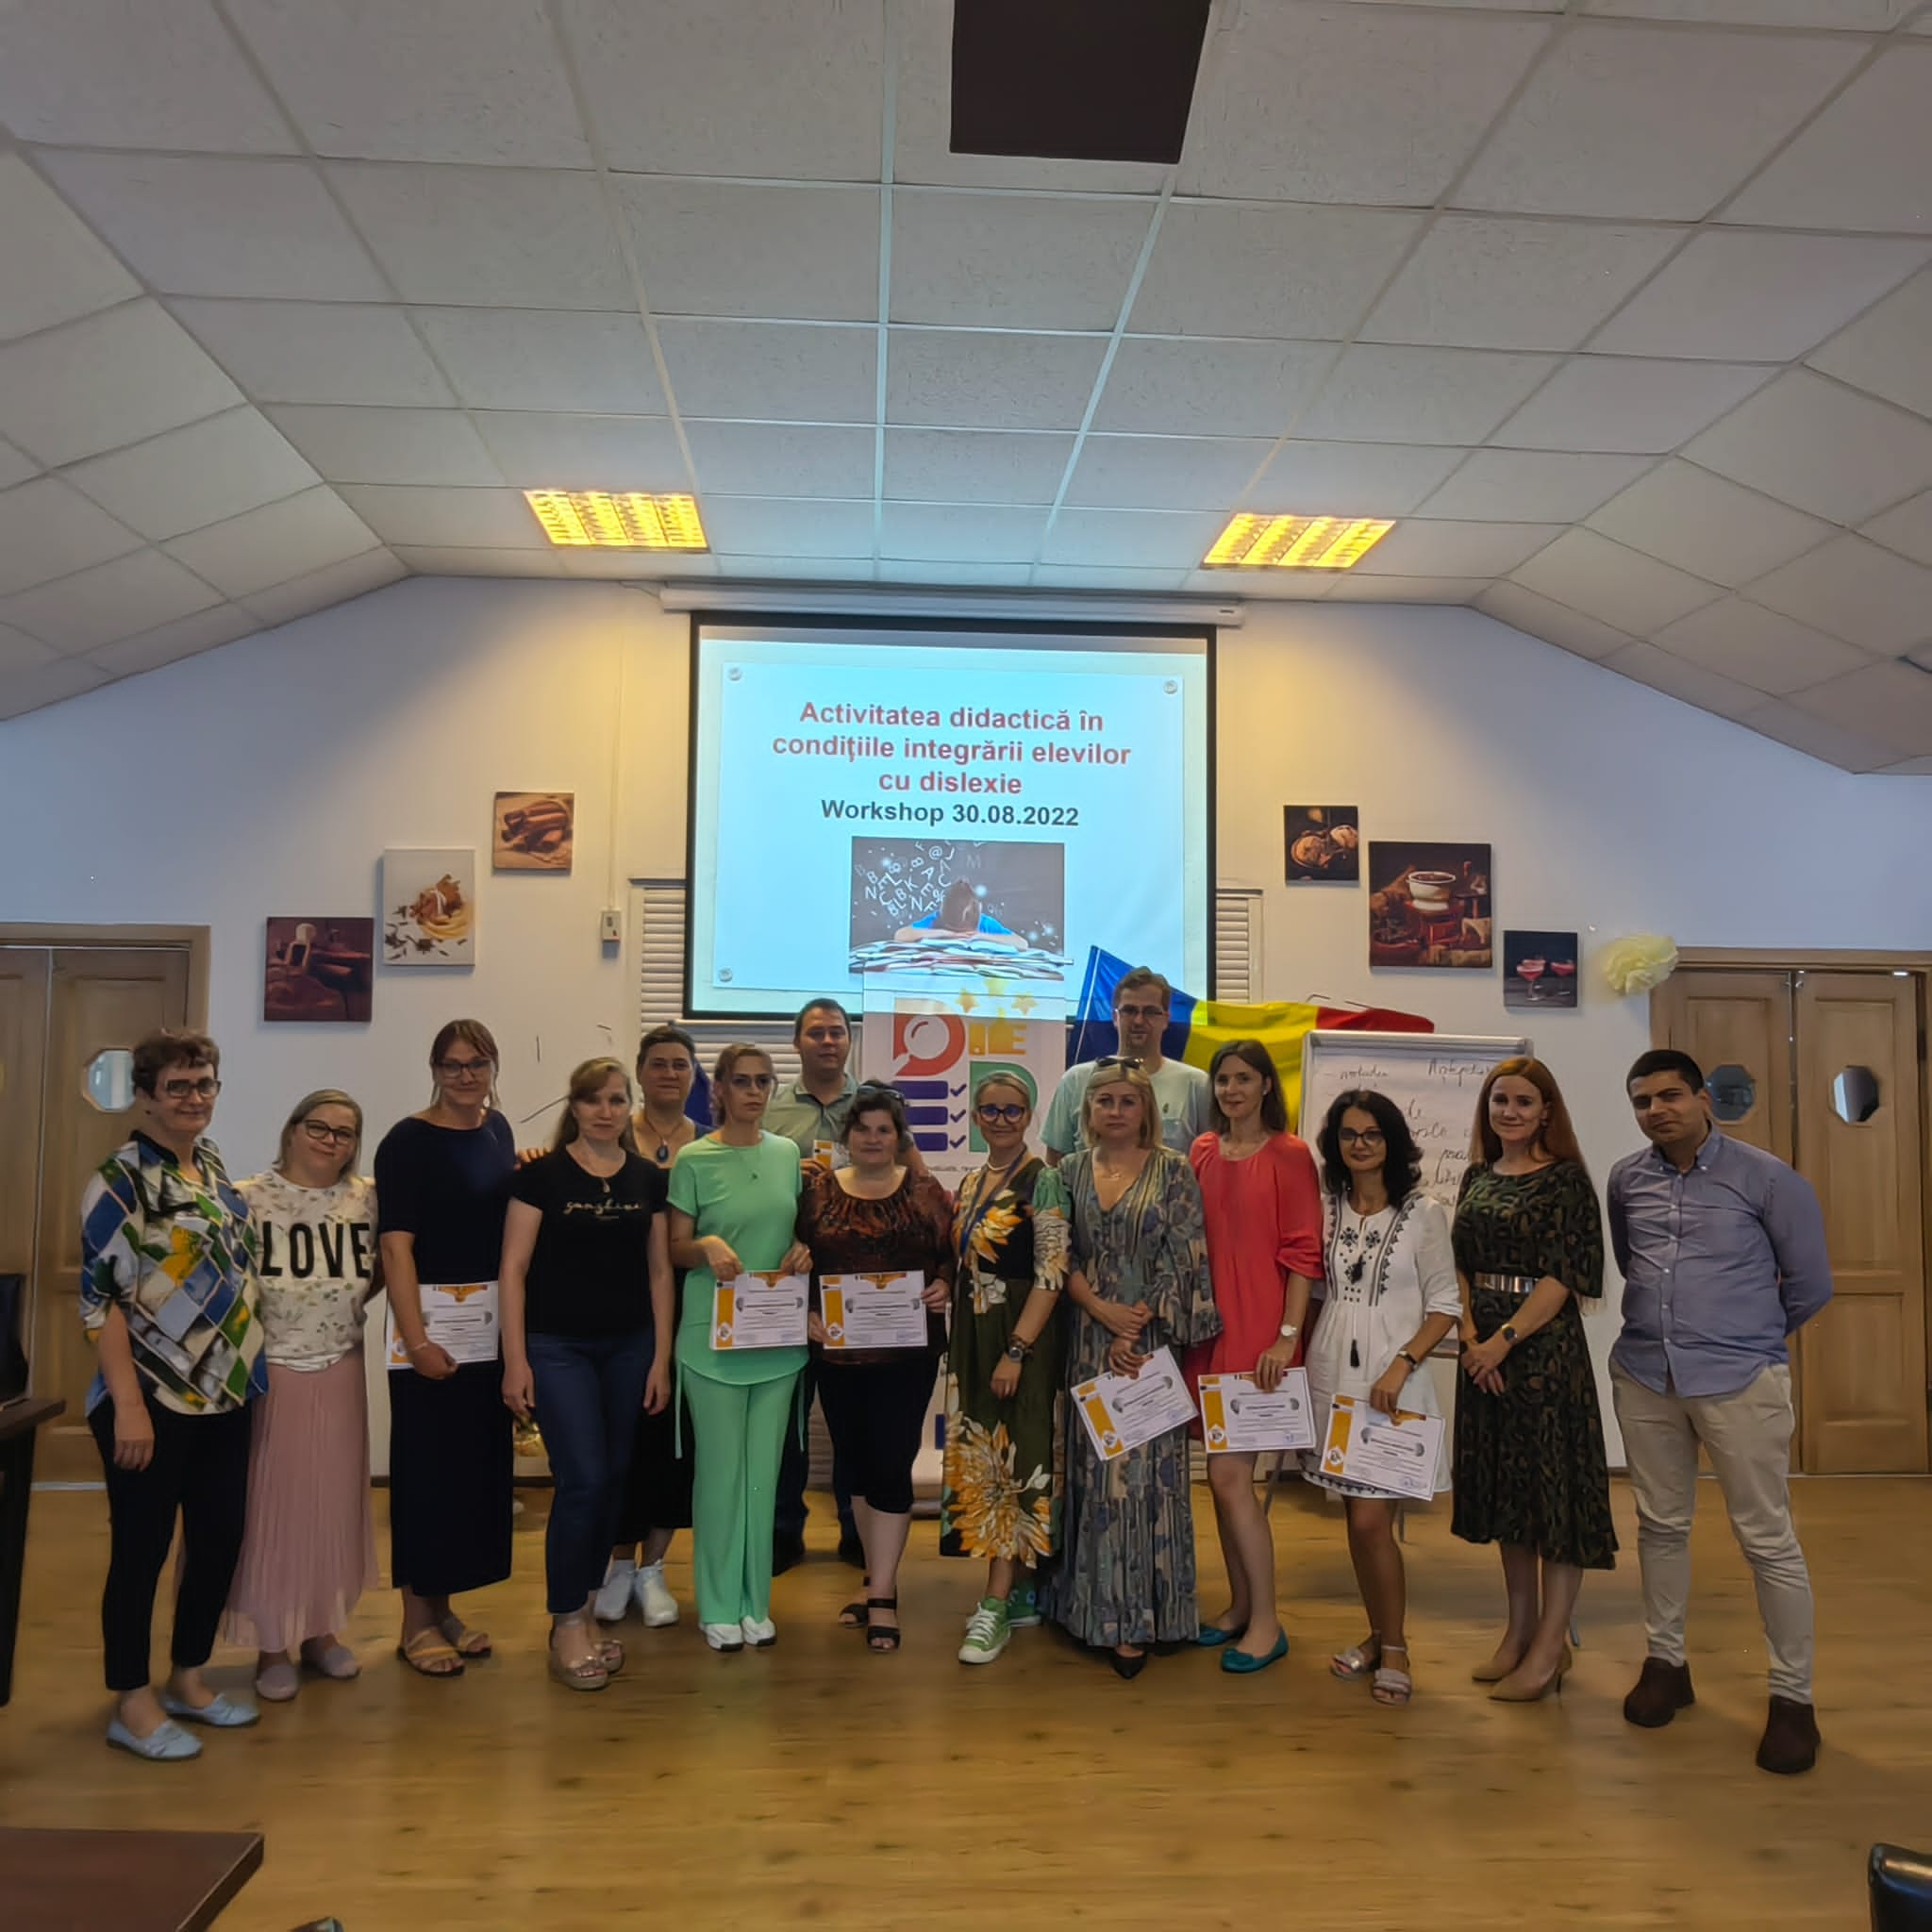
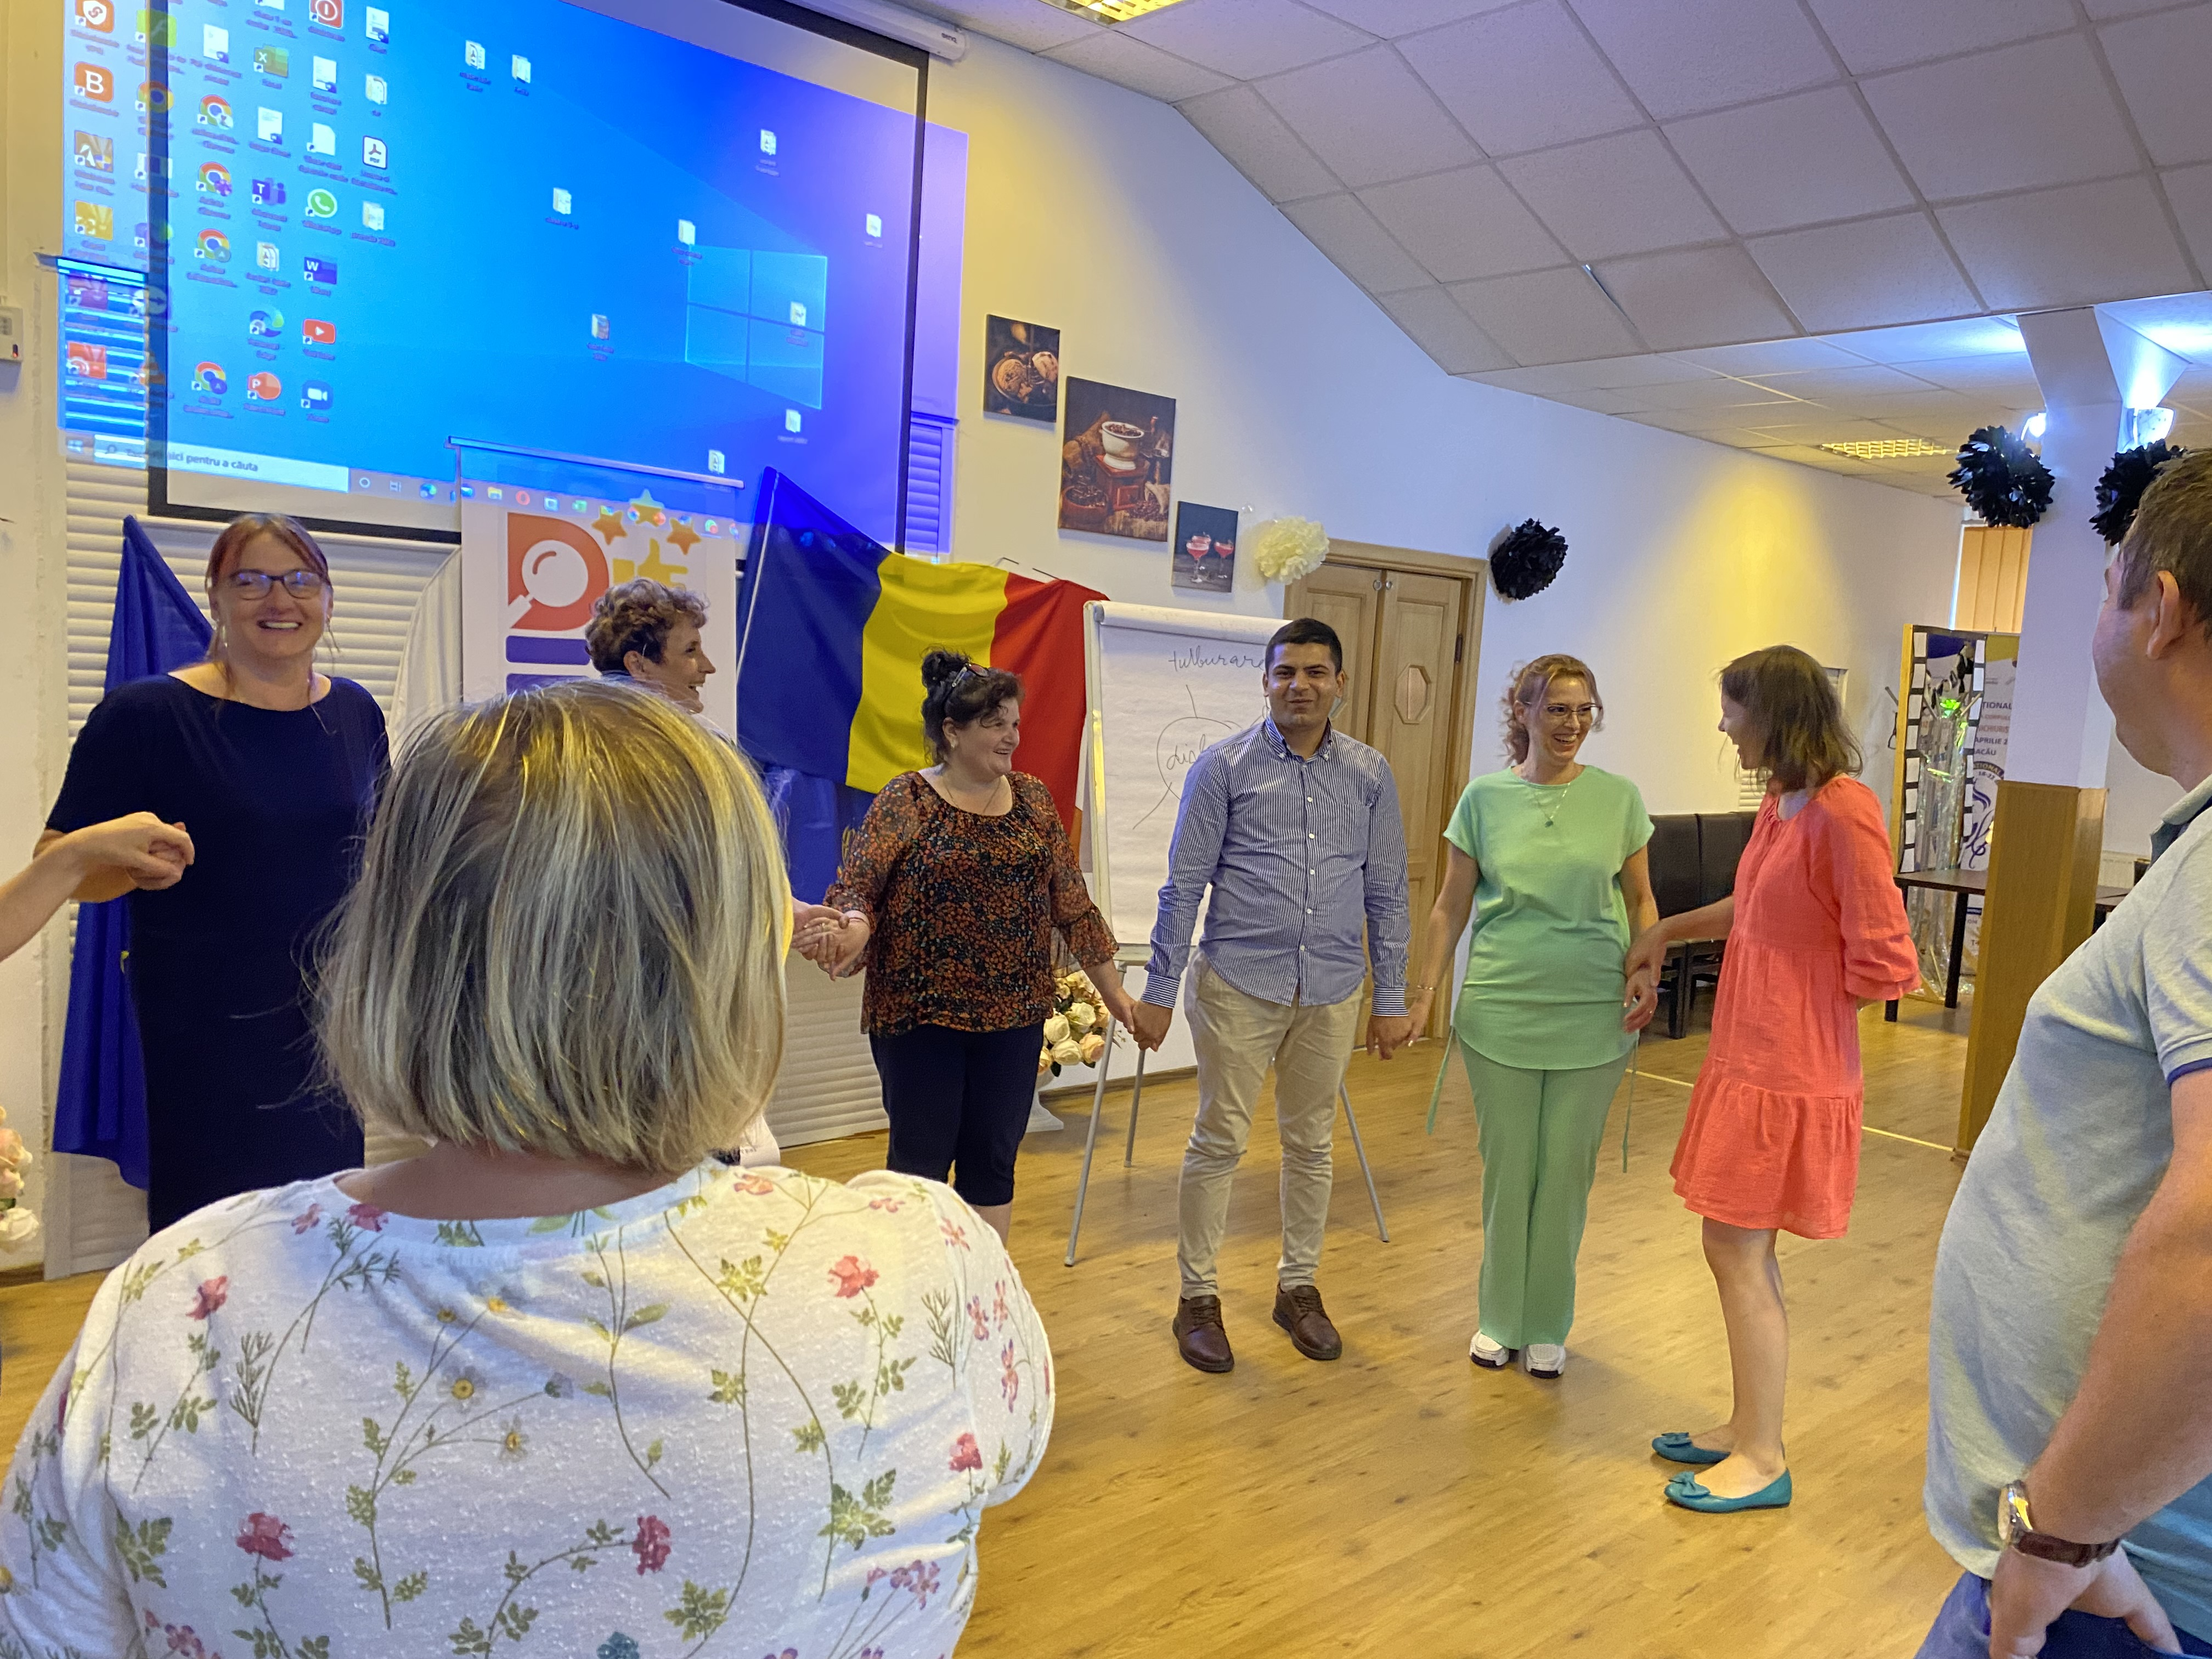
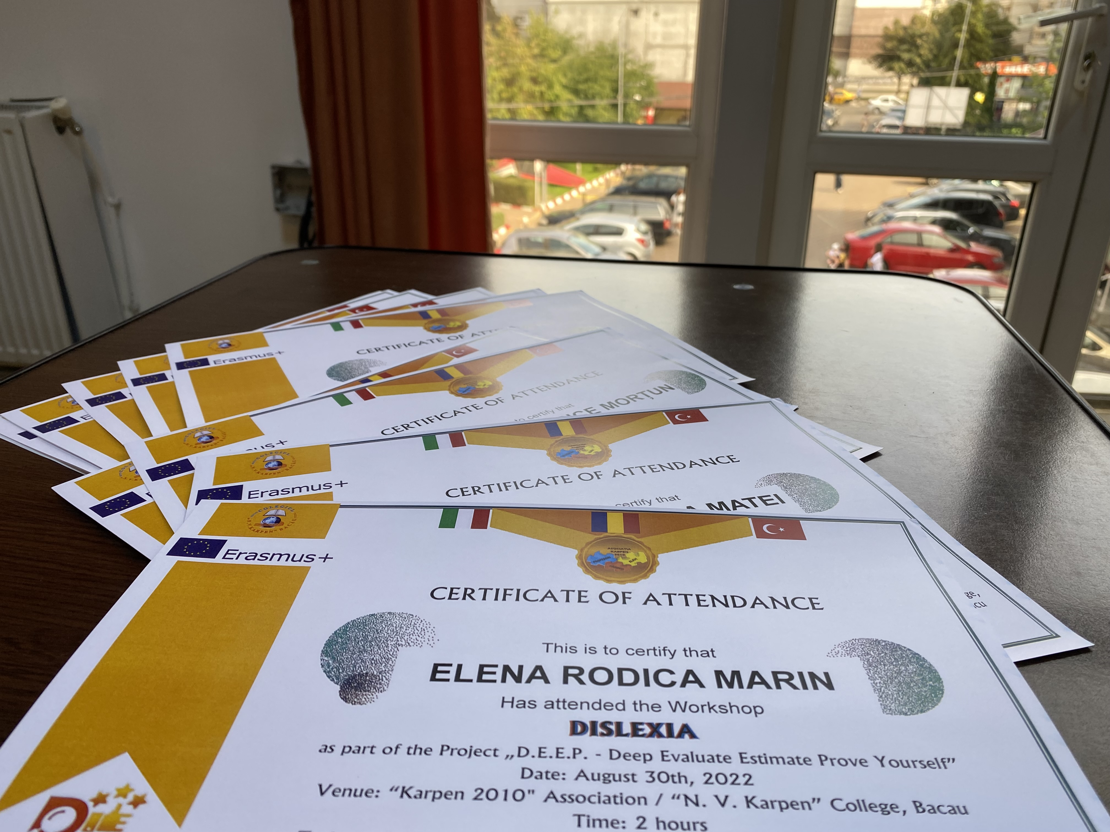
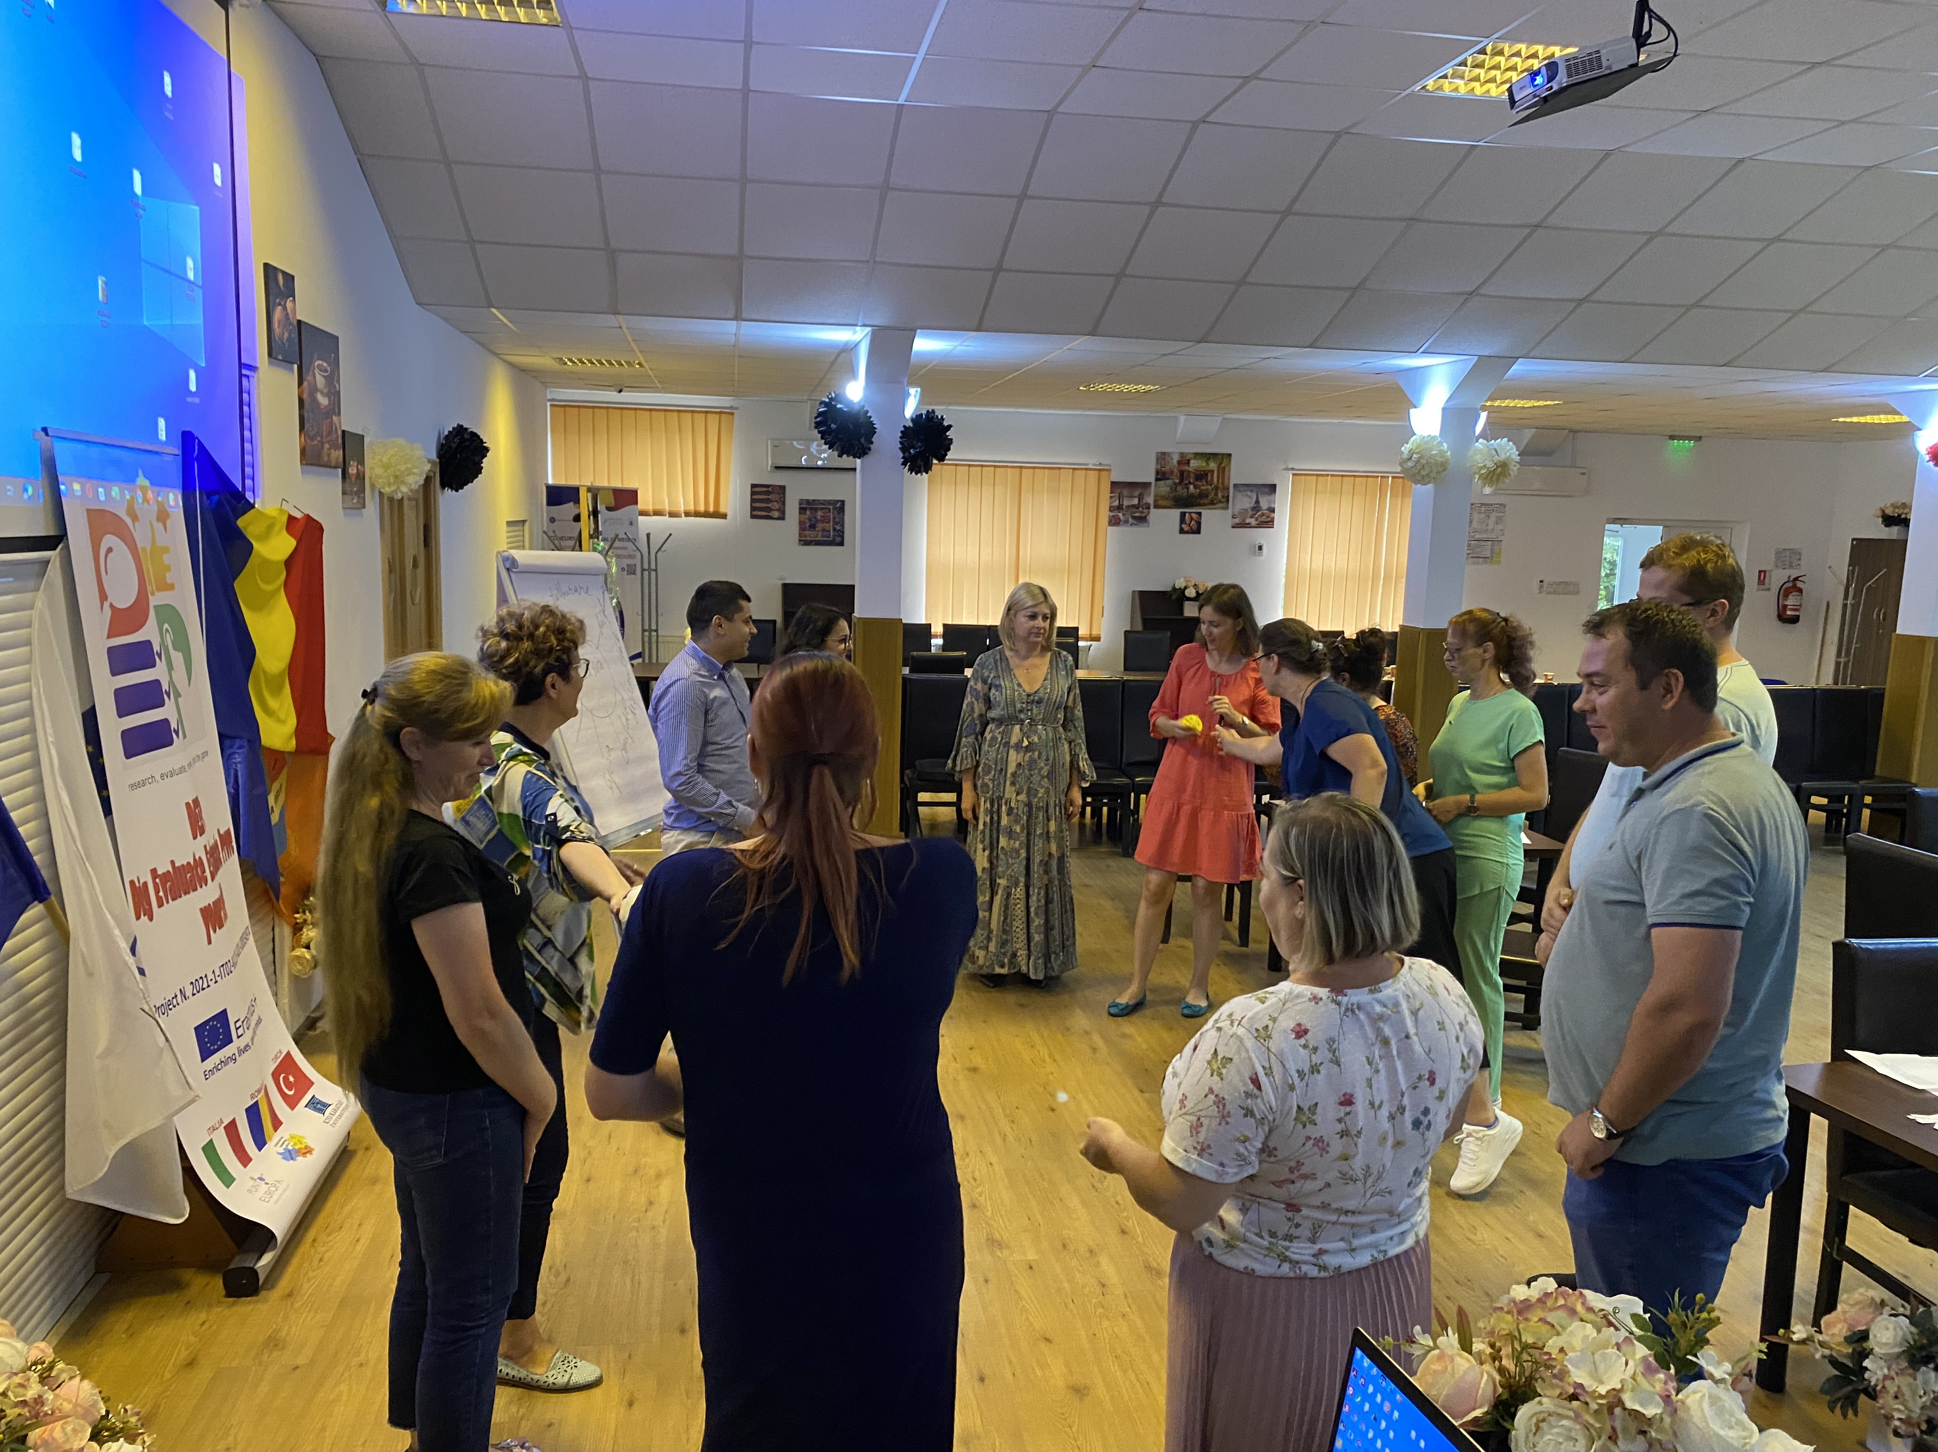
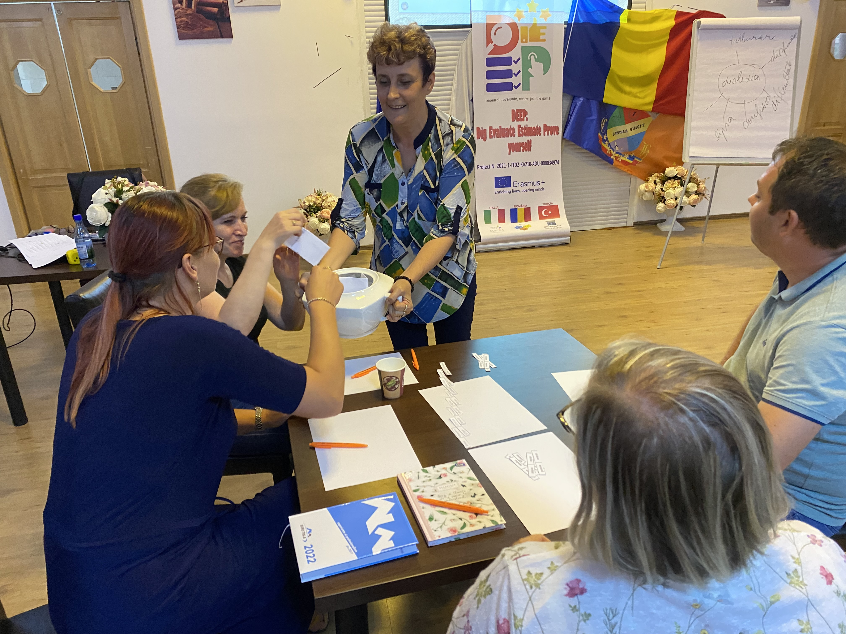
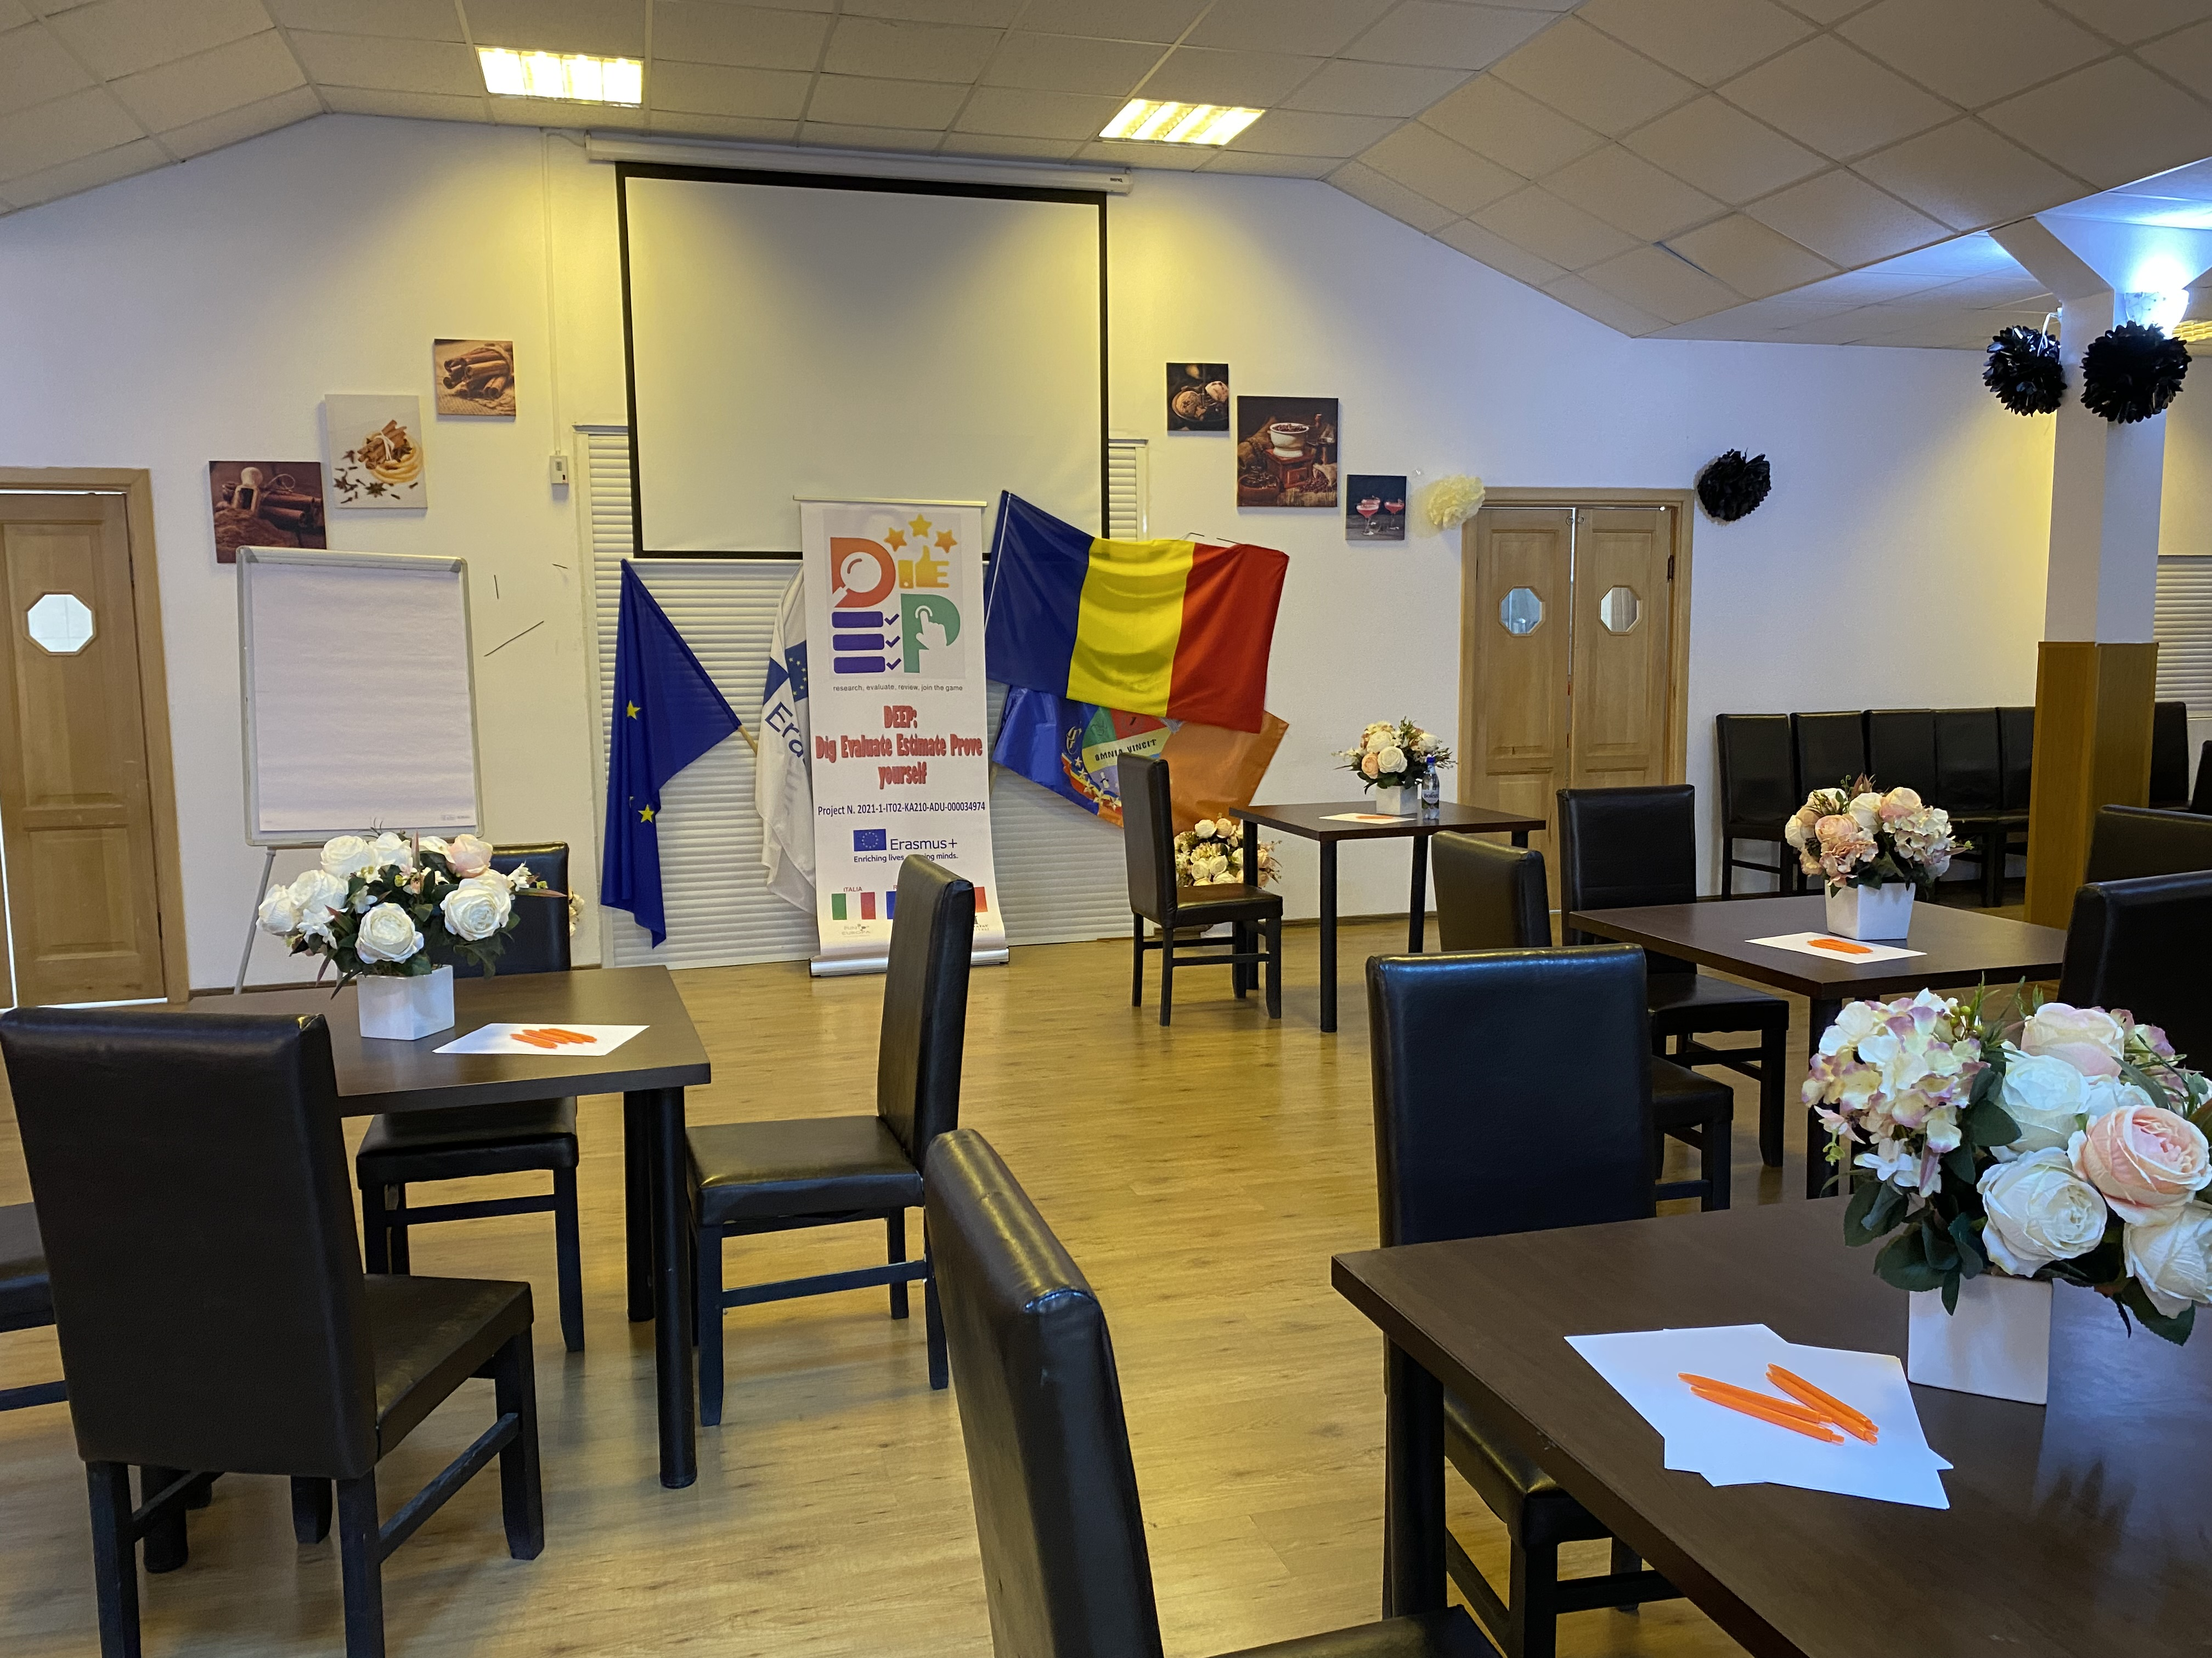

Slide 12
INTERMEDIATE MEETING
BACĂU, ROMANIA, 9 – 15 OF SEPTEMBER 2022

Slide 13
INTERMEDIATE MEETING
The intermediate meeting that took place in Bacau, Romania, during the period 9th of September to 15th of September was hosted by Association Karpen 2010 and involved participants from Italy, Romania and Turkey.
From each partner country were involved 5 persons in the working activities. The participant was divided in homogenous working groups.
All the groups had different tasks that they need to finish until the end of the working session. After finishing each task the working groups needed to present to the other groups their results and the other groups can improve the results obtained and finish together the e-book.
After finishing the e-book, all the participants of the project test the quality of the results created thought evaluation forms and final questioners.

Slide 14
RESULTS OBTAINED FROM THE PROCESS
Initial questionnaire
A final questionnaire
a first questionnaire regards the knowledge about main topics of the course, especially on the methodologies that will be analyzed during the training course.
This was not a static situation because any educator can be more skilled in one methodology than in another and so the tutorship can be extended to other course members for a shared and common knowledge
at the end of the activities it will regard the impressions of the participants in order to compare their initial expectations and knowledge with their final ones, suggesting possible ways to improve the experience and to collect useful data.

Slide 15
