Slide 1
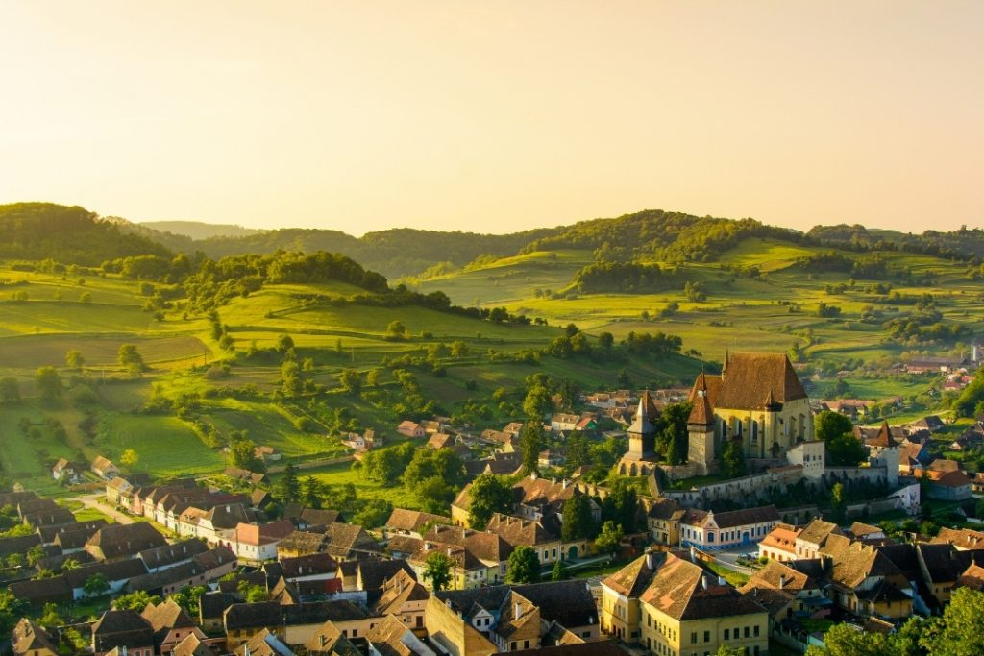
Traditional Transylvanian recipes
Roman Matei
Toia Andrei
Profir Andrei

Slide 2
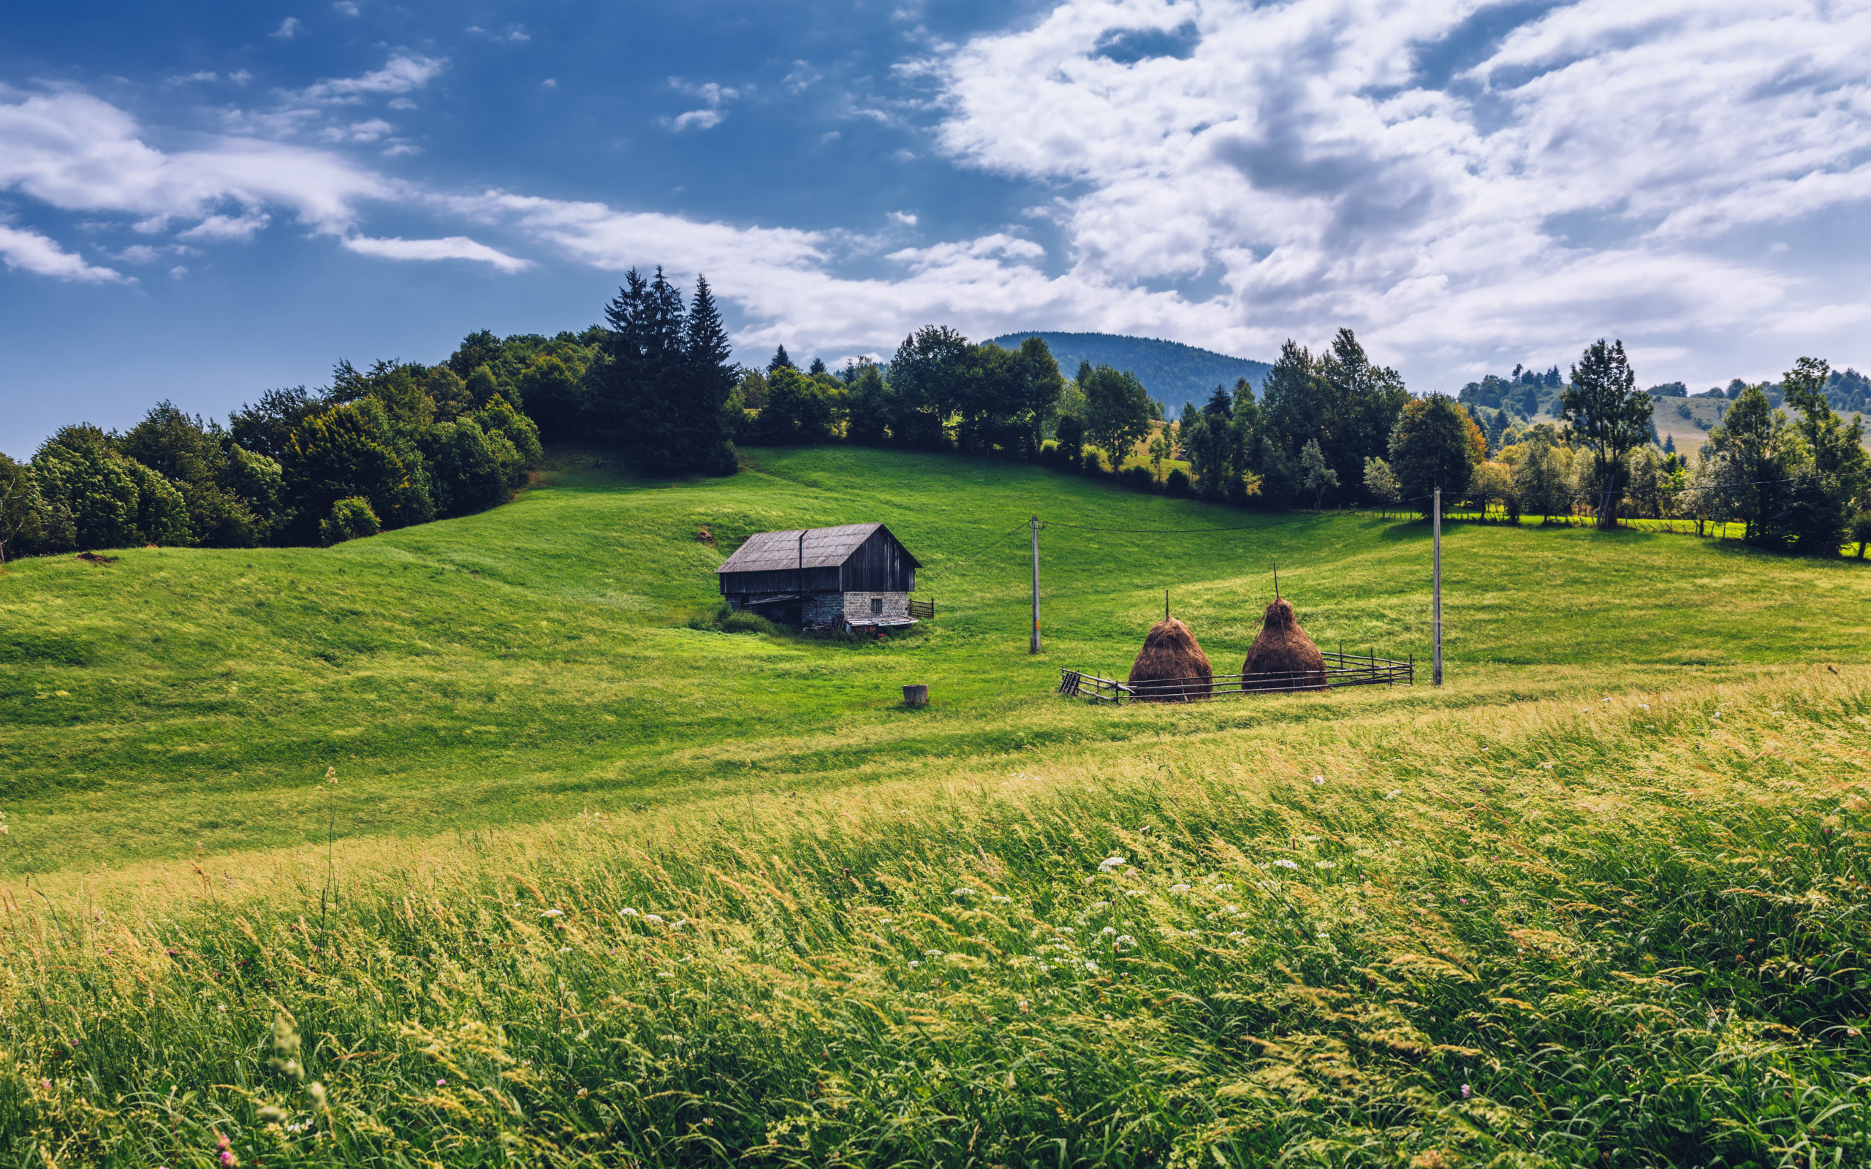
Recipes:
Transylvanian goulash
Cabbage from Cluj
Plum dumplings
Tarragon soup
Chisatura
Transylvanian sarmale

Slide 3
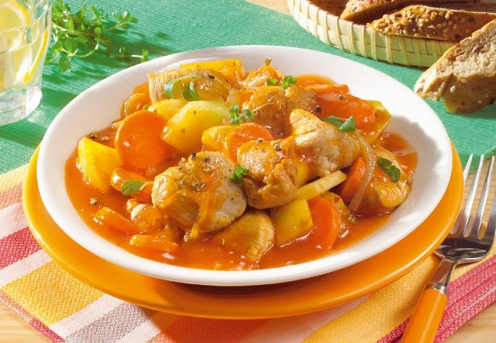
Transylvanian goulash
Beef - 1kg
Garlic - 2-3 puppies
Onions - 2 pieces
Carrots - 1 piece
Baked or canned tomatoes - 500 grams
Bay leaves - 2 pieces
Cumin - 1 teaspoon
Sweet paprika - 1 teaspoon
Potatoes - 250 grams
Red wine - 250 ml
Oil - 20ml
Salt and pepper

Slide 4
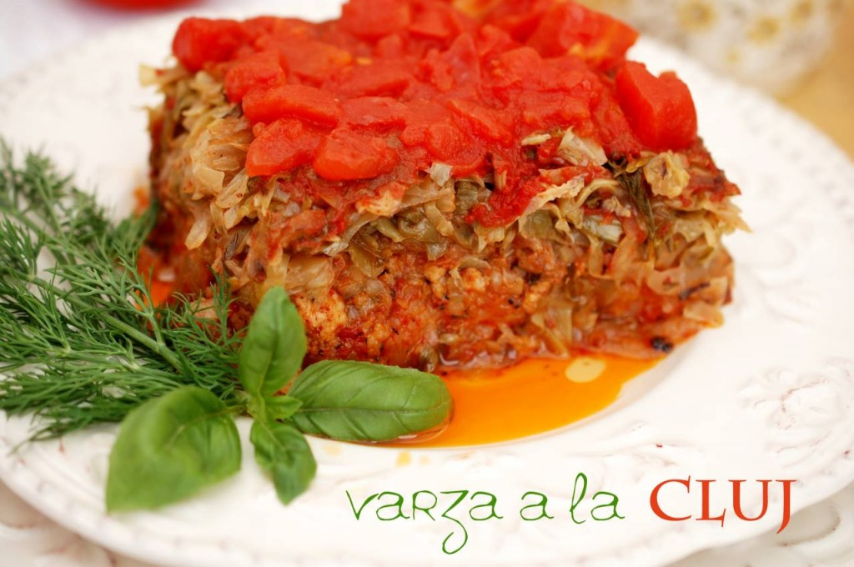
Cabbage from Cluj
Cabbage - 1 kg
Minced pork - 500 grams
Rice - 75 grams
Paprika - 1 teaspoon
Onion - 1 piece
Lard - 1 tablespoon + 1 teaspoon
Broth - 2 tablespoons
Thyme - to taste
Dill - 1 small bunch
Salt and pepper

Slide 5
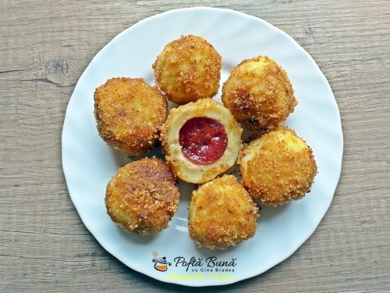
Plum dumplings
Potatoes - 500 g (boiled)
Flour - 150 grams
Egg - 1 piece Oil - half a tablespoon
Plums - 500 grams
Sugar - 2-3 tablespoons
Cinnamon - 1 teaspoon
Salt
For breadcrumbs:
Oil - 10 ml
Breadcrumbs - 150 grams
Sugar - 5 tablespoons

Slide 6
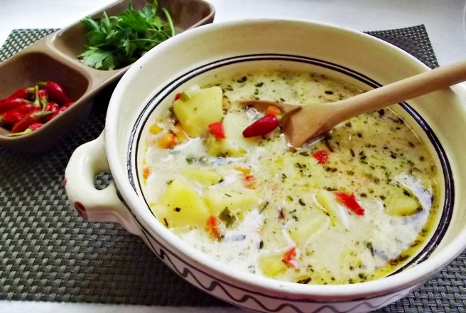
Tarragon soup
Pork - 500 g
Carrots - 3 pieces
Onions - 2 pieces
Celery - 1 small piece
Cream - 300 g Yolks
3 Fresh or pickled tarragon in vinegar
Oil - 15ml
Vinegar
Salt and pepper

Slide 7
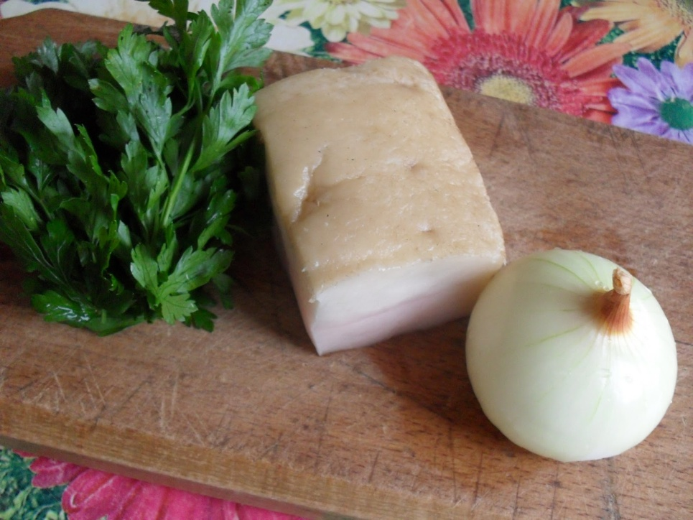
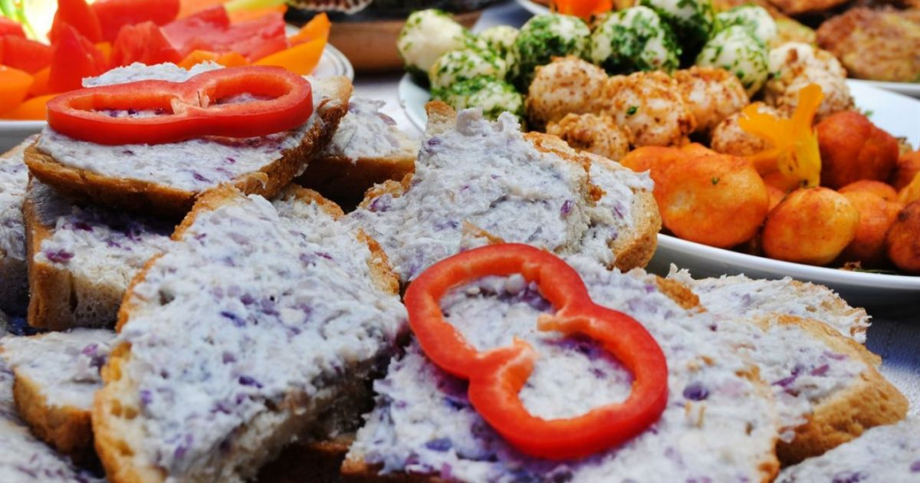
Chisatura
Smoked bacon - 150-200 grams
Onions - 1 piece
Green parsley - 1 bunch
Salt

Slide 8
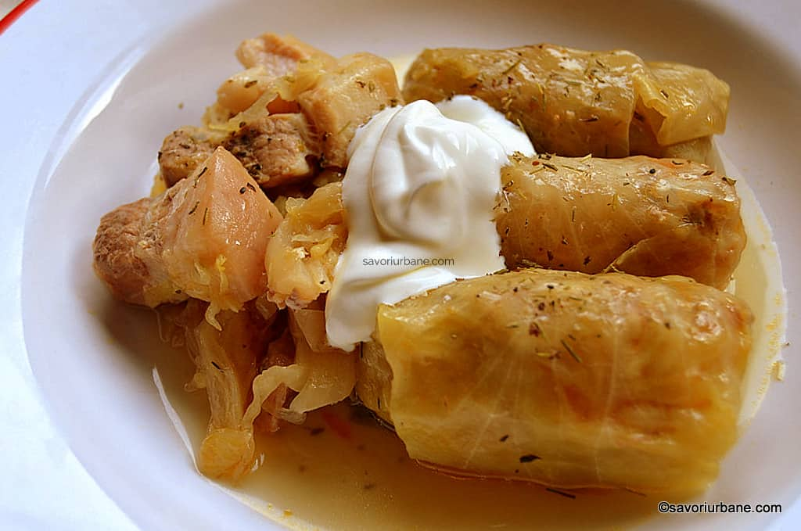
Transylvanian sarmale
100 g of rice
1 tablespoon rice oil
1 and ½ chopped onion for cooking with rice
1 kg was cabbage
500 g pork breast or pork ribs, raw or smoked
½ chopped onion - to be placed on the bottom of the pot
2 tablespoons oil - to sit on the bottom of the pot
5-6 chopped cabbage leaves for the bottom of the pot and place on top of the stuffing
300 ml cabbage juice for sour
sprigs of dried thyme
optional: a cup of broth or tomato juice

Slide 9
Thank you for watching, we hope we made you hungry

