Slide 1
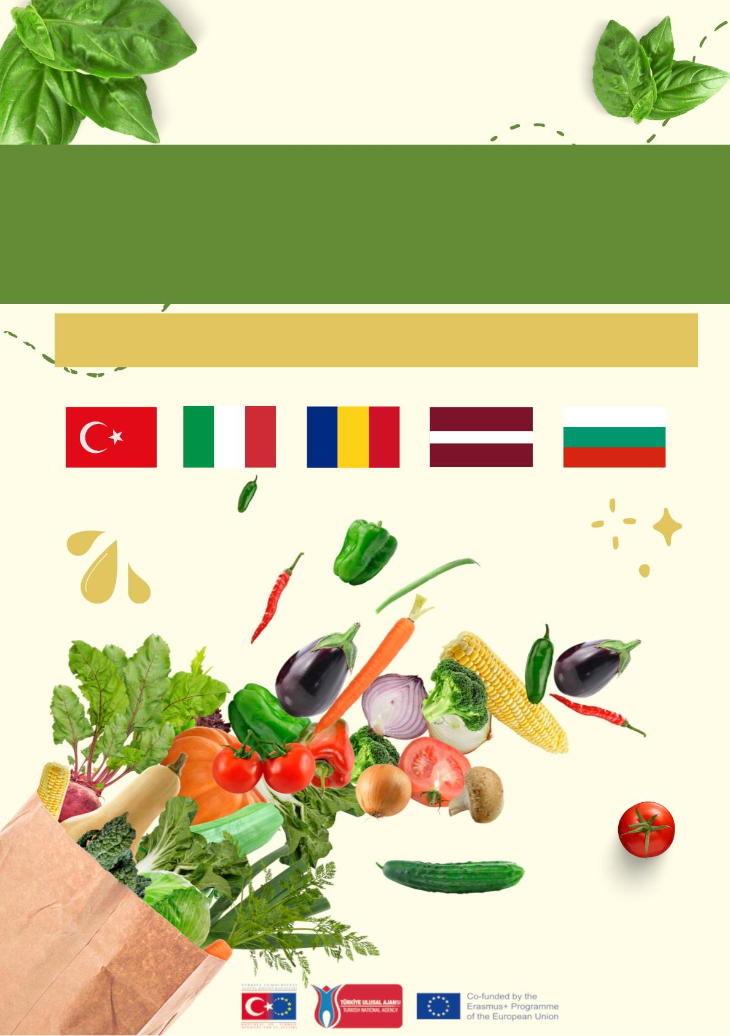
TRADITIONAL AND MODERN
RECIPES BOOK
PROJECT NAME:"CIBO IN CIRCOLO:UN NUOVO PARADIGMA"
PROJECT NUMBER:202-1-IT02-KA229-079059

Slide 2
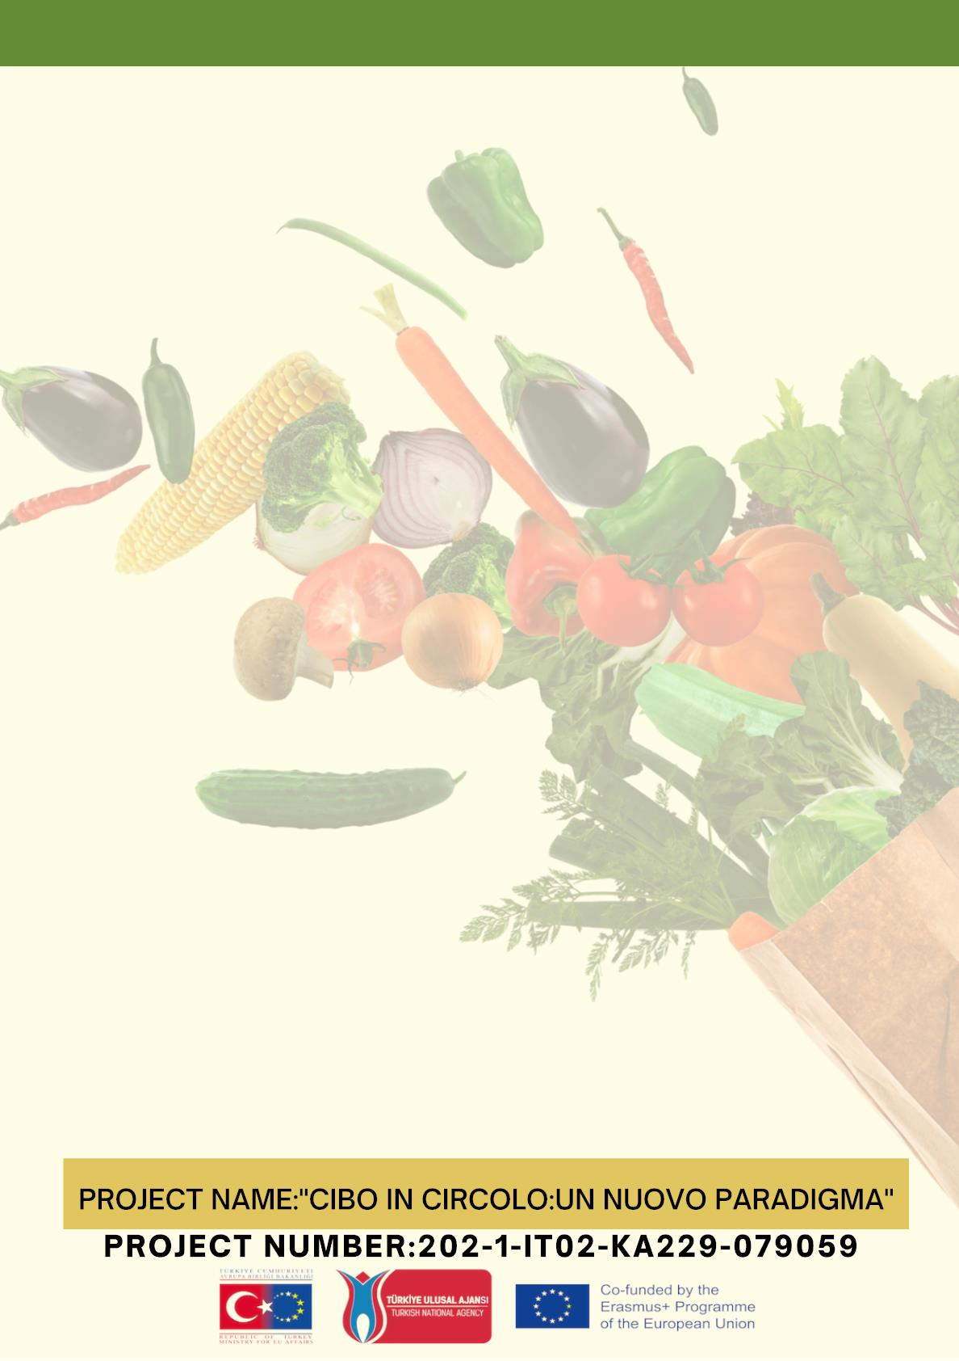

Slide 3
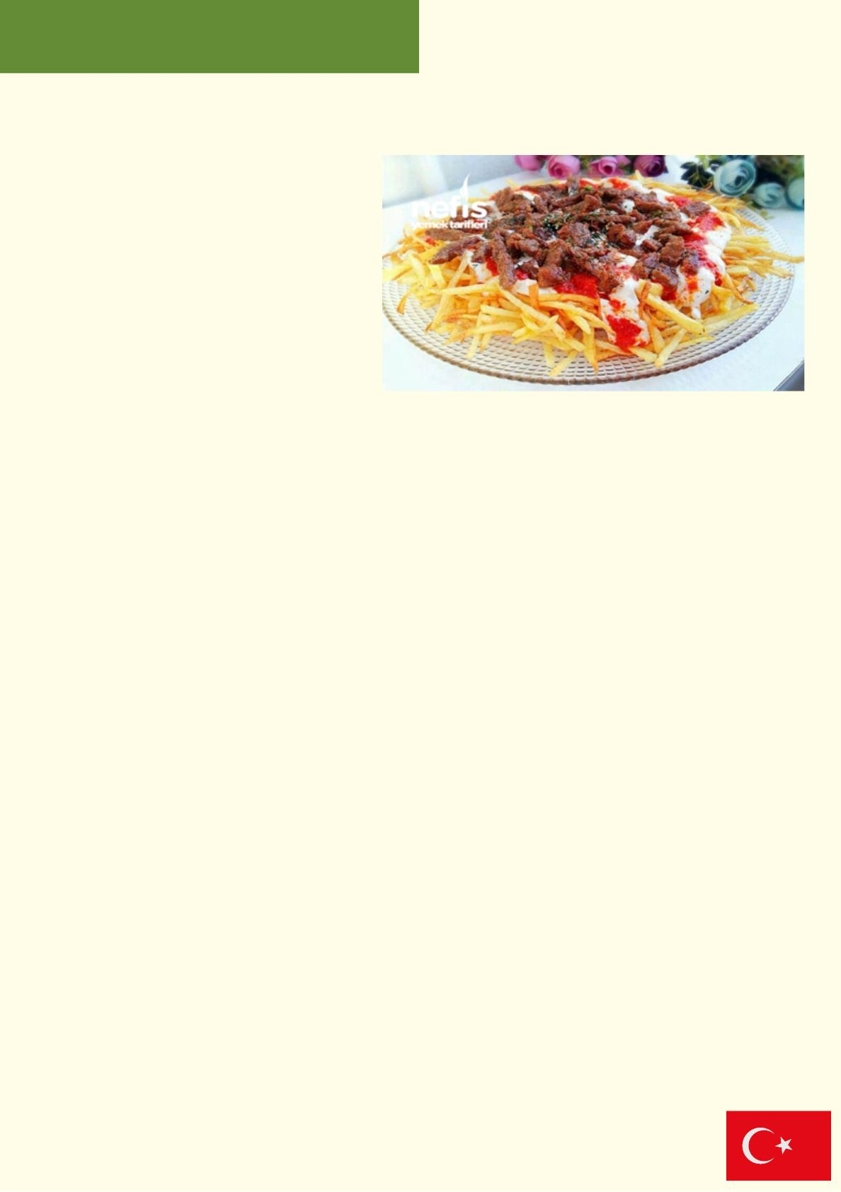
Çökertme Kebabı
Materials
• 250-300 gr julienne cut meat
• 2 tablespoons of oil
• 2 cloves of garlic
• 1 teaspoon of salt
Other Materials;
• 4 full tablespoons of yogurt
• 2 cloves of garlic
• 1 pinch of salt (for yogurt)
• 4 medium potatoes
• 1 teaspoon of salt (for potatoes)
• Oil (for frying)
• 1 spoon of tomato pepper sauce or tomato paste
• 1 spoon of oil
Recꢀpe :
1. To marinate the meat, put it in a bowl and mix it with olive oil, salt, pepper and
vinegar and leave it for at least half an hour.
2. To prepare the tomato sauce, take ½ tea glass of olive oil in a pan and heat it. Add
tomato paste and fry. Add the grated tomatoes and cook until the water is absorbed.
Add salt and sugar and mix. Close the bottom.
3. Quickly cook the meat in a well-heated pan. Allow them to cook without letting them
release their juices, stirring occasionally. Season with salt and pepper.
4. Peel the skin of the potatoes, cut them into matchstick fines, put them in a bowl of
cold water and leave them. Strain through a strainer, wash and dry on a clean kitchen
towel. Fry in heated oil until crispy. Fried potatoes paper towel
take it on it, drain the excess oil and transfer it to the serving plate before it cools
down. Pour the garlic yogurt on top, then pour the tomato sauce. Put the cooked meat
on them and serve.
Modern Turkish Cuisine

Slide 4
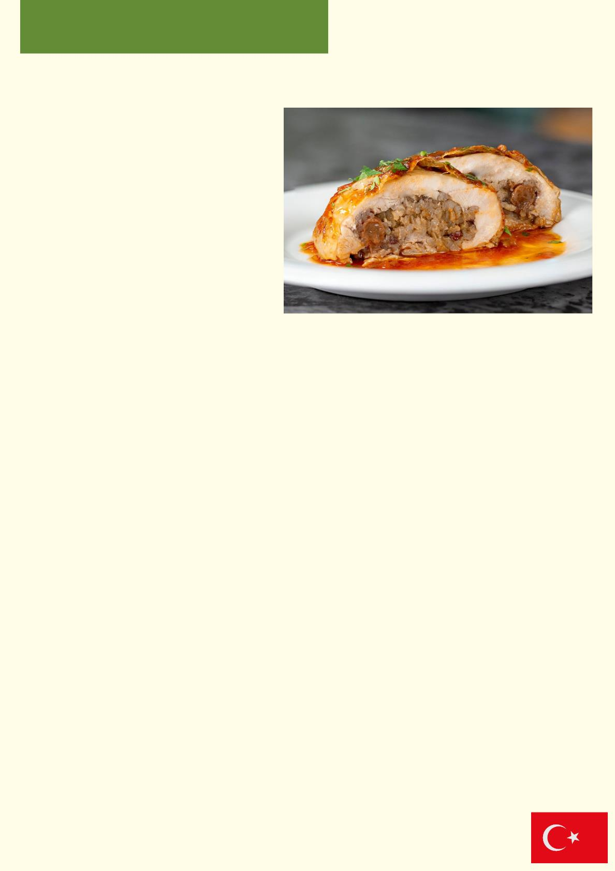
Pꢀlꢀç Topkapı
Materials:
• 7 boneless chicken thighs
• Juice of half a lemon
• 5 tablespoons of olive oil
•Salt
For the stuffed rice;
• Rice (1 tablespoon for each leg)
• 2 tablespoons of lamb liver
• 1 tablespoon of currants
• 1 onion
• 1 tablespoon of pine nuts
• Salt
• Allspice
• 3 tablespoons of oil
• 1 tablespoon of butter
• Hot water (not to exceed)
• To rub on thighs; (although not optional)
• 1 teaspoon of yogurt
• 1 teaspoon tomato paste
Recipe :
1. Boneless thighs are thinned a little and put in a sauce prepared from lemon juice, salt,
olive oil and left overnight (if there is not that much time, at least 6-7 hours).
2. Rice is soaked, its starch is removed.
3. For the stuffed rice; oil and butter are poured into the pan, the pine nuts are slightly
pinked.
4. Finely chopped onion and very finely chopped lamb liver are added and roasted.
5. The rice is filtered and then currants, allspice and salt are added, hot water is added
so that it does not rise to the top and left to cook (it will not be cooked too much, so it will
not be porridge in the oven).
6. The rested pilaf is cooled, the thighs are spread on a flat surface, some of the
prepared pilaf is placed in it and wrapped (not long, but rounded), fastened with a
toothpick and placed on the tray.
7. The same procedure is applied to the other thighs. The remainder of the sauce, in
which we kept the thighs, is poured over it.
8. Mix tomato paste and yoghurt, spread on thighs.
9. Bake in the oven heated to 200 degrees until golden brown. From time to time, the
water in the tray is spooned over the chickens with a spoon.
Modern Turkish Cuisine

Slide 5
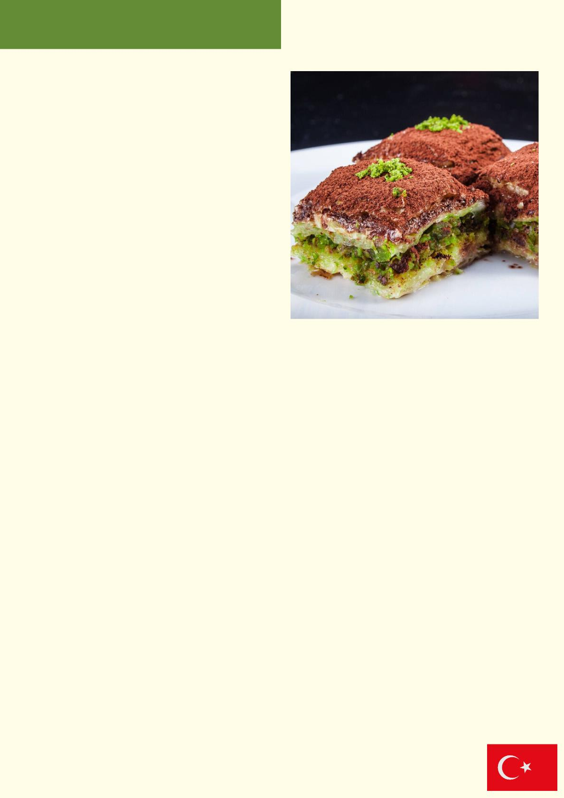
Soğuk Baklava
Materials:
For the Baklava:
• 1 pack of phyllo dough
• 200 grams of butter (14 tablespoons)
• 1 teacup of oil
For between:
• 1 cup of pistachios
For sherbet:
• 2.5 cups of granulated sugar
• 1 glass of water
• 1 glass of water Milk
For the above:
• 1 tablespoon of cocoa
• 1 tablespoon of powdered sugar
• 80 grams of chocolate (grated)
Recipe :
The Tip of the Cold Baklava Recipe with Milk
The syrup we prepared has completely dried up. It was a moist, soft, and crispy top baklava.
But if you want it to be softer and have more syrup, you can add a glass of extra milk. According
to him, increase the sugar by a glass tomorrow.
How to Make Cold Baklava with Milk Recipe?
First, start by making our syrup. Put the water, milk and sugar in a saucepan and stir until the
sugar dissolves. After boiling for 5 minutes, remove from heat and leave to cool.
Melt the butter. To remove the foam formed on it, lay a towel paper in the strainer and pour the
butter. After it has been filtered well, add oil to the butter that is free from foam.
Lay your phyllo on the counter and cut them in pyrex size. Divide the dough in two. I used 20
sheets for the lower base and 22 sheets for the upper base. Wrap the dough you have reserved
for the top in a clean cloth so that it does not dry out. Since they are very thin, they dry quickly.
Lubricate my bore. Place a sheet of phyllo in my debt and oil it.
Stack them on top of each other, lubricating each layer of dough.
Spread the top sheet of dough and spread the peanuts without oiling it and drizzle some oil.
Stack the remaining phyllo sheets on top of each other in the same way, lubricating each layer.
Cut the desired size square by square and apply the remaining oil on it.
Bake in a preheated oven at 170 degrees, upside down, for about 45 minutes, until nicely
browned. Make sure the gold is well cooked.
Let your baklava rest for 10 minutes after cooking. Pour the cold sherbet into your baklava, which
first comes out hot, with the help of a ladle. Let it rest for 2-3 hours.
Mix cocoa and powdered sugar over the dessert and sift it all over. Sprinkle the grated chocolate
on top.
Finally, you can garnish with pistachios and serve.
Modern Turkish Cuisine

Slide 6
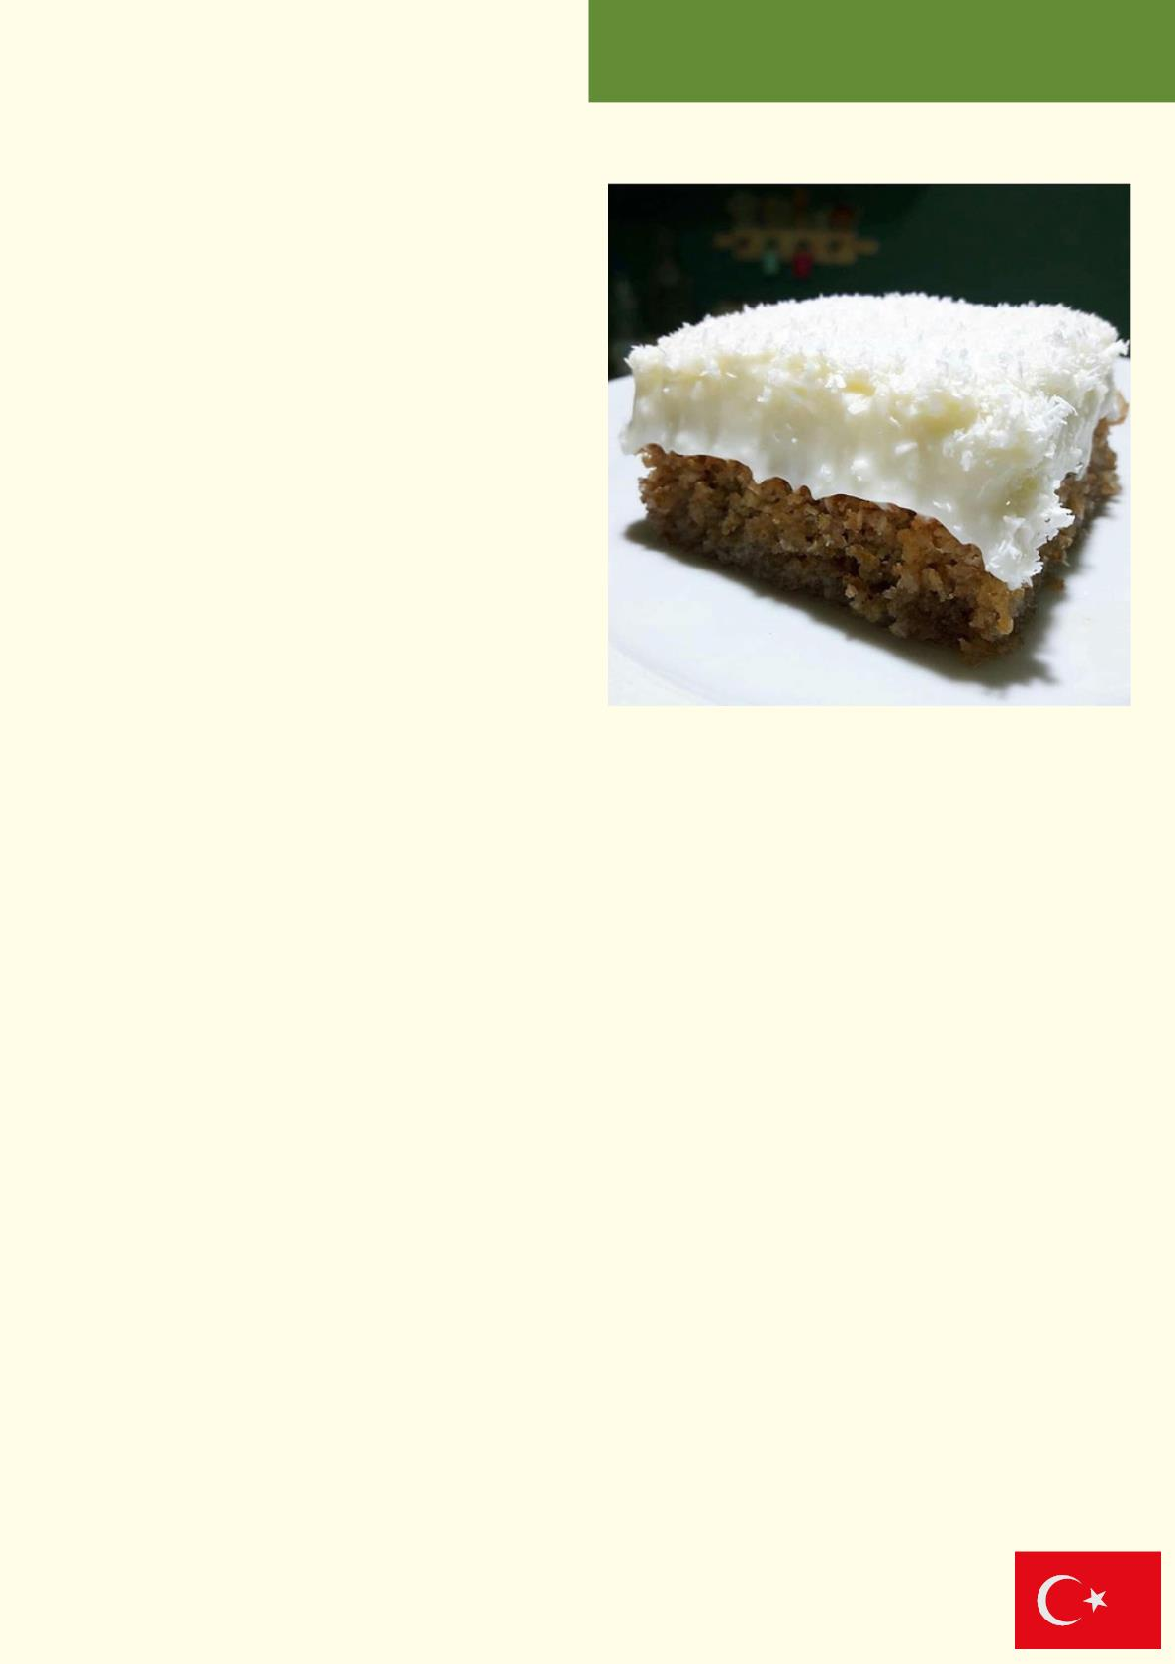
Materials
Kıbrıs Tatlısı
•For the Cake:
•3 eggs
• 1/2 cup of granulated sugar
• 1/2 cup of oil
• 1 glass of coconut
• 1 cup of breadcrumbs
• 1 glass of walnut kernels (finely ground)
•1 packet of baking powder
For the cream:
•1 liter milk
• 1 glass of cornstarch
• 1 tea glass of granulated sugar
• 1 packetvanillin
• 1 pack of whipped cream
For the syrup:
• 1.5 cups of water
• 1 cup of granulated sugar
• 2 drops of freshly squeezed lemon juice
For the above:
• 1 glass of coconut
Recipe :
For the syrup of the dessert; Take water and granulated sugar into a deep mixing bowl. Boil the
syrup mixture, which you are constantly stirring, over low heat for 15 minutes until the sugar
grains dissolve.
Add lemon juice to the sherbet, which thickens and becomes syrupy, and cuts it off, then remove
it from the stove. Let it rest in a separate place to cool.
To prepare the dessert cake; Break the eggs you have kept at room temperature into a deep
mixing bowl. Stir until the sugar grains are completely dissolved with the addition of granulated
sugar.
Respectively; Add oil, grated coconut, breadcrumbs, finely ground walnut kernels and baking
powder and continue mixing.
Grease the baking mold with oil. After spreading the cake mix you have prepared evenly, bake it
in a preheated 160 degree oven for 30 minutes.
Pour the cold sherbet you prepared on it and wait for it to absorb.
For the cream; Take milk, starch and granulated sugar in a deep saucepan and cook over
medium heat, stirring constantly. Before removing the cream that has the consistency of pudding
from the stove, add vanillin and mix it and remove it from the stove.
After removing it from the stove, mix it by whisking with the addition of powdered whipped cream.
Spread the cream mixture over the dessert that draws the syrup.
Sprinkle the coconut over the entire surface.
After cooling in the refrigerator, decorate and enjoy with your loved ones.
Modern Turkish Cuisine

Slide 7
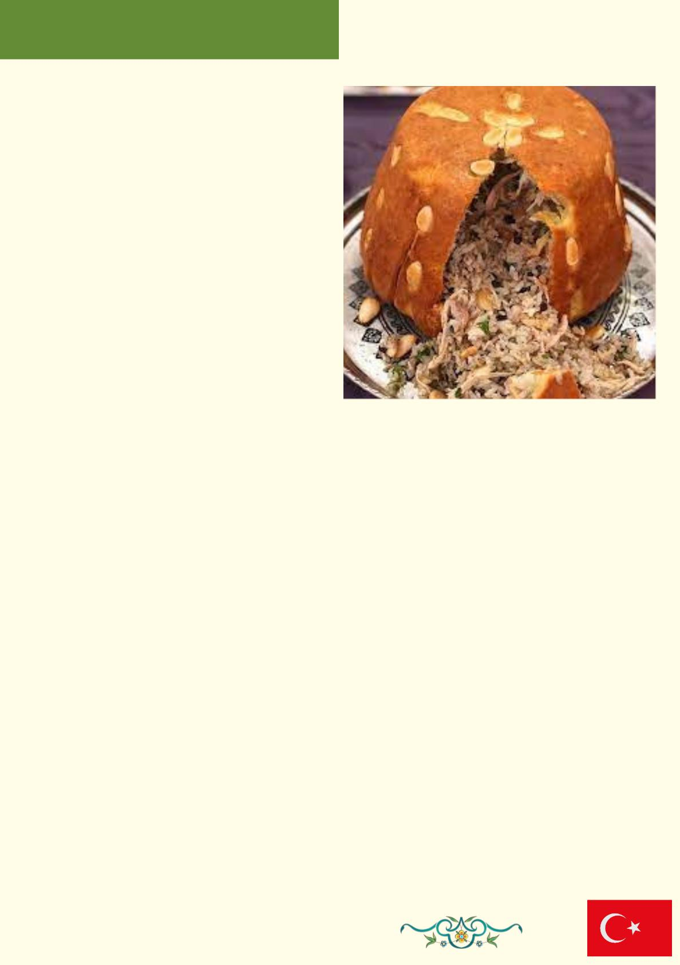
Perde Pꢀlavı
Materials
For the inner pilaf of Perde rice:
• 3 cups of rice
• 2 spoonful butter
• 4.5 cups of water and chicken broth mix
• 2 chicken legs
• Half a coffee cup of currants
• 200 g raw almonds
• 1 coffee cup of pine nuts
• Black pepper, salt
For the Curtain Rice Dough:
• 2 eggs
• 4 tablespoons of yogurt
• Half a glass of olive oil
• Salt
• As much flour as it takes
Recipe :
1. I first started making Perde rice by boiling the chicken thighs. After boiling the
chickens, I started making chicken broth and rice.
2. Melt the margarine in a rice cooker and fry the rice in oil for 3-4 minutes after
washing and draining the water thoroughly.
3. Add 2 bowls of the broth from the boiled chickens to the rice.
4. Add half a tablespoon of salt and close the lid.
5. Remove the rice from the heat before it is fully cooked, while it is still alive.
6. Mix the chopped chicken, currants and black pepper with the rice.
7. Making the dough: knead your dough by mixing all the ingredients.
8. Divide the dough into two parts, one small and one large.
9. Open the large one with a thickness of 3 mm and place it on the bottom of the bowl,
covering the edges.
10. Pour the rice into it.
11. Open the small piece of dough in the same way and place it on the rice.
12. Bake the curtain pilaf in the oven heated to 200 degrees until golden brown. Turn it
over and serve.
P.C : To enhance the appearance of the curtain pilaf, I lined the bottom of the bowl
with almonds before laying the dough.
Traditional Turkish Cuisine

Slide 8
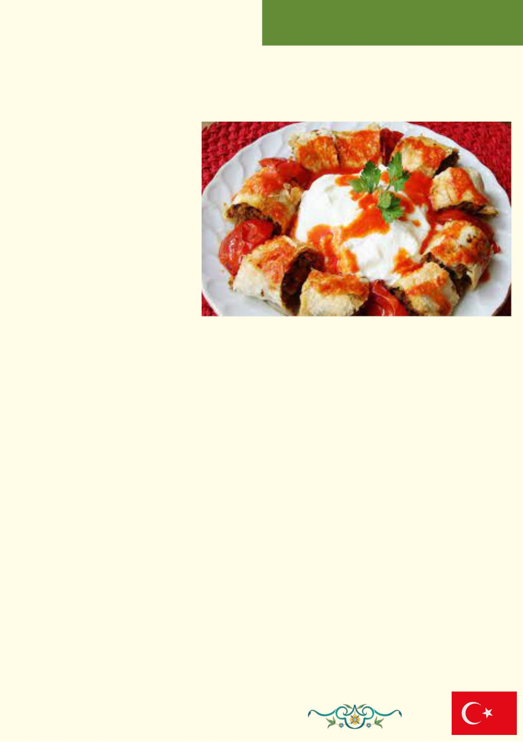
Beytꢀ Kebabı
Materials
For Meatball Mortar;
500 grams lamb mince
1 onion
4 cloves of garlic
1 teaspoon of black pepper
1 teaspoon cumin
1 teaspoon salt
1 teaspoon paprika
1 teaspoon of red chili powder.
1 cup of breadcrumbs
For Lavash;
3 cups flour
1 teaspoon of yeast
1 teaspoon salt
2 tablespoons of yogurt
2 tablespoons of oil
For the above;
1 tablespoon tomato paste
1 tablespoon of ketchup
1/2 teaspoon of water
2 spoonful butter
Recipe :
First, prepare the dough in the consistency of an earlobe by mixing the ingredients for
lavash. Divide the dough you prepared into egg-sized balls.
- Open it with the help of a rolling pin (take care to roll it as thin as possible) and cook it
in the pan. Put the cooked lavash between a cloth so that it does not dry out.
Mix all the meatball ingredients and knead well. Let it rest for 2 hours in the refrigerator.
- Roll the rested mortar with your hands and give it a thin and long shape. Place on a
baking tray lined with greaseproof paper and shape it with your hands. Apply oil on it and
bake in the oven at 200 degrees until golden brown.
- Cut the cooked meatballs into bites by wrapping them between the lavash and arrange
them on the plate.
- Lightly fry 1 tablespoon of ketchup and 1 tablespoon of tomato paste in a pan, pour half
a tea glass of water on it and cook for 1 minute and pour it over the Beyti.
- Lastly, heat 2 tablespoons of butter in a pan and pour it over the Beyti.
Traditional Turkish Cuisine

Slide 9
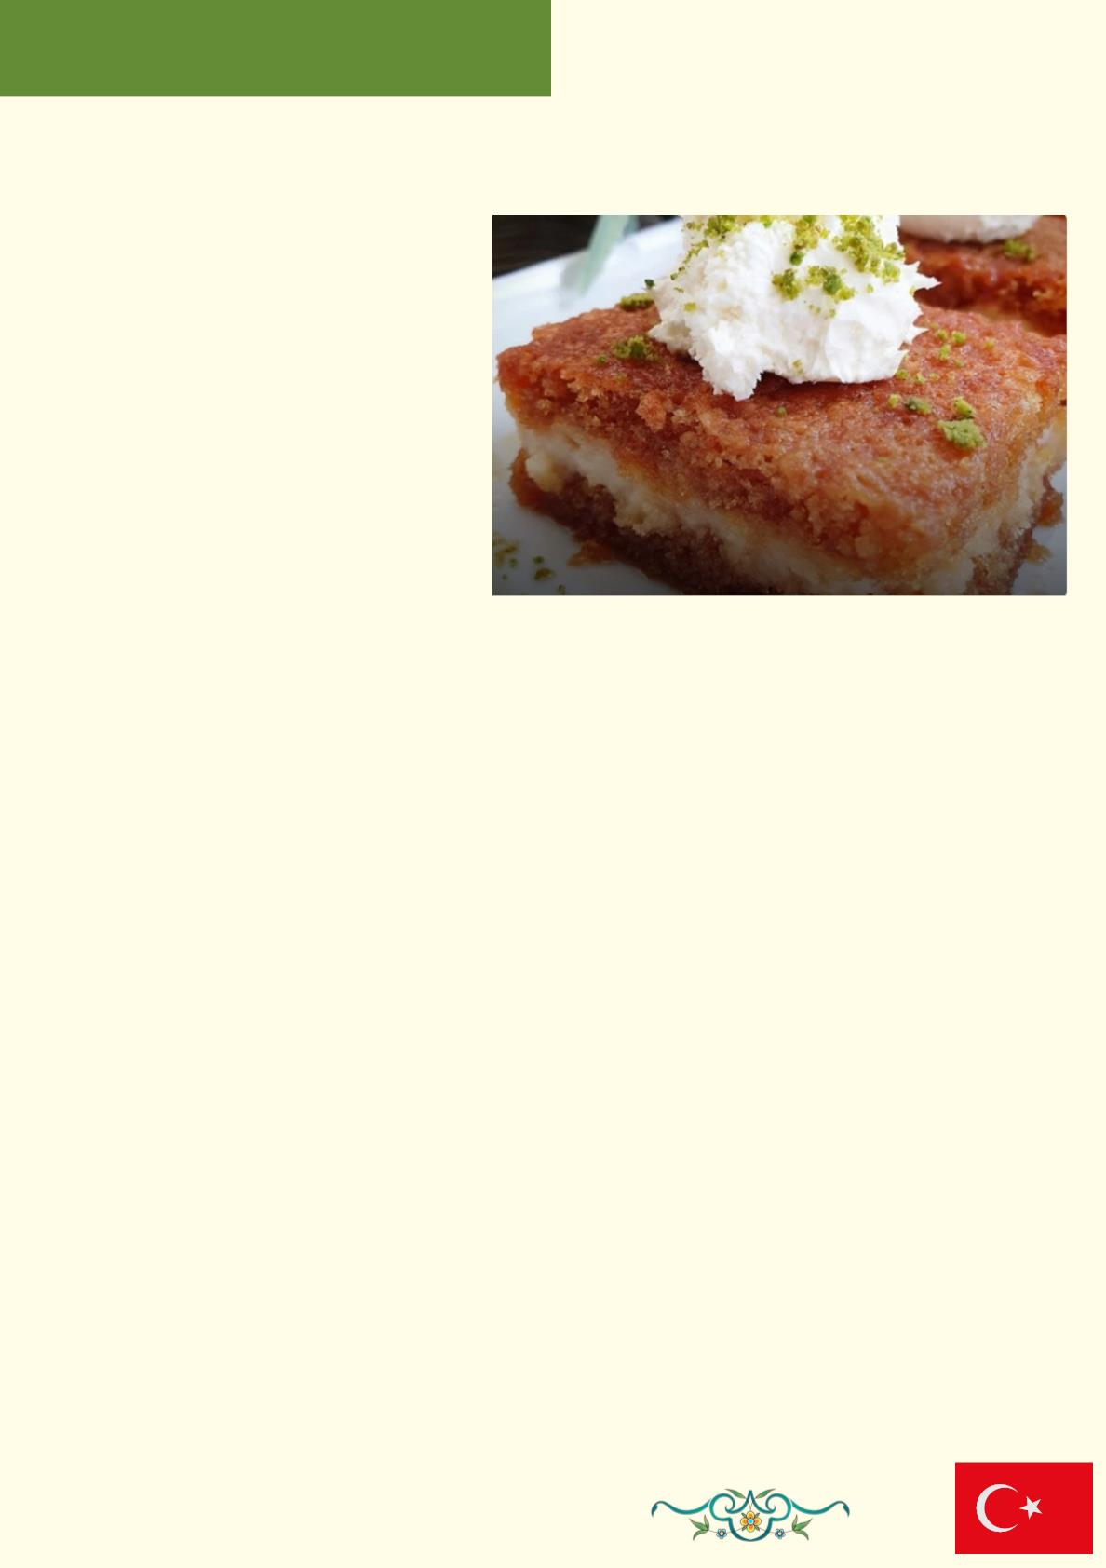
Ekmek Kadayıfı
Materials
Ingredients for the cake:
•3 eggs
• 1 glass of granulated sugar
• 3 Turkish coffee cups of flour
•1 packet of baking powder
•1 packet of vanilla
For the caramel syrup:
• 3 glasses of water
• 3 glasses of sugar
Intermediate cream:
• 2, 5 glasses of milk
• 3 tablespoons of flour
• 2 tablespoons of coconut
• 4 tablespoons of sugar
•1 packet of vanilla
Recipe :
1. Mix the egg and sugar with a mixer for 5 minutes. After whisking, add the flour, baking
powder, vanilla and mix.
2. We bake in a preheated oven at 170 degrees (350 F) for 20 minutes without opening the
door. (for a small rectangular pyrex or tray)
3. After the cake has cooled, we prepare the caramel with 3 glasses of sugar and 3 glasses of
boiling water.
4. We put the sugar in a saucepan and melt it on a low setting, when it becomes a liquid, we
pour 3 glasses of boiling water on it slowly
5. When you add the water, the sugar solidifies, and we boil it until the sugar dissolves again.
6. . For the cream, we mix all the ingredients except coconut and vanilla, and after it is cooked,
we add the coconut and vanilla and whisk it with a mixer. We leave it to cool.
7. Divide the cooled cake in half crosswise, first we put the bottom part on the tray where we
cooked it again.
8. Pour half of our caramel syrup, whose first temperature has risen, to the lower part (at this
stage, it is necessary to adjust the amount of sherbet well, since it will be poured to the upper
part).
9. We pour all of our cream in the middle and spread it well.
10. Place the top part carefully and pour the remaining syrup all over the cake.
11. If possible, we keep it in the refrigerator overnight, and serve it with cream or whipped
cream
Traditional Turkish Cuisine

Slide 10
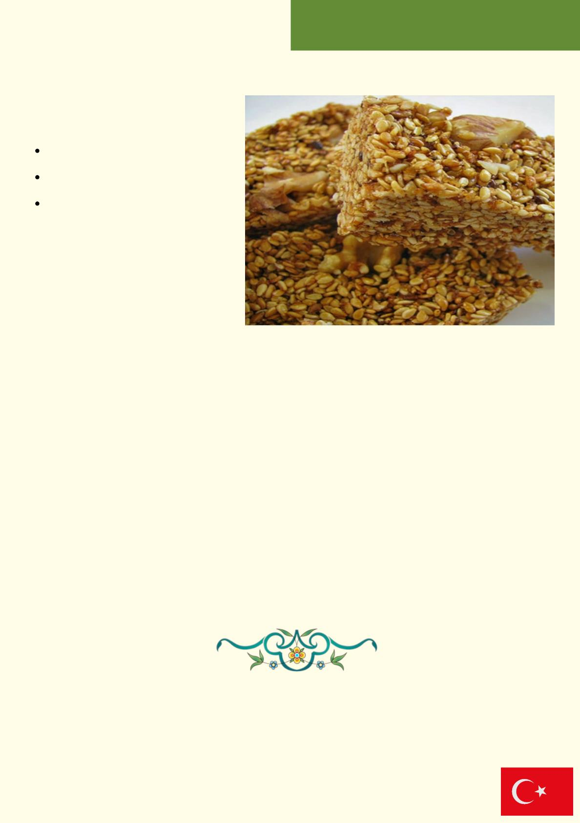
Çꢀtꢀrdꢀk
Materials
500 grams sesame
400-450 grams of honey
2 cups pistachios, walnuts
or almonds
Recipe :
Extract and wash the sesame.
Take it in a pan and fry it without adding oil, stirring constantly, until it changes color.
When sesame is roasted, add honey on it.
Optionally, add peanuts, walnuts or almonds.
Sesame seeds that are close to cooking will start to become foamy by holding each
other.
After cooking, pour it on an oiled tray or bread board and press it down with a
spoon.
Set aside to cool. Slice into squares or rectangles before they cool completely.
You can serve it with tea when it cools down.
Enjoy your meal...
Traditional Turkish Cuisine

Slide 11
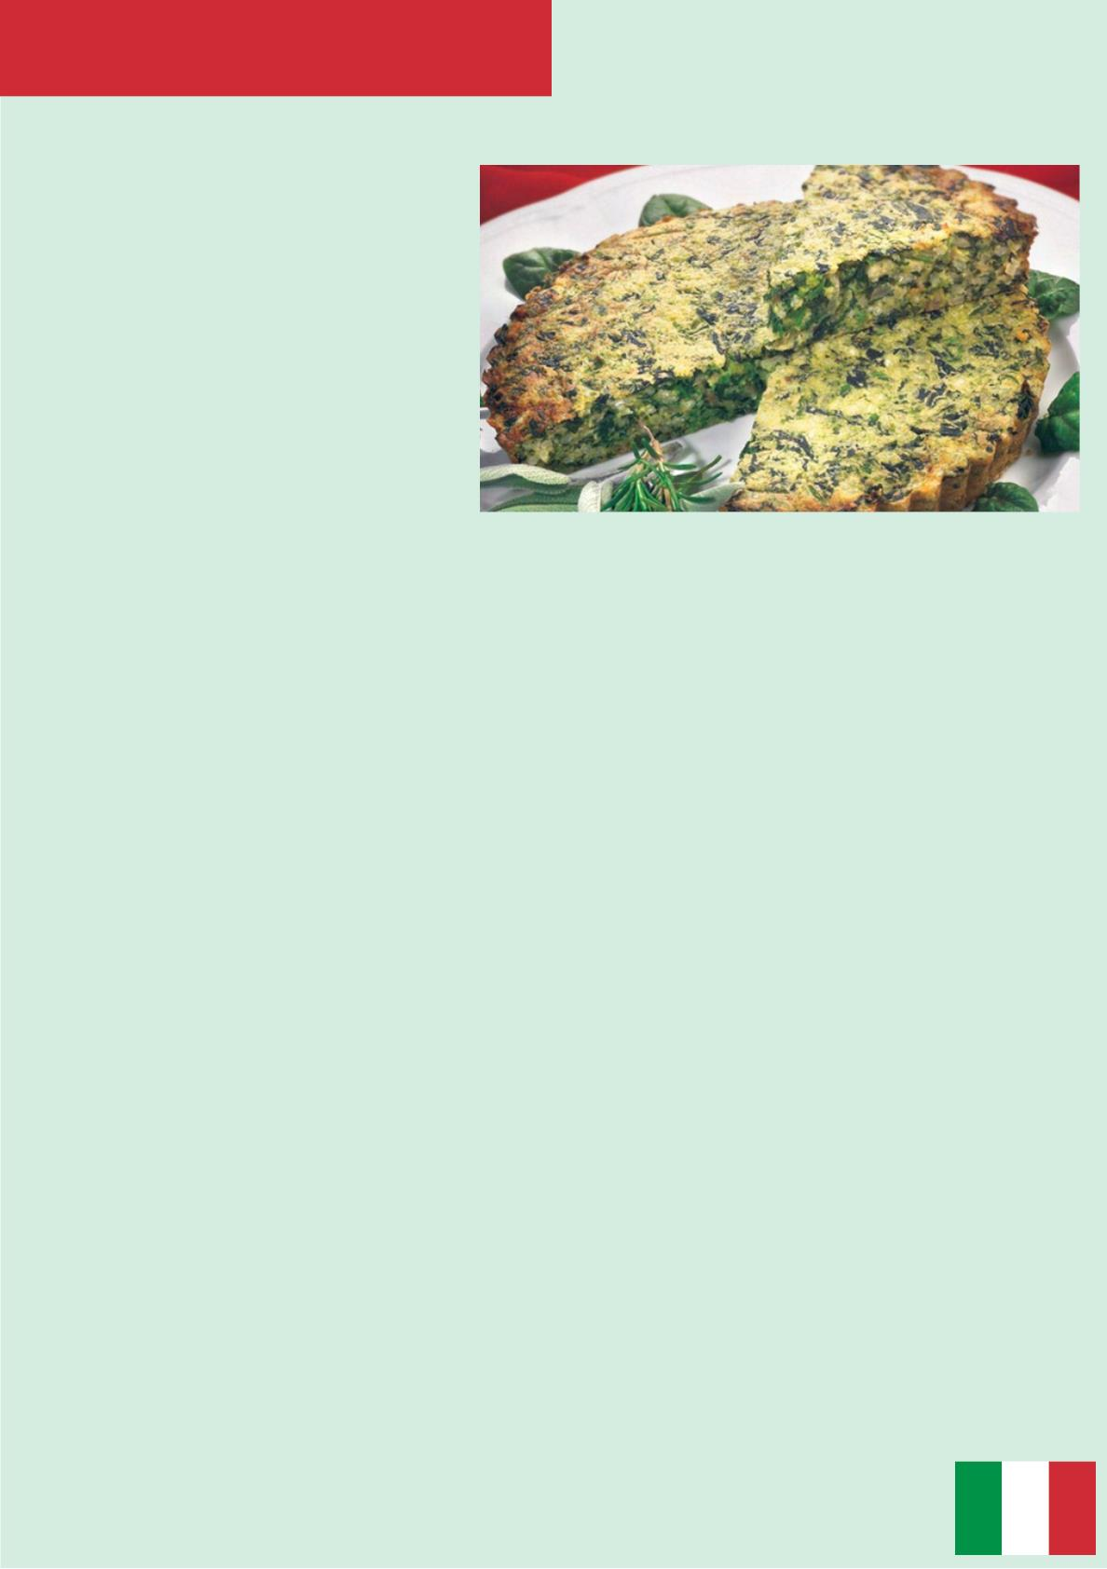
RICE CAKE: AN ANCIENT
PIEDMONTESE STARTER
ZERO WASTE RECIPES
INGREDIENTS:
·Fresh spinach or any type of
vegetables 800 g
·Arborio rice 200 g
·Leftovers of meat (raw or already
cooked) 300 g
·Onion 1
·Eggs 4
·Milk as needed
·Extra virgin olive oil as needed
·Grated parmesan cheese
·Bread crumbs
Salt, pepper and nutmeg to taste
METHOD:
1. If you don’t use leftovers of rice, spinach and meat, cook it as you prefer and
then let cool down.
2. Dice the meat and chop the onion, place them in a pan with some oil and let it
brown, meanwhile chop spinach or the other vegetables.
3. Combine the rice mixture and the meat, than let cool it down.
4. After that, add the eggs and the milk until the mixture becomes nearly liquid,
add the parmesan and season with salt pepper and nutmeg to taste.
5. Pour the mixture in a baking pan and sprinkle the top with breadcrumbs.
6. Bake it in pre-heated oven at 160°C for at least 20 minutes, use a toothpick to
check if the cake is ready. Serve hot!
Traditional Italian Cuisine

Slide 12
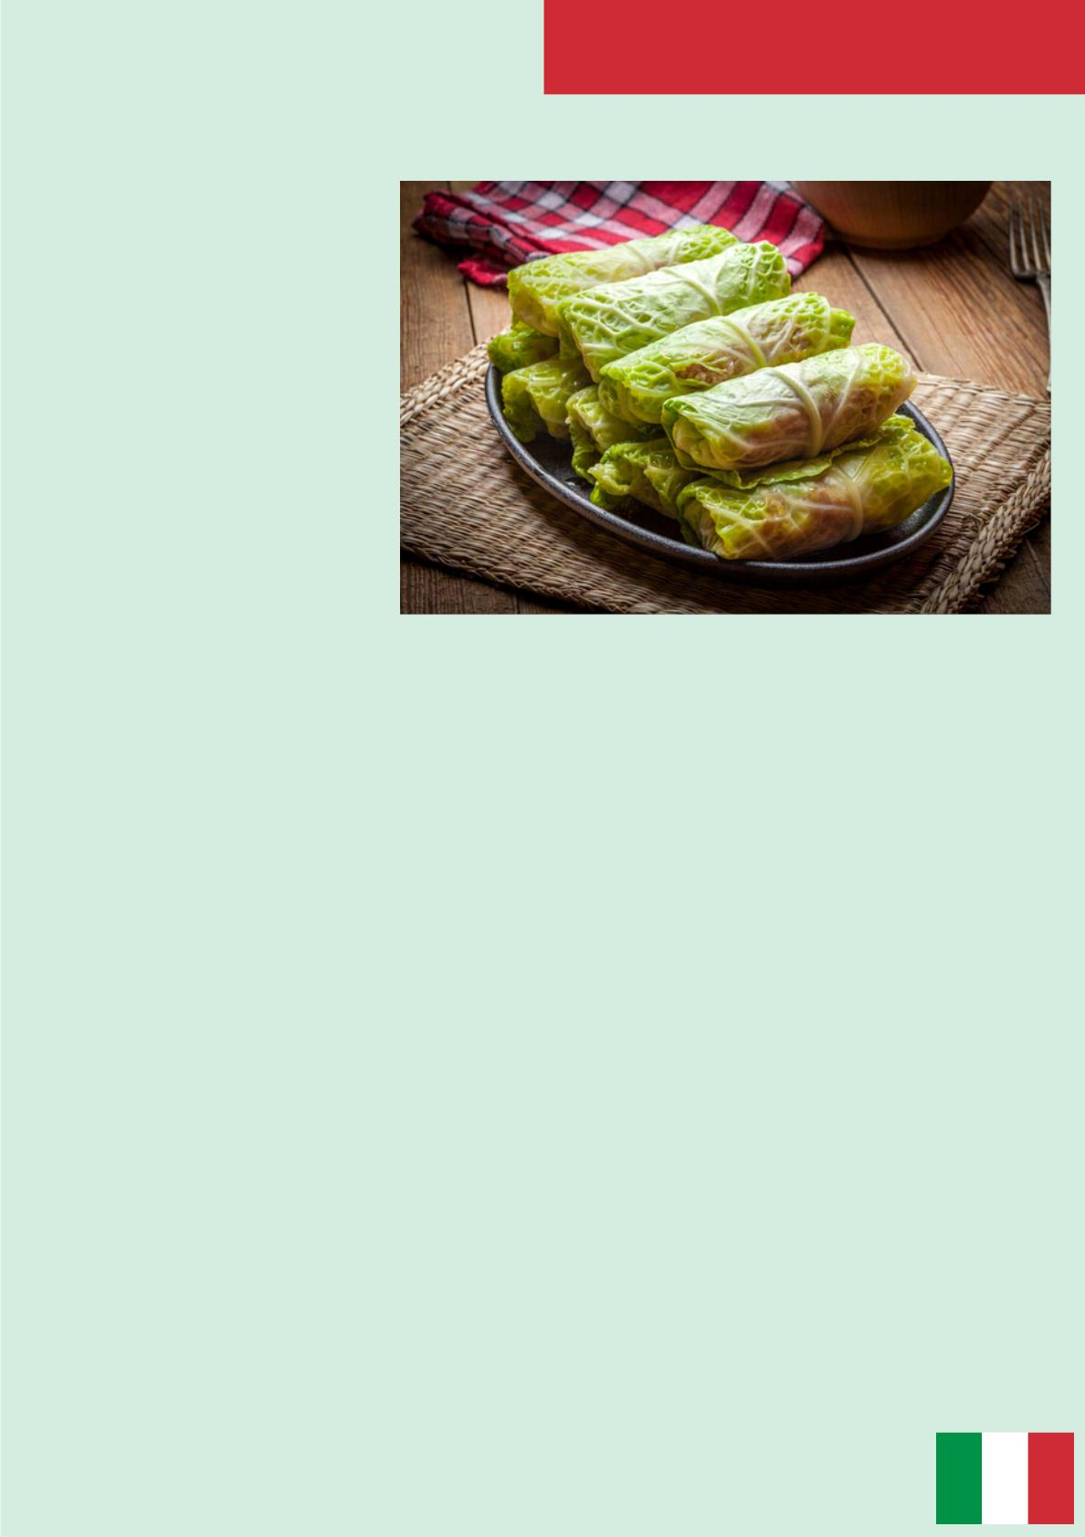
ZERO WASTE RECIPES
CAPUNET
INGREDIENTS:
·10 cabbage leavesꢀ
·1 eggꢀ
·2 tbsp of bread crumbs ꢀ
·400g of minced meatꢀ
·80g of Parmesan cheeseꢀ
·Salt and pepper to taste
·Butter to grease
METHOD:
1. Open the cabbage leaves gently without breaking them, wash and blanch them
in lightly salted boiling water for a few minutes.ꢀ
2. Drain them, place them to dry on kitchen paper and remove the hardest central
part with a knife.ꢀ
3. Prepare the filling: mix the minced meat with the egg, the grated cheese and
bread crumbs, it must not be excessively dry. Season with salt and pepper and mix
well all the ingredients.ꢀ
4. On each leaf of cabbage place in the centre a spoonful of the mixture; roll it up
and close tight with a toothpick. Continue until the ingredients are finished.ꢀ
5. Line a baking tray with baking paper and place all the rolls side by side. Add
butter flakes on each roll.ꢀ
6. Bake in a hot oven at 190 º C for about 40 minutes, until golden.
Traditional Italian Cuisine

Slide 13
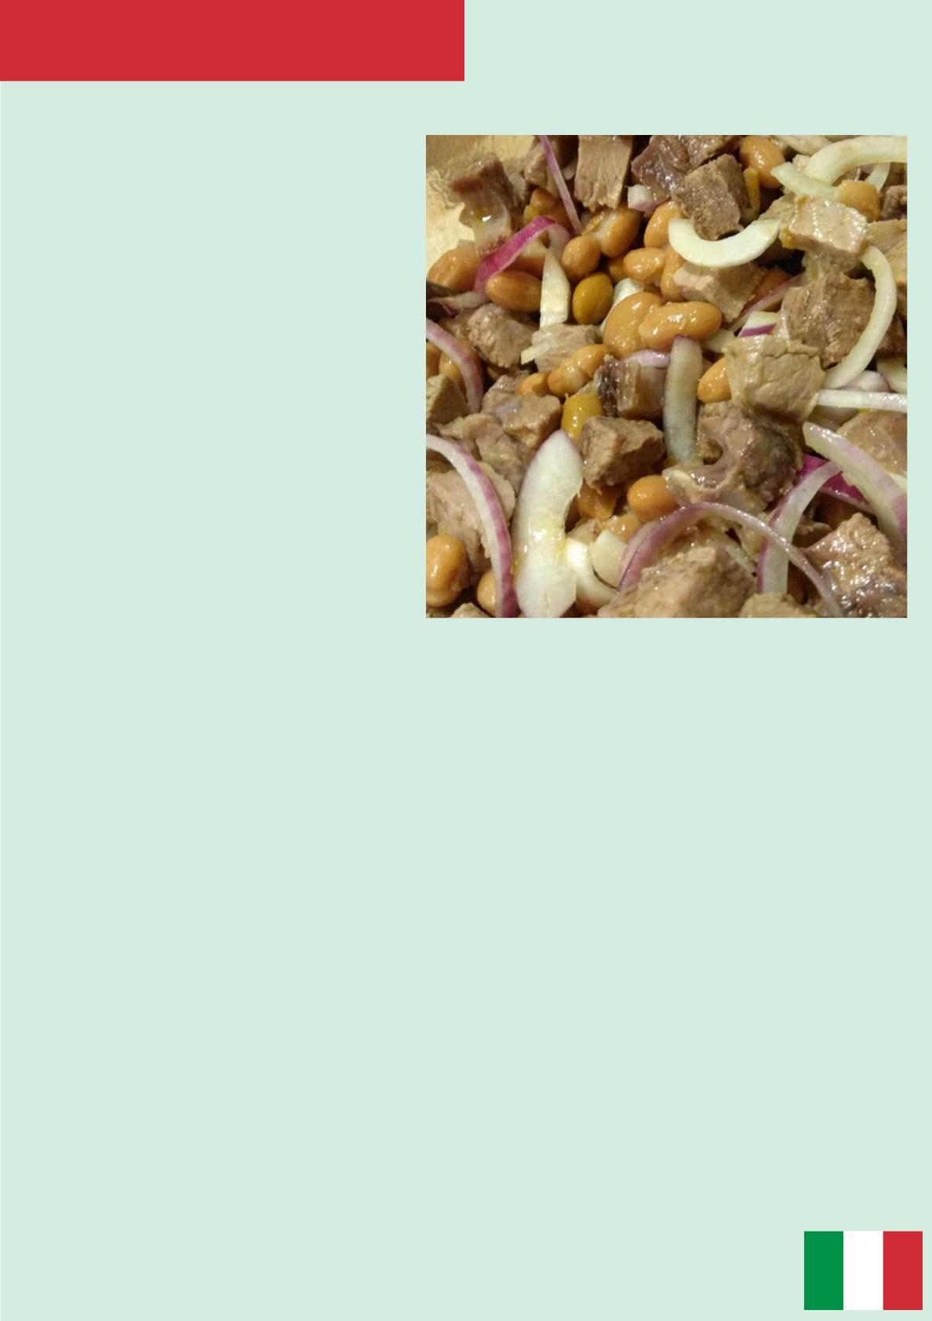
ANCIENT SALAD OF: “BOLLITO E
FAGIOLI”
ZERO WASTE RECIPES
INGREDIENTS:
·200 gr of dried beans
·400 gr of “bollito” (boiled veal meat)
·1/2 cup of chopped parsley
·2 leaves of sage
·1 celery stick
·2 spring onions
·Salt and pepper to taste
·1 tbsp of red vinegar
·3 tbsp of extra virgin olive oil
METHOD:
1. Rehydrate beans with cold water for a night. The day after boil them with
some salt, celery and sage until tender.
2. Drain them and let cool down.
3. Cut the meat in small and thin slices, chop the spring onions.
4. Combine the meat with the spring onions and the parsley in a large bowl,
season with salt and pepper, oil and vinegar. Serve the dish cold.
Traditional Italian Cuisine

Slide 14
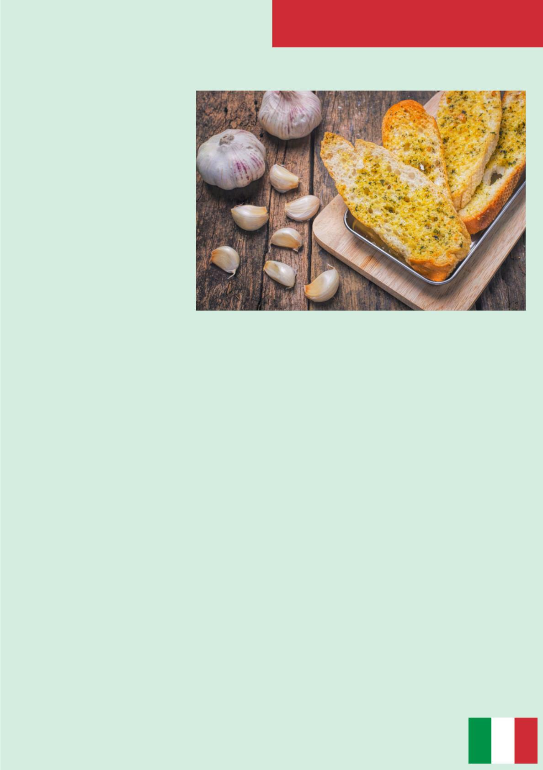
ZERO WASTE RECIPES
SOMA D’AJ (CRUSTY BREAD WITH
GARLIC & CHEESE PATE`)
INGREDIENTS:
·Leftovers of bread, sliced
·200 gr of Gorgonzola
cheese
·1 head of garlic
·Extra virgin olive oil
·Salt and pepper to taste
METHOD:
1. Halve the head of garlic, wrap each half in greased baking paper and cook in
preheated oven until soft and golden.
2. Meanwhile toast the bread in the oven.
3. Separate the garlic cloves and peel them. Then mash them and combine with
Gorgonzola cheese to form a smooth cream.
4. Top the toasted bread with the garlic mixture by using a piping bag, sprinkle
some salt and freshly ground pepper and taste it!
Traditional Italian Cuisine

Slide 15
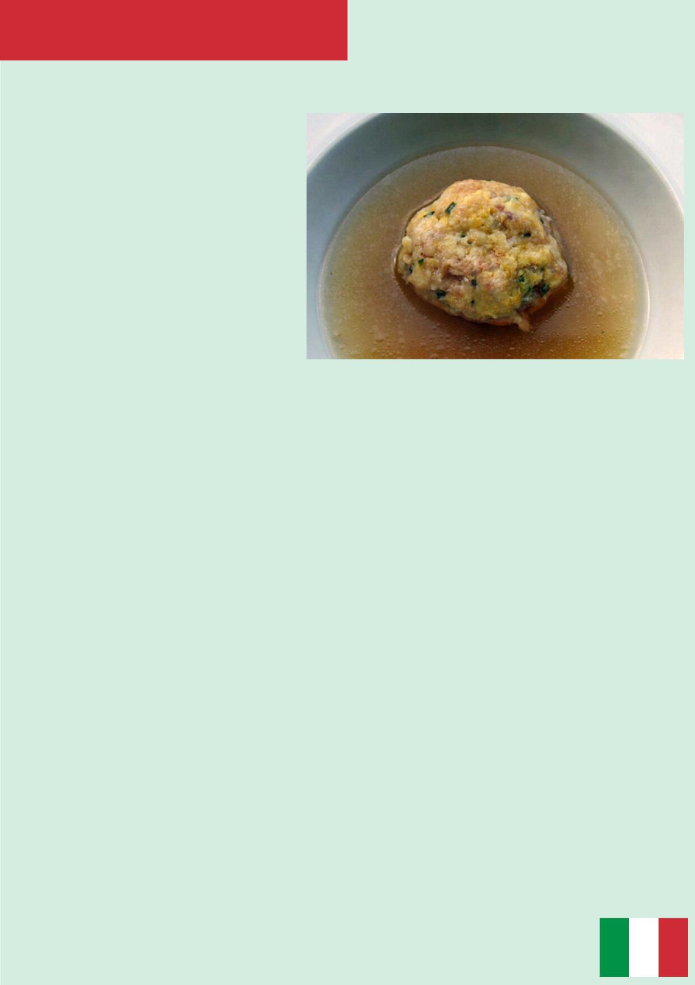
CANEDERLI WITH CHICKEN AND
BROCCOLI SAUCE
ZERO WASTE RECIPES
INGREDIENTS:
·200 gr of roasted chicken
·20 gr of raisin
·30 gr of grated Parmesan cheese
·1 egg
·Bread crumbs to taste
·Salt
·2 tbsp of extra virgin olive oil
·water
·200 gr of boiled broccoli
·1 boiled potato
METHOD:
1. Mince the meat of the roasted chicken, add the egg, a pinch of salt and the
cheese. Mix well.
2. Stir in the breadcrumbs until the mixture becomes thick; put in the raisin and
start to make the balls.
3. Blend broccoli with the potato, a pinch of salt and some olive oil until creamy.
4. Cook “canederli” in boiling salted water for 2/3 minutes.
5.Drain and serve them in a dish with the sauce on the base, top with raisins.
Modern Italian Cuisine

Slide 16
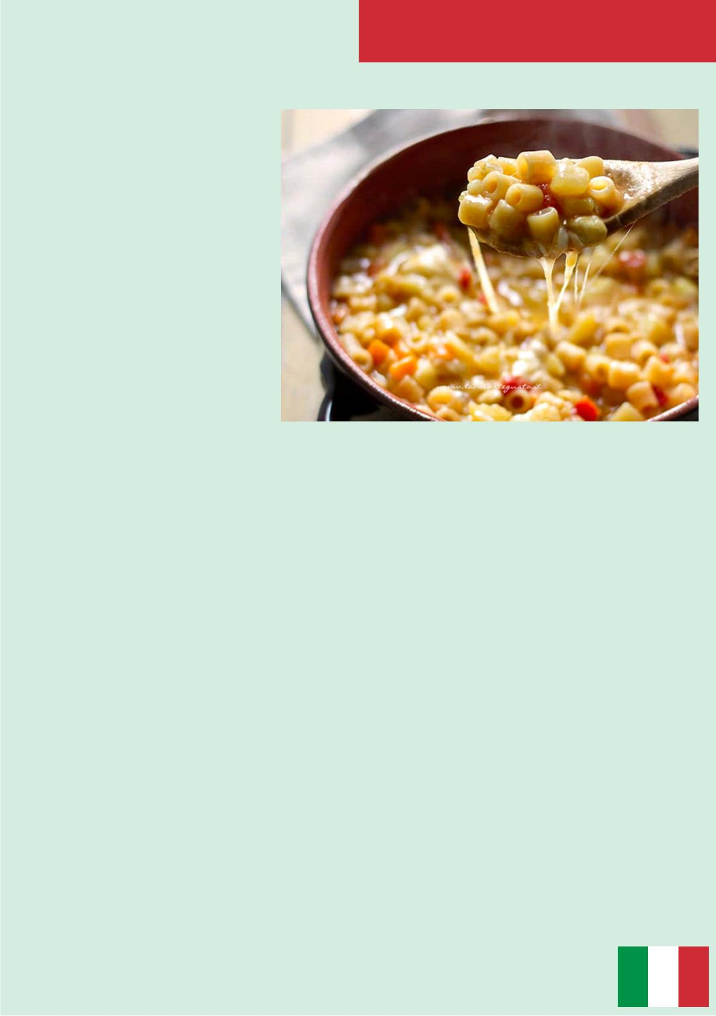
ZERO WASTE RECIPES
CHEESY “PASTA AND POTATOES”
INGREDIENTS:
·320 gr of mixed leftovers of
pasta
·500 gr of potatoes
·100 gr of chopped tomatoes
·1 onion
·1 carrot
·1 celery stick
·5 tbsp of extra virgin olive oil
·Salt and pepper to taste
·Crust of mixed cheeses
METHOD:
1. First of all, chop celery, onion and carrot to make the typical Italian “soffritto”,
then brown it in a large saucepan with the oil.
2. Peel and cube potatoes, put them in the pan with the tomatoes. Add two
glasses of water and cook for at least 20 minutes.
3. Finally, add the pasta. Remove from the stove and add all the grated cheeses.
It’ll be a delicious thick soup. Enjoy!
Modern Italian Cuisine

Slide 17
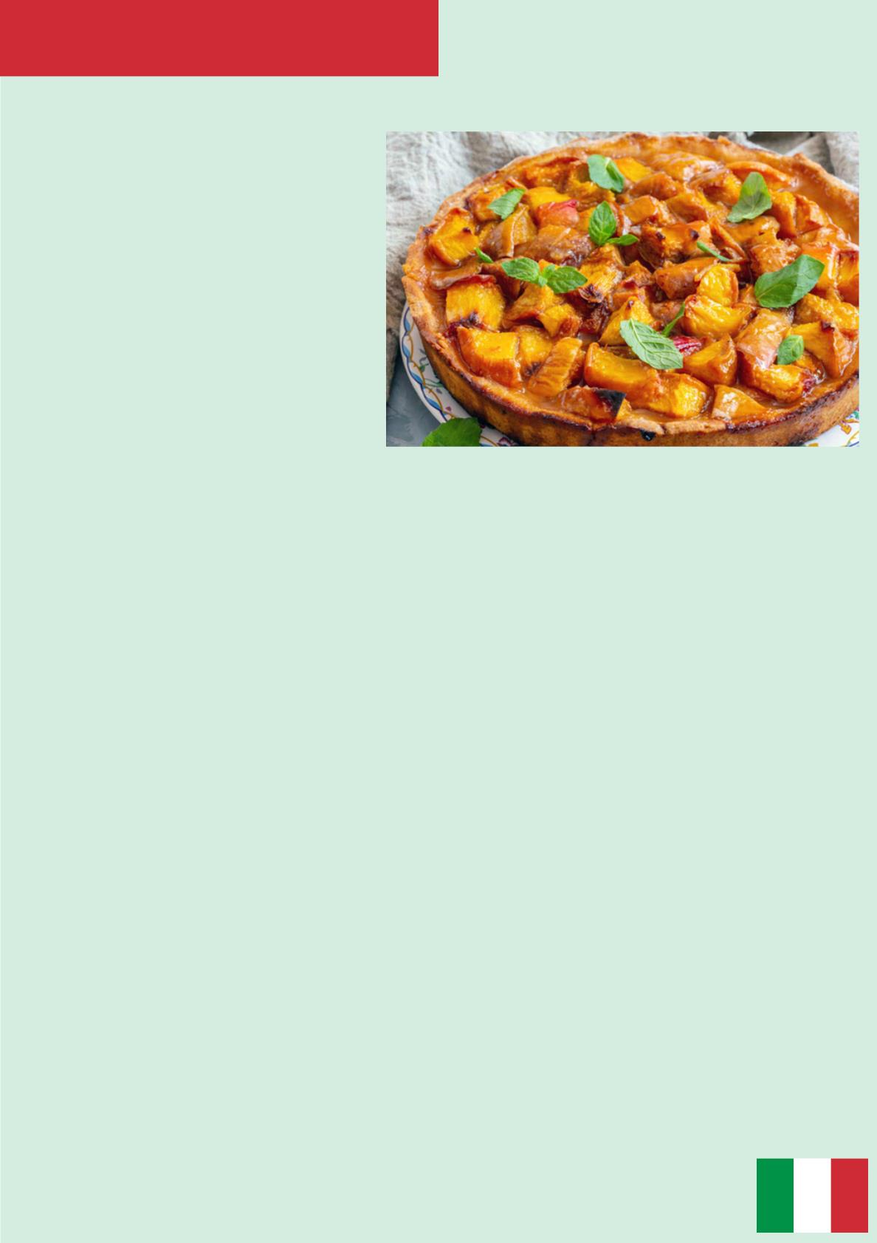
PEACH AND AMARETTI CAKE
ZERO WASTE RECIPES
INGREDIENTS:
·250 gr of soft butter
·250 gr of sugar
·200 gr of plain flour
·50 gr of potato starch
·600 gr of ripe peaches
·4 eggs
·1tsp of baking powder
100 gr of crushed amaretti biscuits
METHOD:
1. Beat the butter with sugar, add the eggs and mix well.
2. Sieve the baking powder and add it to the mixture. Blend half of the crushed
amaretti.
3. Butter a baking tray, place half of the mixture in the tray, flatten the top and
garnish it with peeled and sliced peaches. Finally, add the second half of the
mixture and cover with the remaining amaretti.
4. Bake in preheated oven at 180°C for 40 minutes. Let it cool and serve.
Modern Italian Cuisine

Slide 18
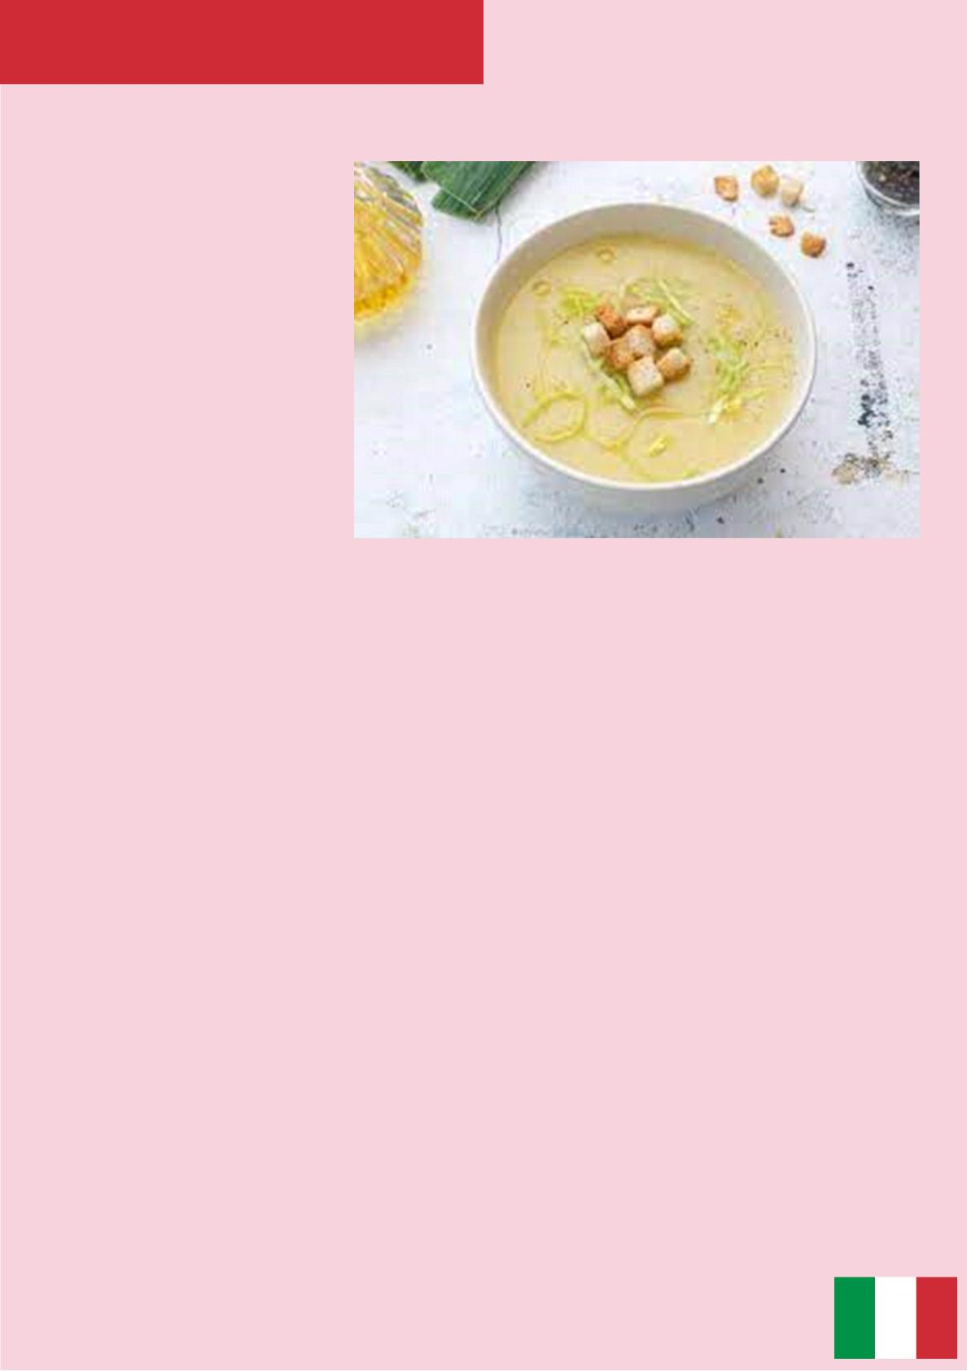
CREAM OF LEEKS AND POTATOES WITH FOCACCIA
CROUTONS AND FRIED POTATO PEELS
INGREDIENTS:
1500 g leek
750 g potatoes
500 g sunflower seed oil
500 g water
400 g focaccia
170 g olive oil
15 g rosemary
10 g salt
METHOD OF PREPARATION
1. Make focaccia croutons with advanced low focaccia, cut into cubes, season with
oil, salt and rosemary. Now bake at 180 degrees for 8 minutes, check from time to
time.
2. Peel the potatoes and fry the peels in seed oil at 160 degrees and dry them with
a paper cloth.
3. Wash and clean the leeks, cut them into small pieces and brown in a pot with oil.
4. Meanwhile, cut the potatoes already peeled and cut them into small cubes.
5. When the leek is ready, add the potatoes and brown them for a few minutes
6. Add the water and stem of the leek, cook for 30 minutes.
7. Remove the stem leek, and blend it, if there is too much water, remove it.
8. Add the salt.
9. Serve the velvety with the focaccia croutons and the fried potato peel in the
center of the plate and serve adding oil
Modern Italian Cuisine

Slide 19
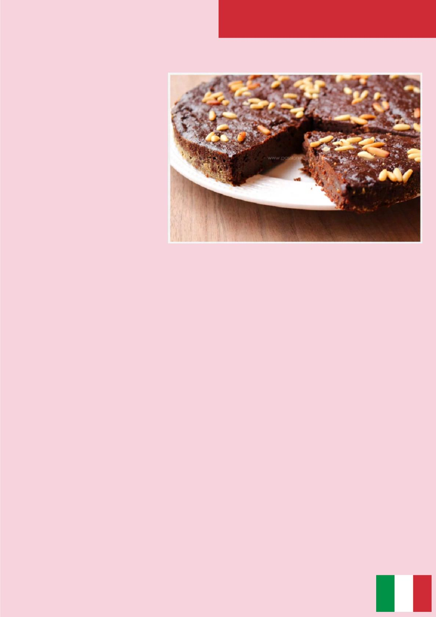
TORTA PAESANA
INGREDIENTS
1600 g milk
500 g stale bread
300 g amaretti
250 g raisins
150 g sugar
100 g 70% dark chocolate
100 g bitter cocoa powder
100 g pine Nuts
2 eggs
1 pinch of salt
1 sachet of vanillin
METHOD OF PREPARATION
1.
First of all, cut the stale bread into pieces, put it in a large bowl with the milk
and let it dunk for at least 3 hours, so that the bread absorbs all the liquid and falls
apart. Mix everything occasionally. In the meantime turn on the oven at 180° static.
2.
When everything is melted, mix and mash with a fork. There should be no
pieces of bread. To speed everything up you can also blend the mixture a little at a
time. Then add the vanillin, a pinch of salt, the sugar and the eggs. Combine all the
ingredients.
3.Separately, blend the amaretti biscuits with the chocolate pieces and reduce
them to powder. Pour into the bread dough and also add the bitter cocoa. Mix
everything well. Finally, add the pine nuts and the raisins.
4.Grease the pan (30×40) and pour the mixture into it. Level well and add a handful
of pine nuts on the surface. Place in a hot oven and cook at 180° for 80 – 90
minutes. Once cooked, remove from the oven and leave to cool completely.
Modern Italian Cuisine

Slide 20

ARANCINI
INGREDIENTS
1 sachet of saffron
30 g butter
500 g Vialone nano rice
1 pinch of salt
1.2 l water
100 g seasoned grated Caciocavallo
FOR THE RAGÙ FILLING
Salt (to taste)
Black pepper (to taste)
½ onion
FOR THE HAM FILLING
30 g baked ham (in a single slice)
60 g mozzarella cheese
25 g butter
FOR THE BATTER
200 g 00 Flour
1 pinch of salt
300 ml water
100 g minced pork
Extra virgin olive oil (to taste)
200 ml tomato puree
80 g peas
50 g fresh Caciocavallo
50 ml red wine
FOR BREADING AND FRYING
Breadcrumbs (to taste)
Seed oil (to taste)
METHOD OF PREPARATION
1. Start by boiling the rice in 1.2 liters of boiling salted water, so that, after cooking, the water has been completely
absorbed (this will allow all the starch to remain in the pot and you will obtain a very dry and compact rice). Cook
for about 15 minutes, then dissolve the saffron in a very little hot water and add it to the cooked rice. Also add the
diced butter.
2. Add the grated cheese, combine well everything, then pour and level the rice on a wide and low tray and cover
it with the film, to make it cool completely (the film will prevent the surface of the rice from drying out). Let the rice
rest for a couple of hours out of the fridge.
3. In the meantime, dedicate yourself to the ragù filling: peel and finely slice the onion . Stew the chopped onion in
a pan with 2 tablespoons of oil and the butter, then add the minced meat; brown it over high heat, then add the
wine and let it fade.
4. At this point add the tomato puree, season with salt and pepper and cook over low heat covering the pot with a
lid for at least 20 minutes. Halfway through cooking, add the peas (11-12) (if necessary you can add very little hot
water because the sauce must be well thickened and not liquid).
1.
have all the fillings ready.
2. Once the rice has completely cooled, you can form the arancini. To help you form them, keep a bowl full of
While the peas are cooking, dice the Caciocavallo, the baked ham and the mozzarella cheese. Thus you will
water nearby so you can moisten your hands. Take a couple of tablespoons of rice at a time (about 120 g of rice),
crush the mound in the center of your hand forming a bowl and pour a teaspoon of meat sauce filling inside, add a
few cubes of caciocavallo. Then close the base of the arancino with the rice and model it, giving a pointed shape
(you can give this shape to all the arancini stuffed with ragù).
3.
with this type of filling is traditionally called "butter" and shape them into a round shape.
4. Once all the arancini are ready, prepare the batter: pour the sifted flour, a pinch of salt and the water into a
While for the ham filling, fill each arancino (about 130 g of rice) with diced ham and mozzarella. The filling
bowl. Mix thoroughly with a whisk to prevent lumps from forming. Then dip the arancini, one by one, into the batter
taking care to cover them entirely and roll them in breadcrumbs.
9. In a saucepan, heat the oil and bring it to a temperature of 170°, at that point fry one arancino at a time or
maximum two so as not to lower the oil temperature: when they are golden brown you can drain them placing them
on a tray lined with paper towels.
10. At last….enjoy the hot Sicilian rice balls!
Modern Italian Cuisine

Slide 21
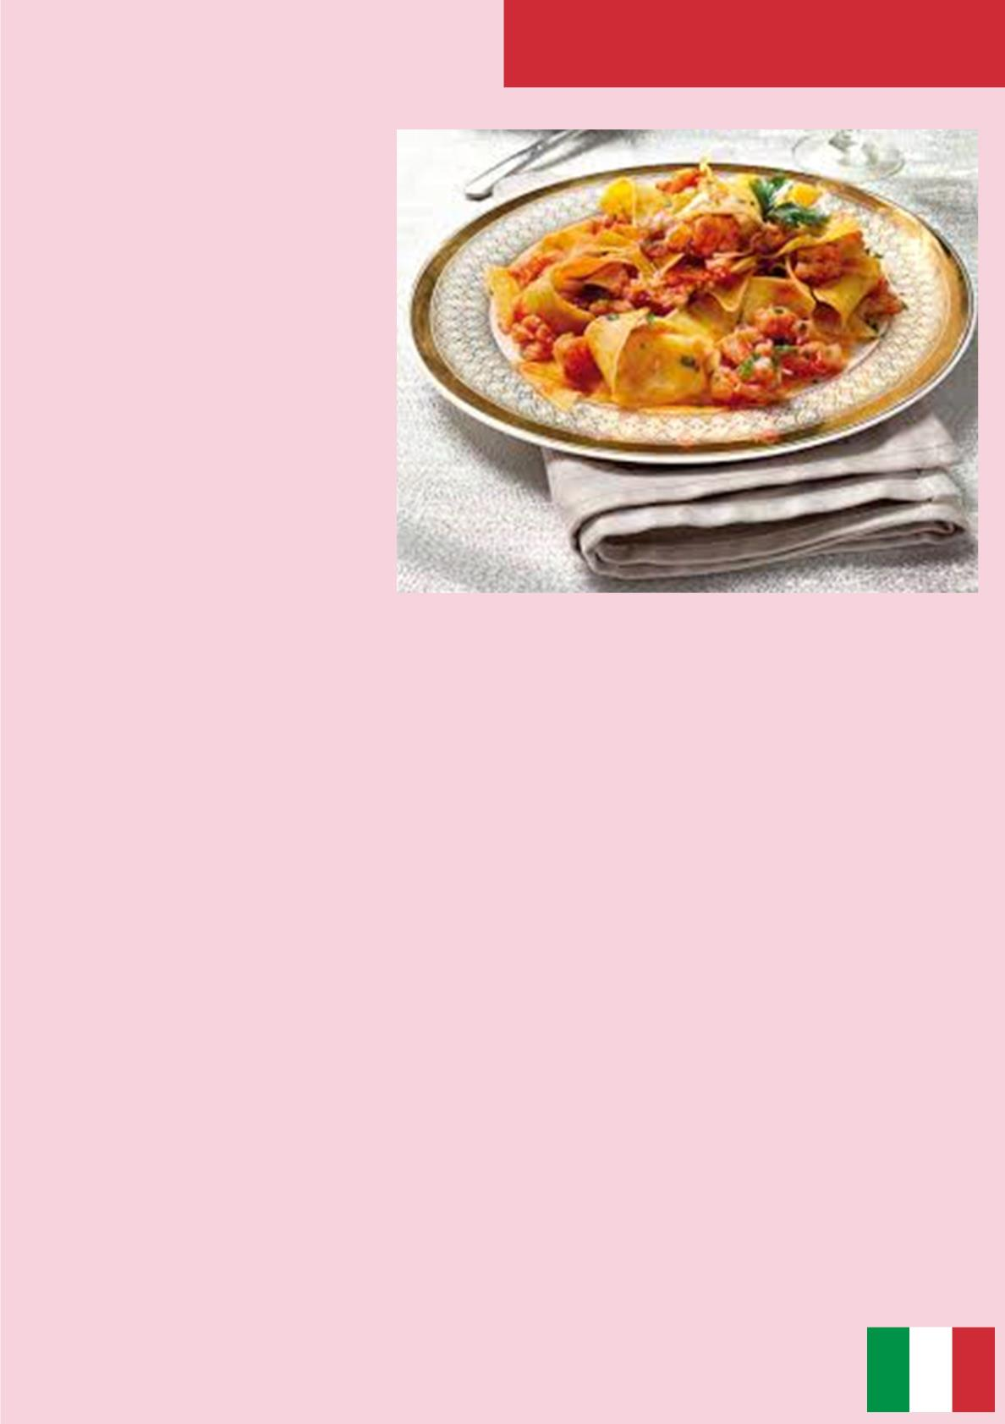
MALTAGLIATI WITH RAGU’
INGREDIENTS:
FOR MALTAGLIATI PASTA:
1000g 00 Flour
600g (or 10) Eggs
FOR RAGÙ:
900 g Minced beef
800 g Tomato sauce
120g Celery
120g Onion
120g Carrot
170g Extra virgin olive oil
1g Black pepper
10g Salt
1g Laurel
METHOD OF PREPARATION:
1.
Arrange the flour as a fountain, put the eggs in the middle of the fountain,
combine the ingredients and knead the dough. Then let it rest in the fridge for 30
mins.
2. Roll out the dough giving the typical shape of maltagliati pasta.
3. Pour some water into a large pot and salt it. Let it boil.
4. Cook the pasta into the pot with the boiling water and when it's ready drain it
5. Chop the celery, the carrots and the onion.
6. Brown them with extra virgin olive oil into a pan
7. Add the minced beef and when it is ready pour the tomato sauce, some water,
salt, black pepper and laurel.
8. Cook the sauce for two hours
9. Season Maltagliati with the tomato sauce (called ragù) and serve it.
Traditional Italian Cuisine

Slide 22
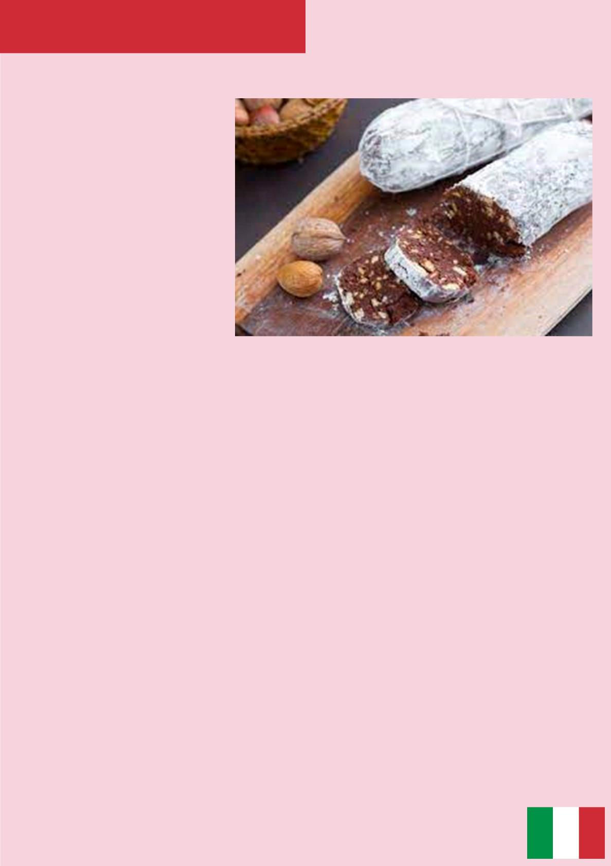
SALAME DI CIOCCOLATO
INGREDIENTS:
200 g dark chocolate
100 g dry biscuits
100 g butter
150 g sugar
10 g dark cocoa powder
FOR THE GARNISH:
Icing sugar (to taste)
METHOD OF PREPARATION:
1. Start by chopping the dark chocolate with a knife, melt it in a bain-marie and then
let it cool
2. Meanwhile, put the butter and the sugar in a bowl and start to mix with an
electric mixer.
3. When the butter has become creamy add the cool melted chocolate and the
dark cocoa powder, mix it until it becomes a homogeneous dough.
4. Crumble the dry biscuits with your hands, add them to the dough and rub in with
a spatula.
5. Pour the mix on the middle of some baking paper, shape the dough with your
hands into a cylinder. Wrap it with baking paper and roll it out.
6. Close the ends of the baking paper and let it cool in the refrigerator for 3 hours.
7. When cooled, remove the baking paper and sprinkle it with some icing sugar.
Now you can taste your salame di cioccolato!
Traditional Italian Cuisine

Slide 23
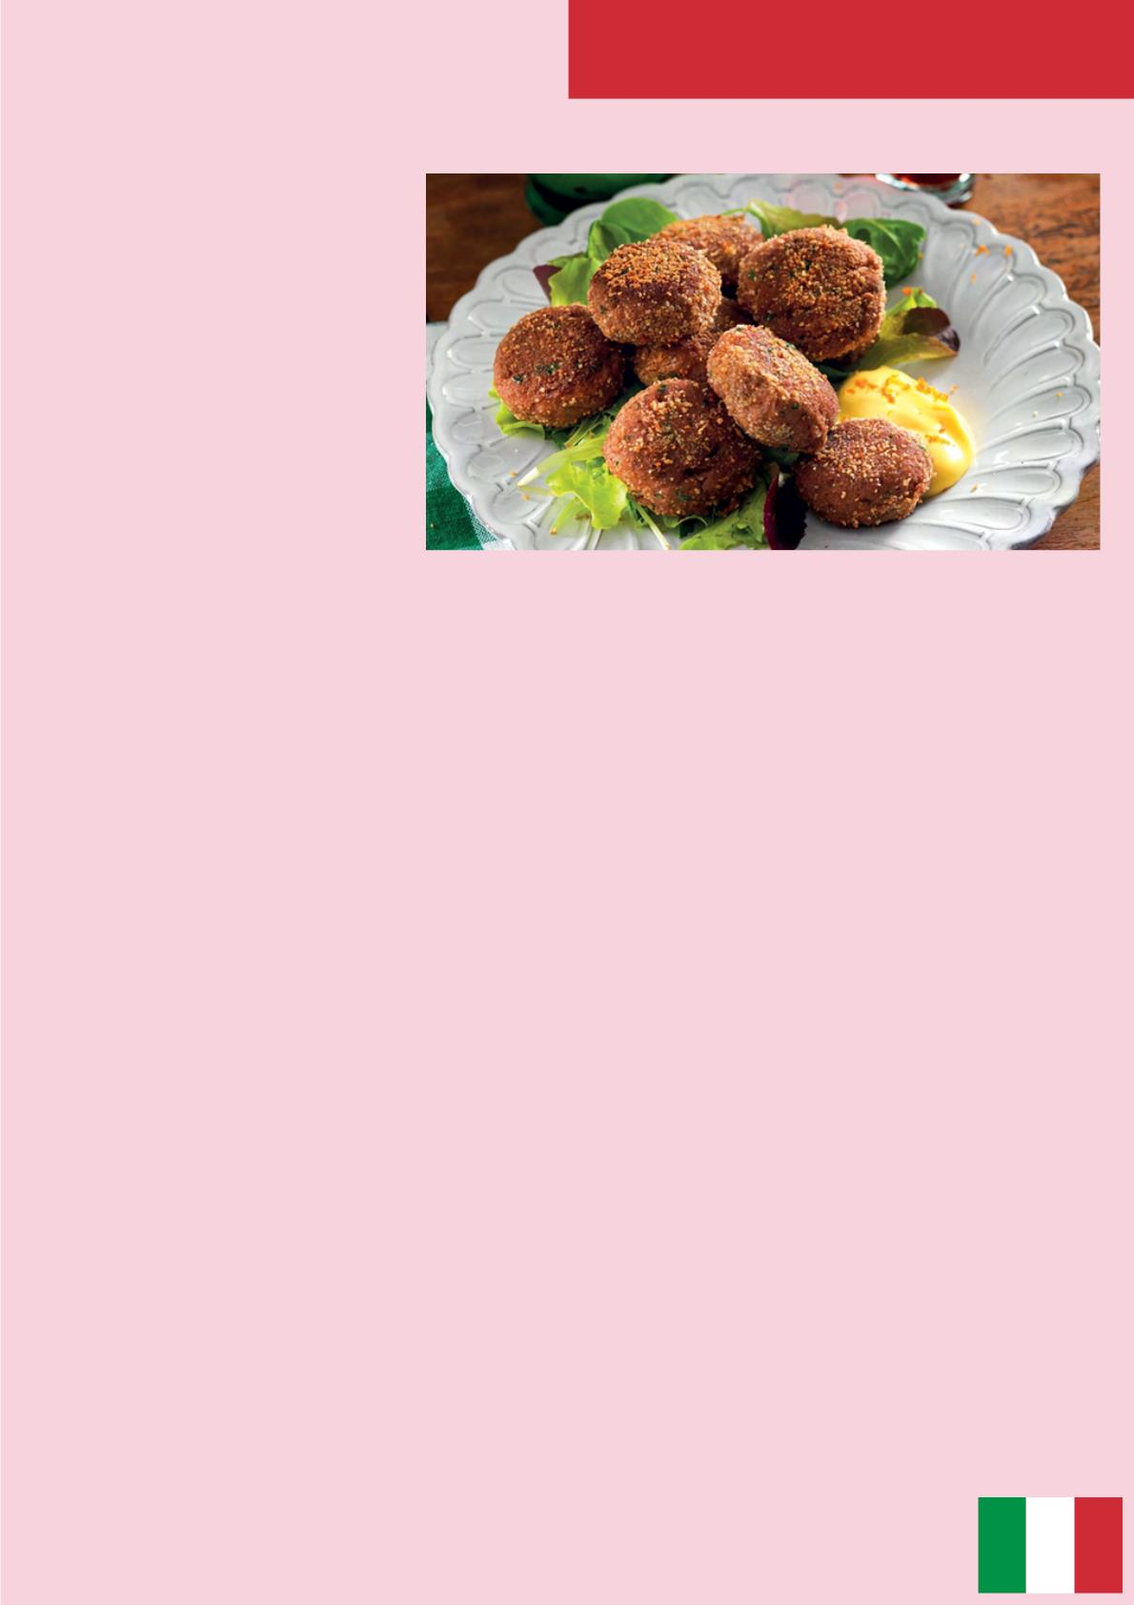
MONDEGHILI (MILAN MEATBALLS)
INGREDIENTS:
300 g beef tenderloin
20 g Grana Padano cheese
Lemon zest
1 celery
1 carrot
1 onion
5 g chopped parsley
130 g stale bread
80 g milk
Black pepper (to taste)
Salt (to taste)
Nutmeg (to taste)
For the breading and the cooking
8 tablespoons bread crumbs
250 g butter
METHOD OF PREPARATION:
1. Start by preparing the broth: add the celery, the onion and the carrot to some
water and let it boil. When the broth is boiling add the tenderloin and let it cook until
the meat is soft.
2. When the meat is ready, turn off the heat and let it cool.
3. Meanwhile, pour the bread into a bowl and add the milk.
4. When the bread is soft add the meat and pass them into a meat grinder.
5. Add the lemon zest, the egg and the grated cheese and the spices to the
mixture. Mix the dough with the hands until it’s homogeneous.
6. At this point, shape 35g of the dough into an oval and coat it with the bread
crumbs.
7. For the cooking, melt the butter in a nonstick pan and then cook the Mondeghili
into the butter for 2 minutes. When they are ready, pour them on some blotting
paper to absorb some excess oil. Now the Mondeghili is ready!
Traditional Italian Cuisine

Slide 24
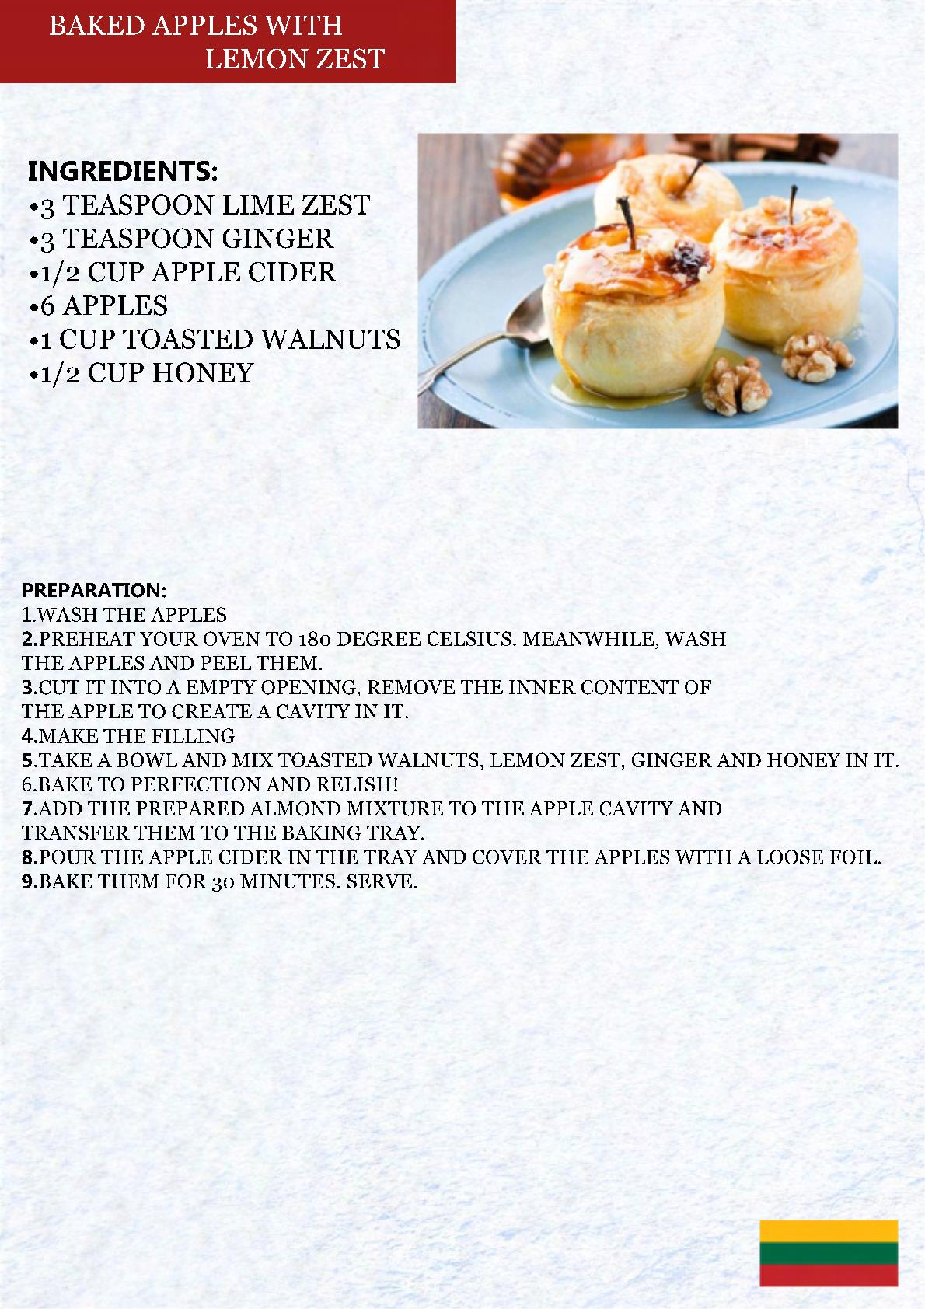

Slide 25
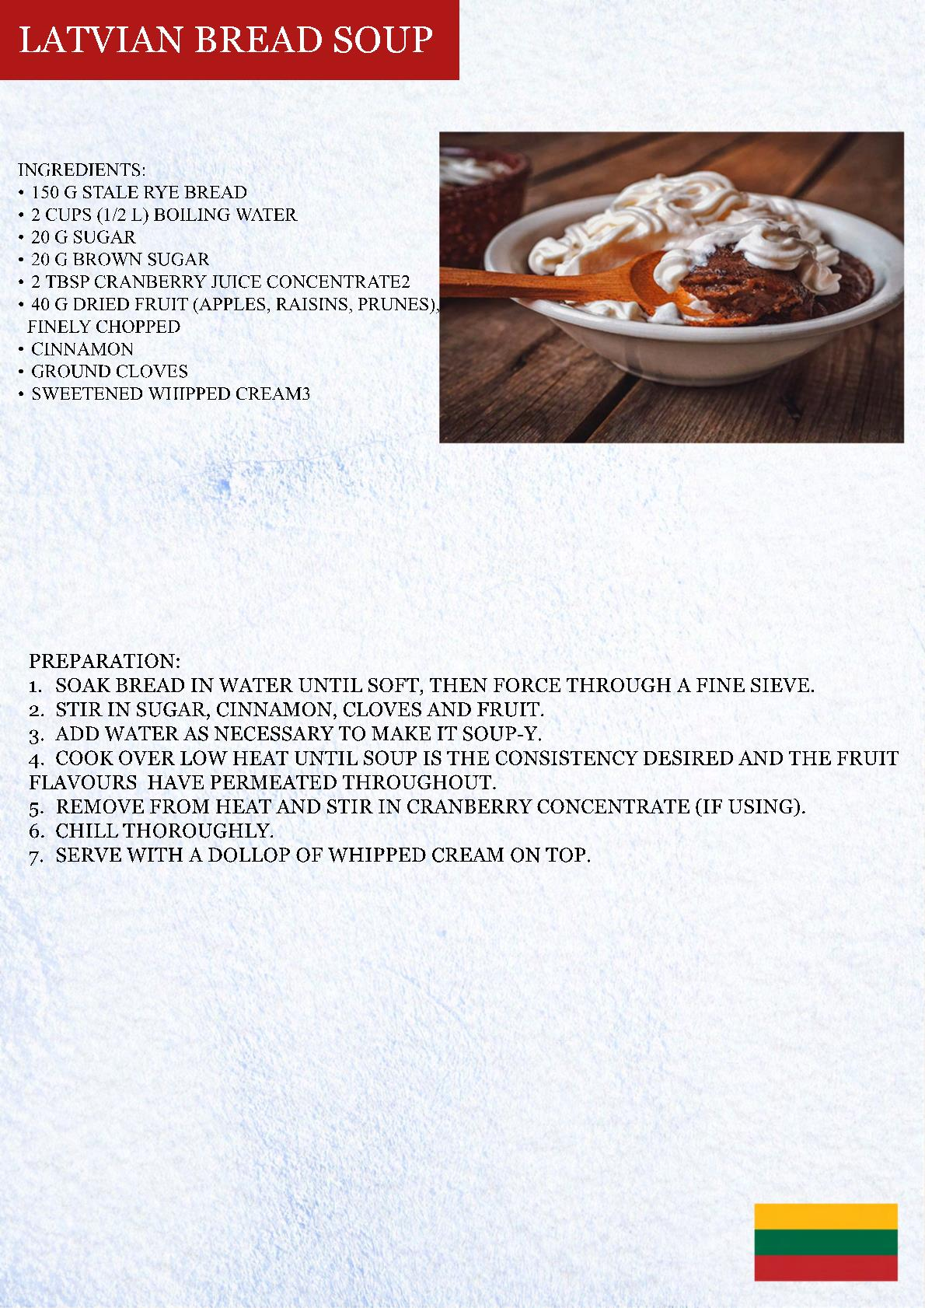

Slide 26
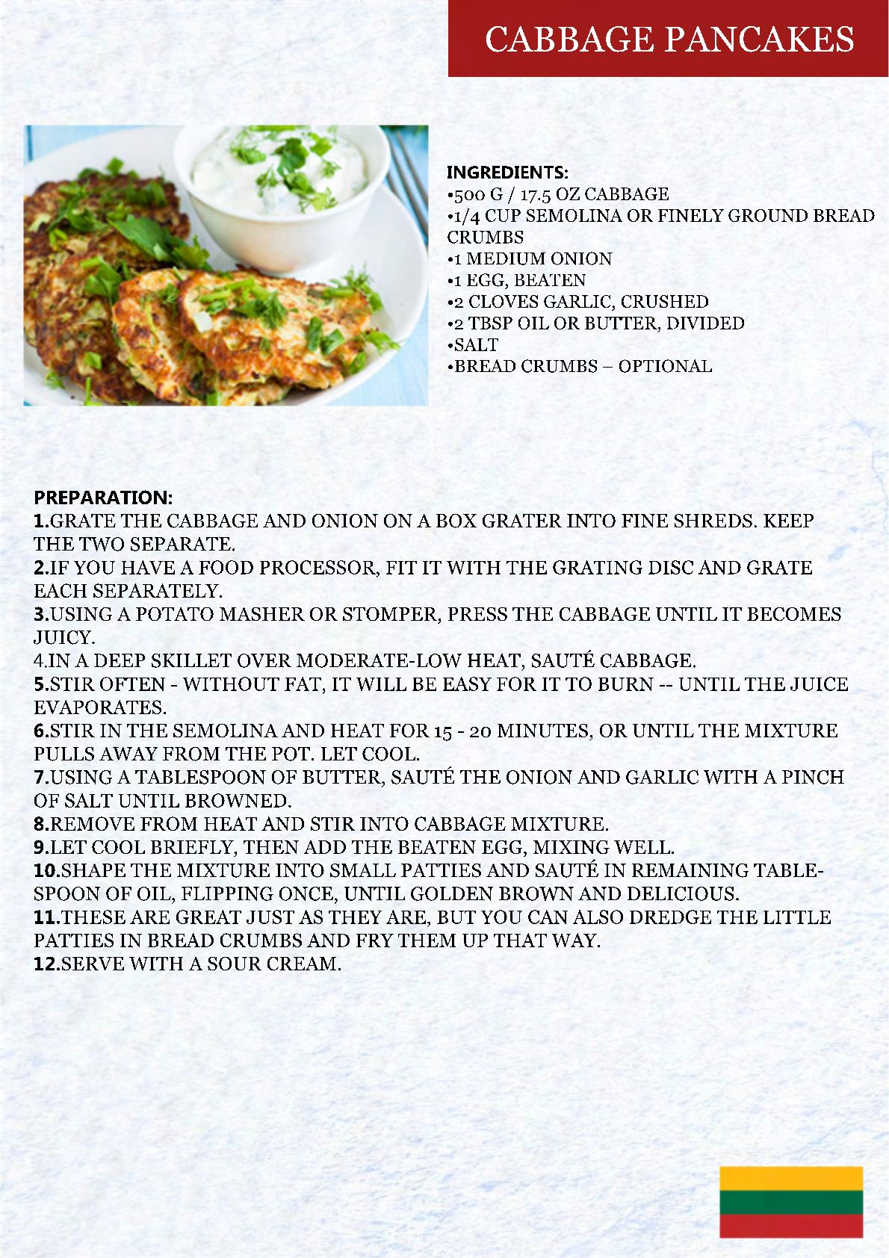

Slide 27
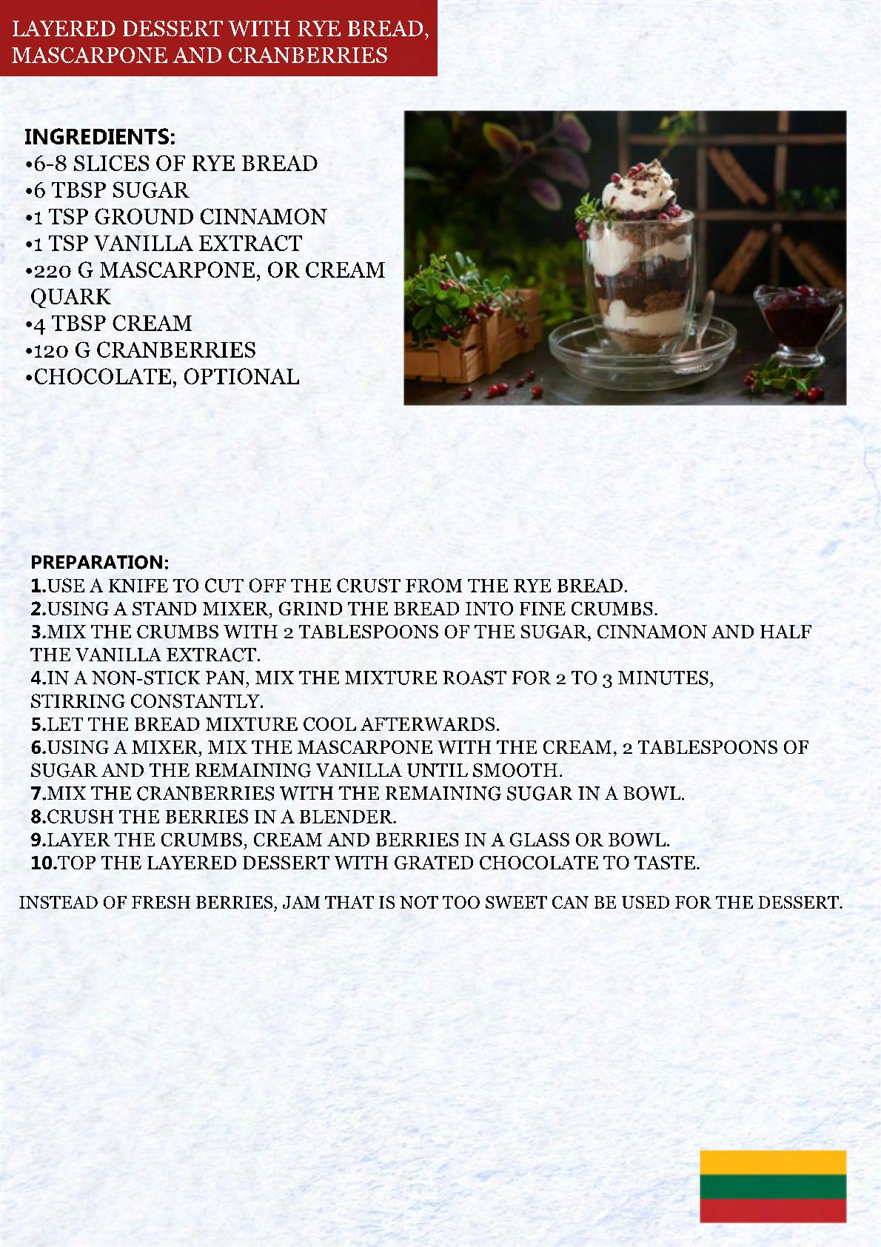

Slide 28
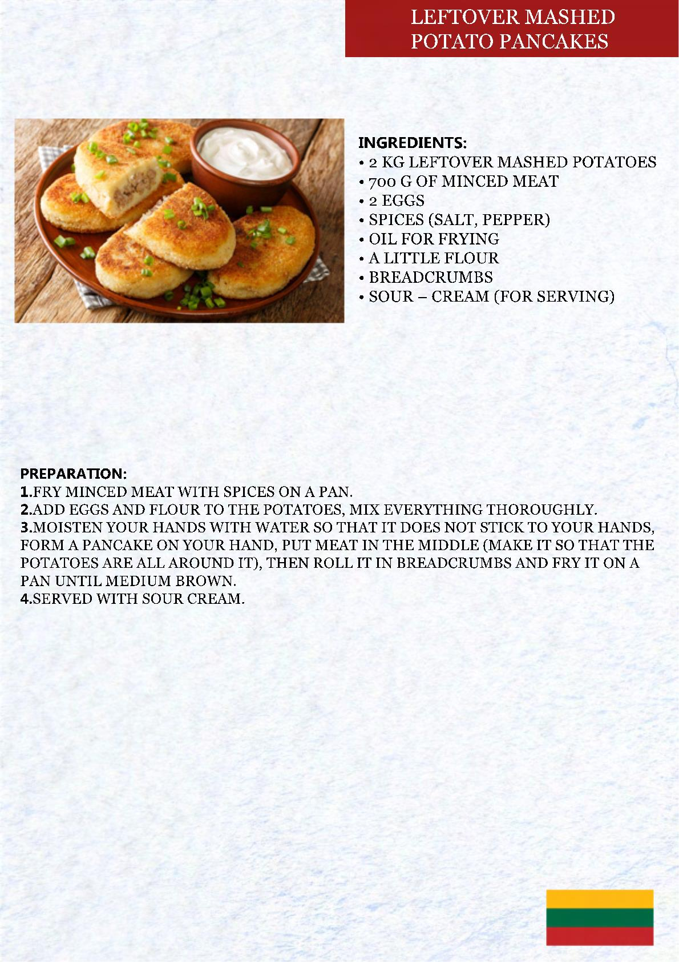

Slide 29
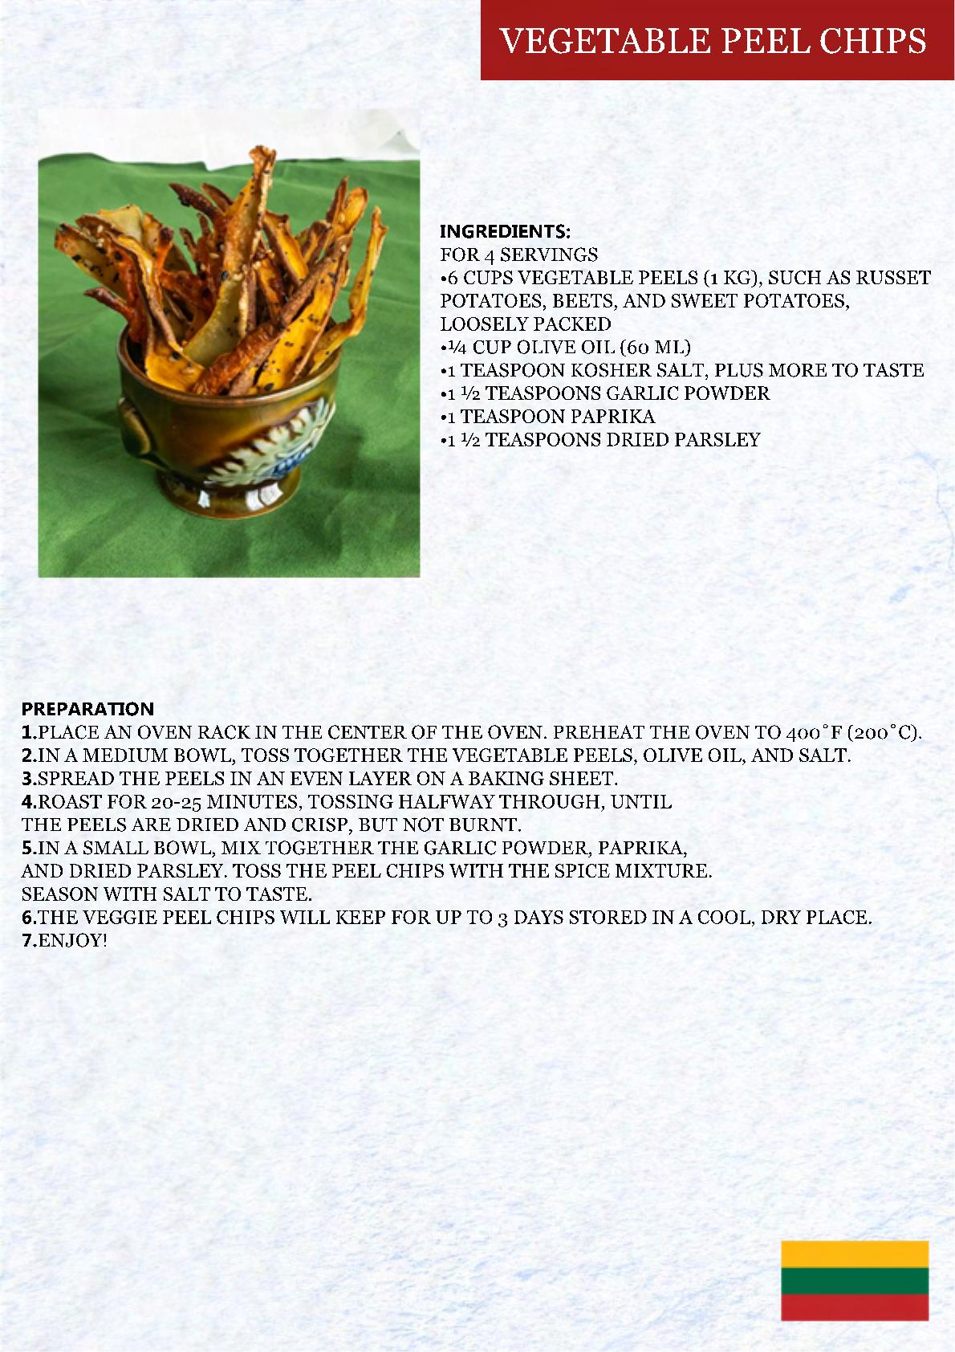

Slide 30
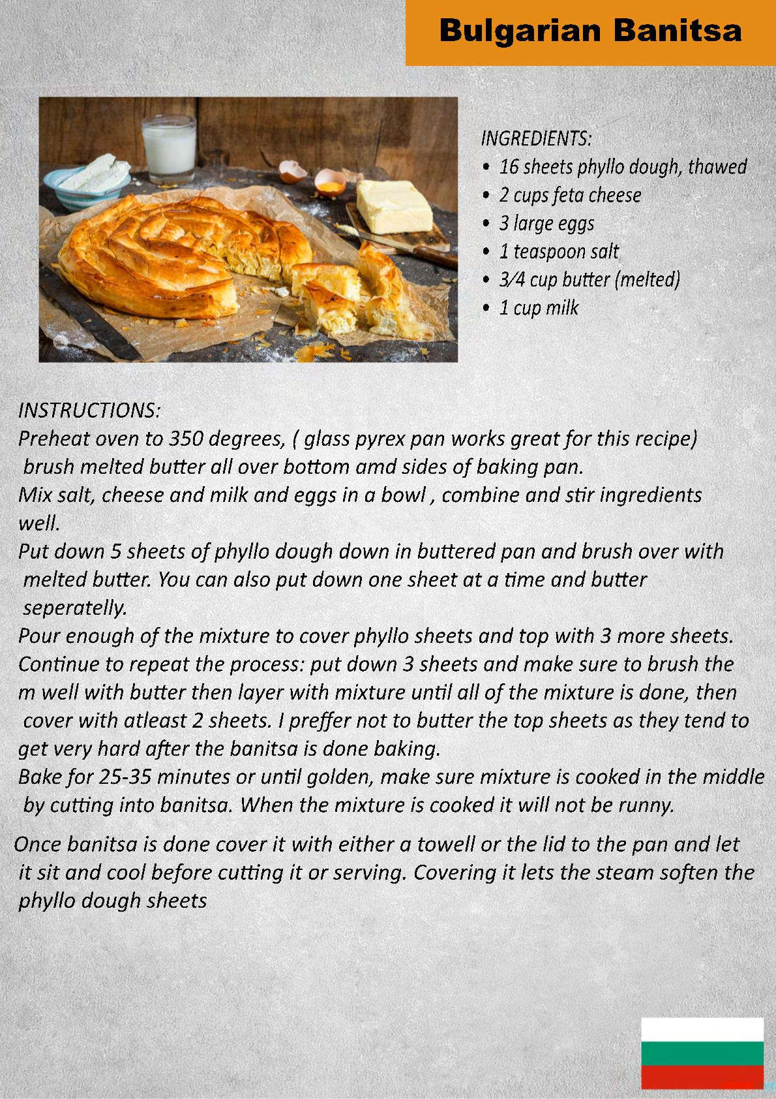

Slide 31
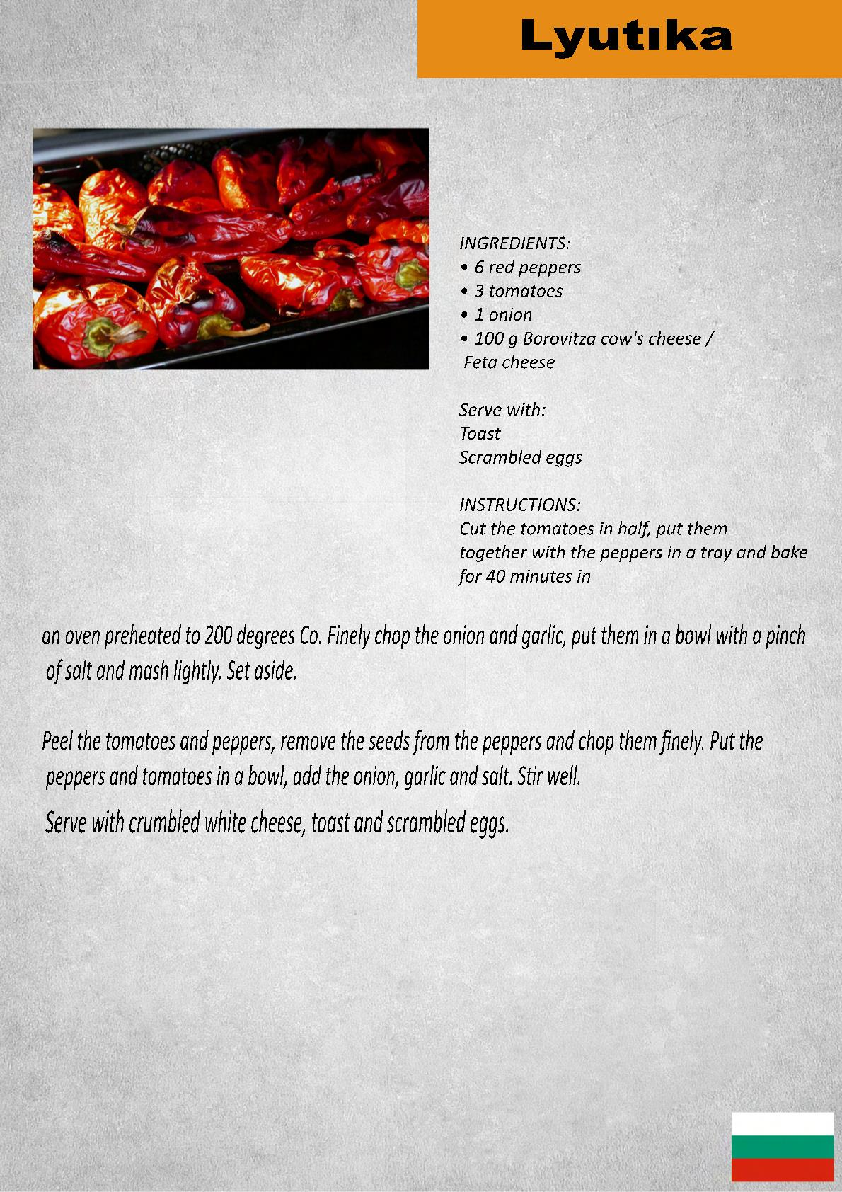

Slide 32
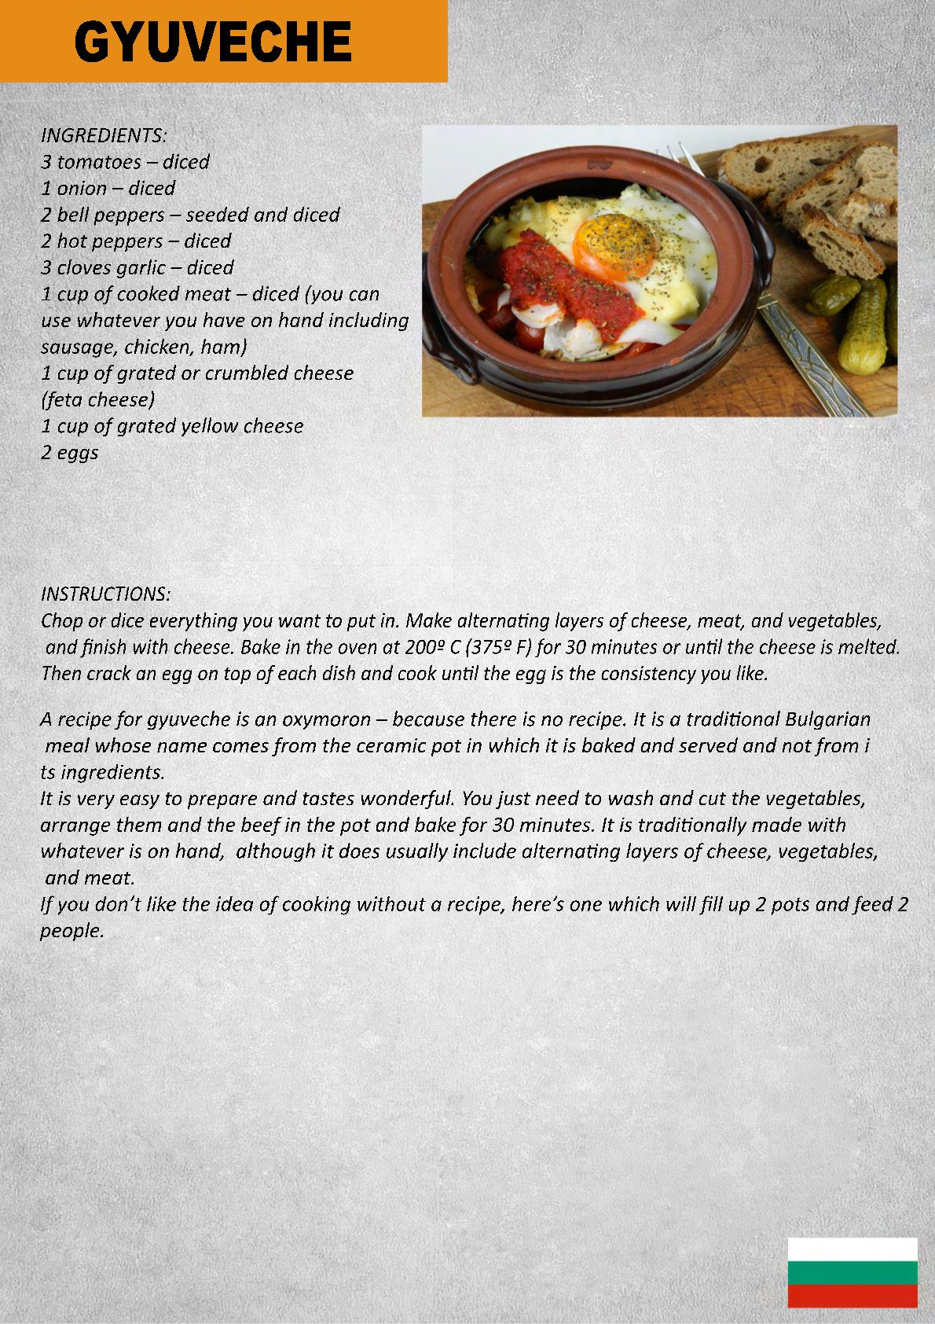

Slide 33
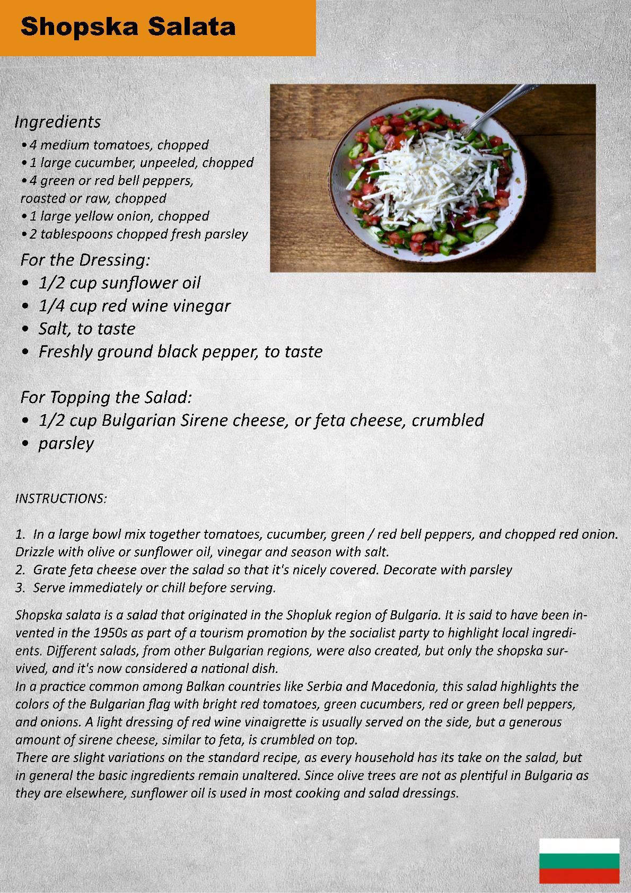

Slide 34
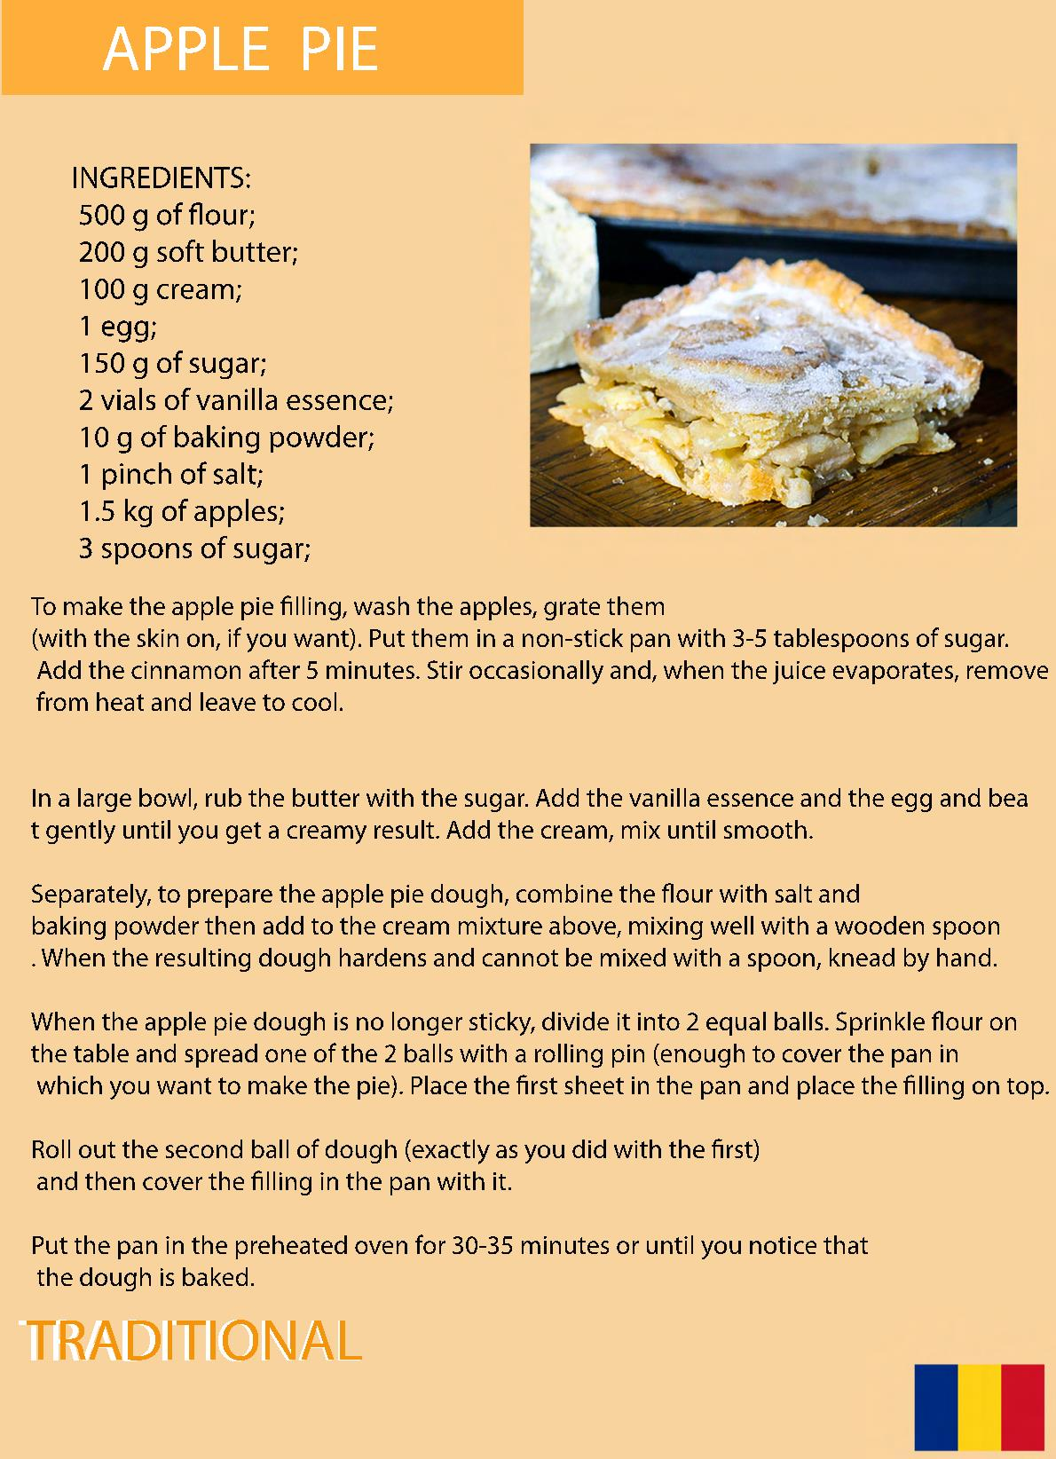

Slide 35
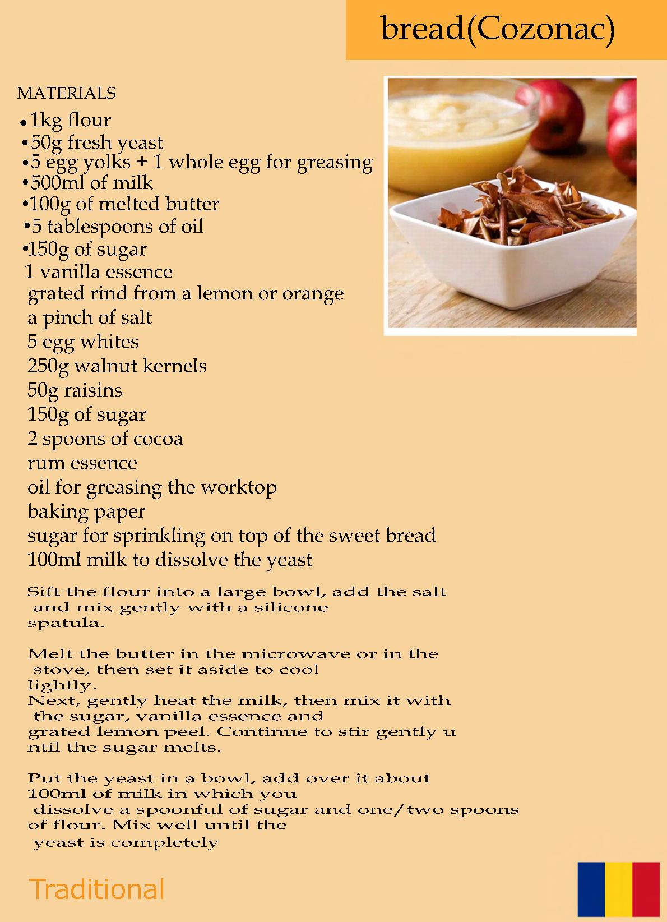

Slide 36
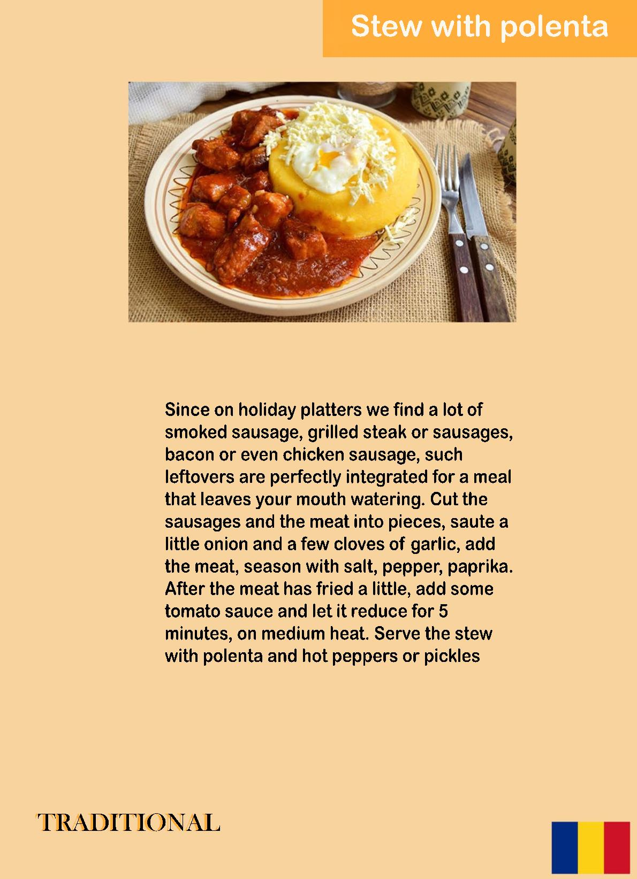

Slide 37
