Slide 1


DON’T WASTE FOOD
KA2 - Cooperation for innovation and the exchange of good practices
KA229 - School Exchange Partnerships
2020-1-IT02-KA229-079059
TURKISH MOBILITY
Coordinator of the project: Stefania Bottino

Slide 2
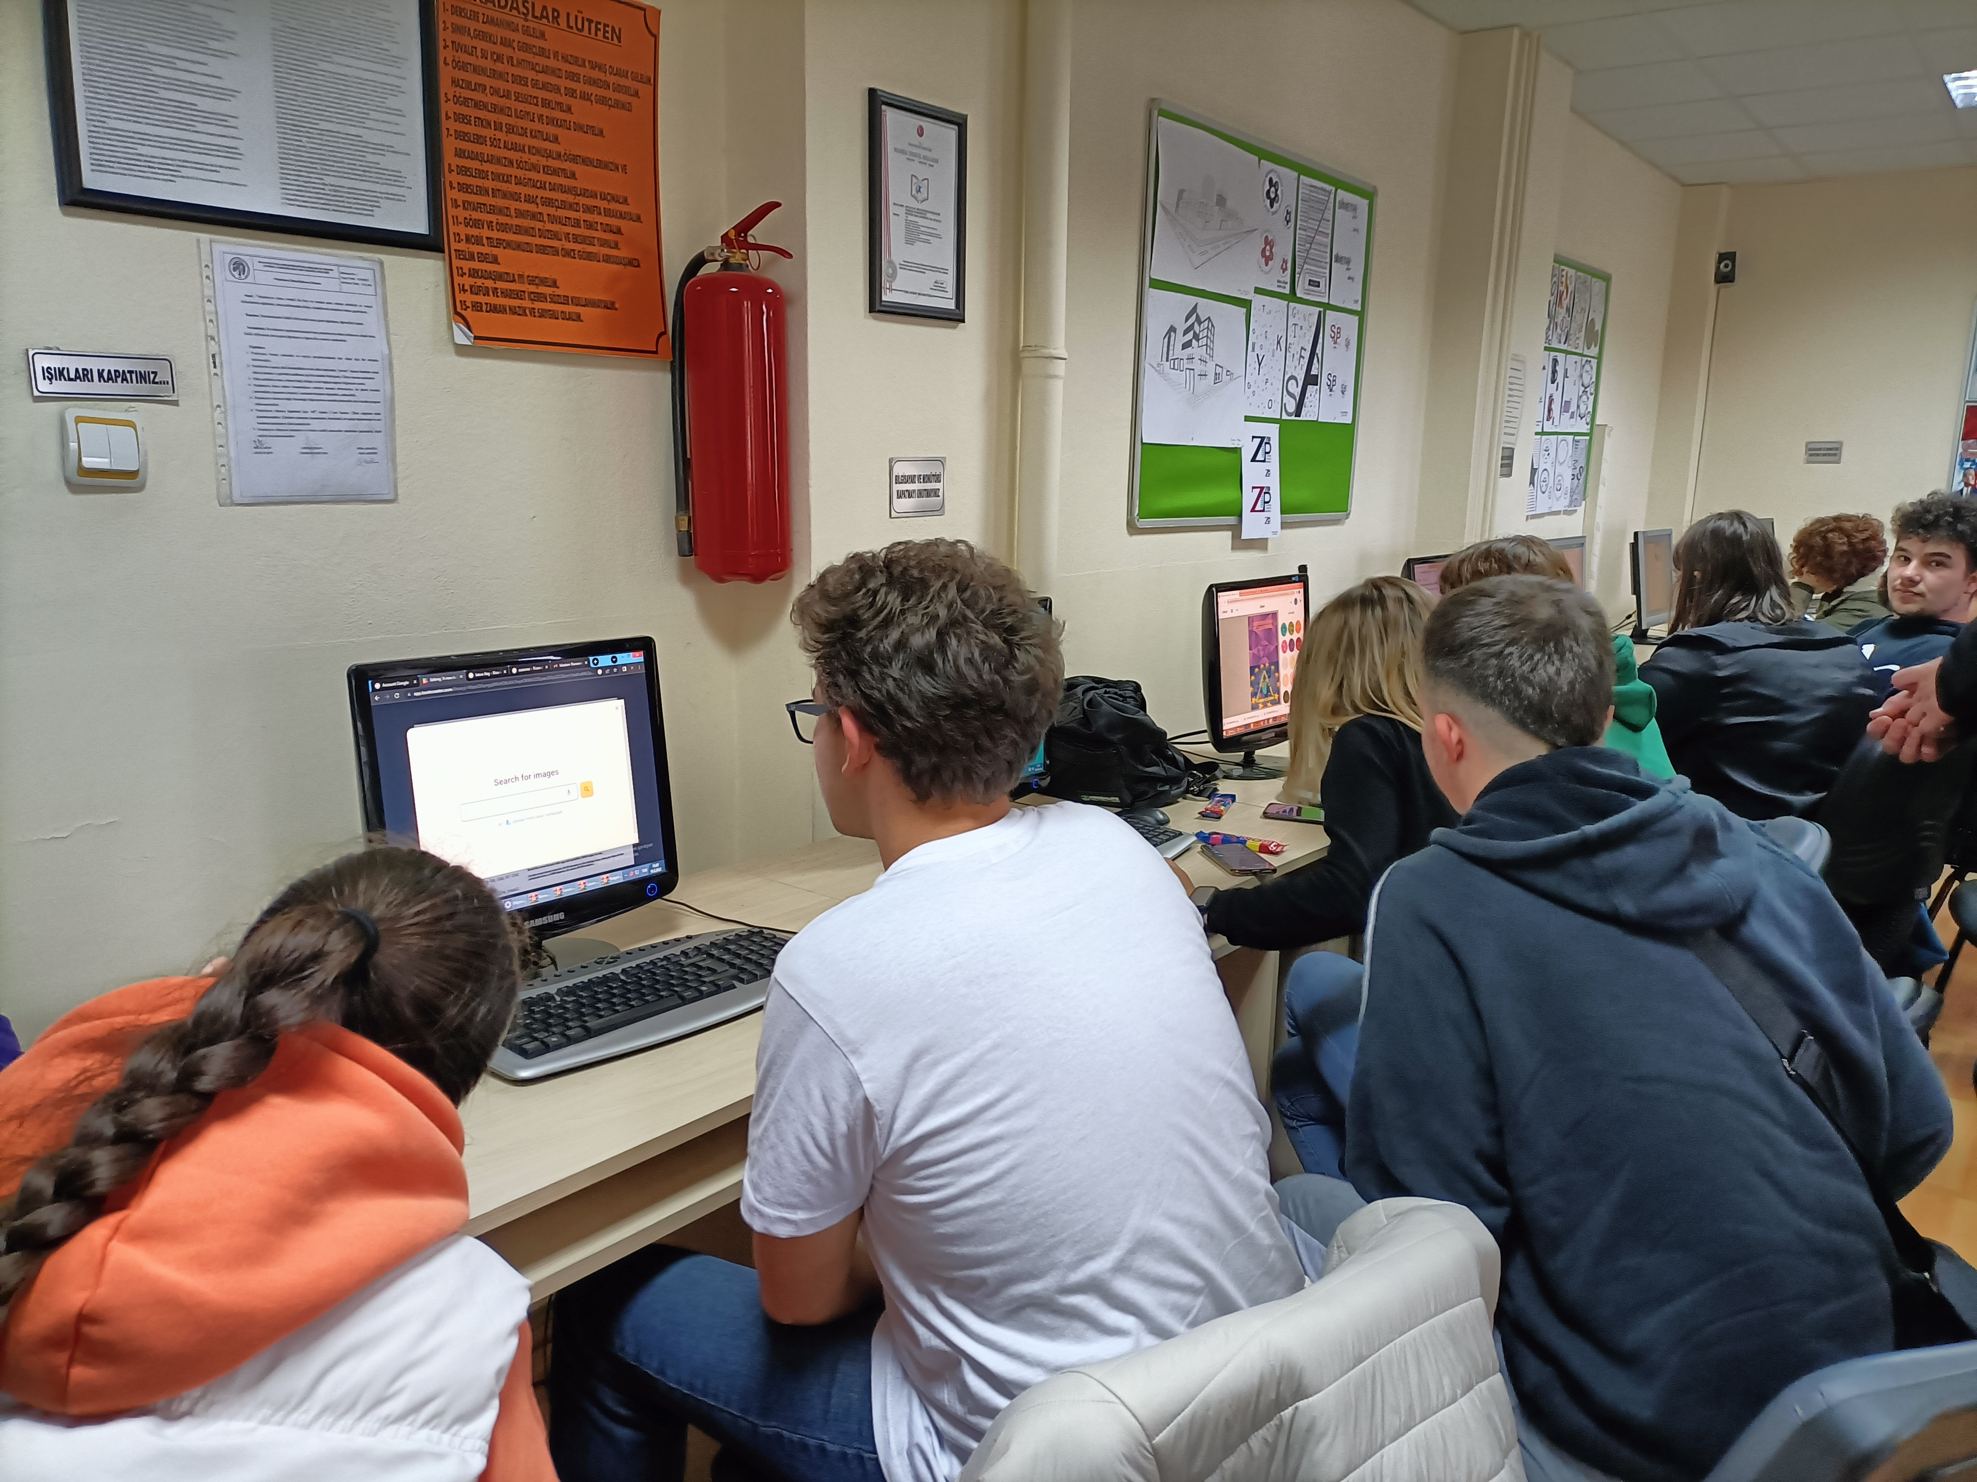
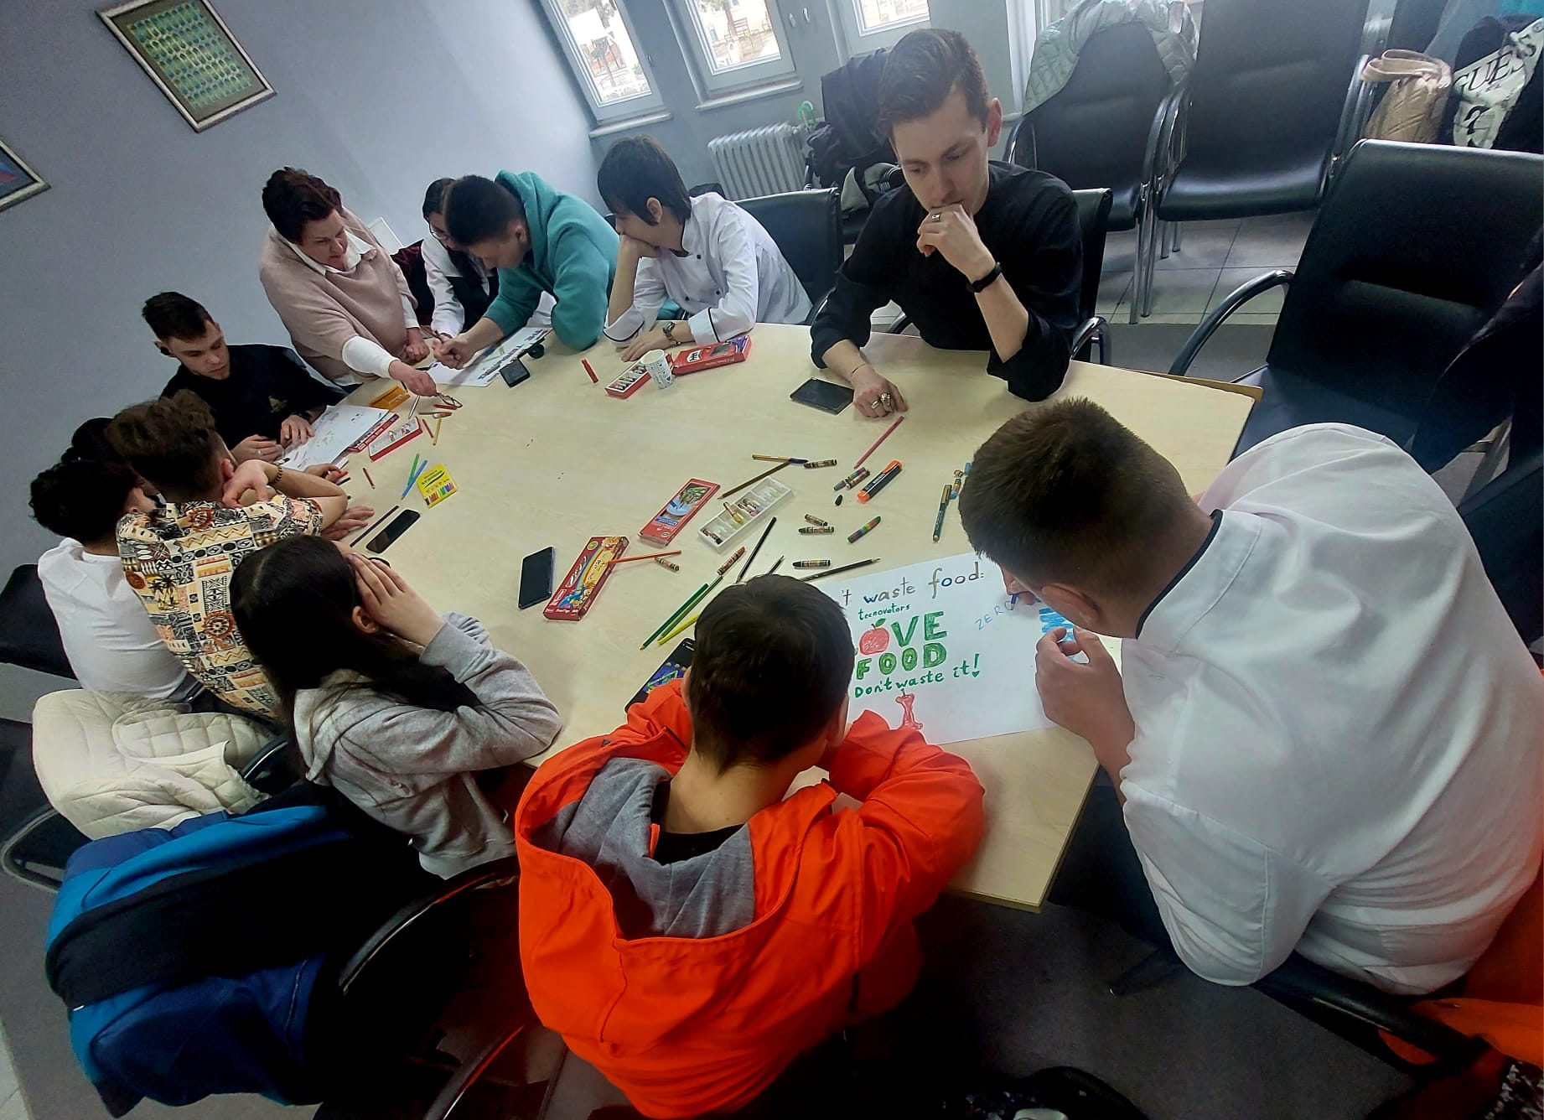
DON’T WASTE FOOD: OUR MANIFESTO

Slide 3
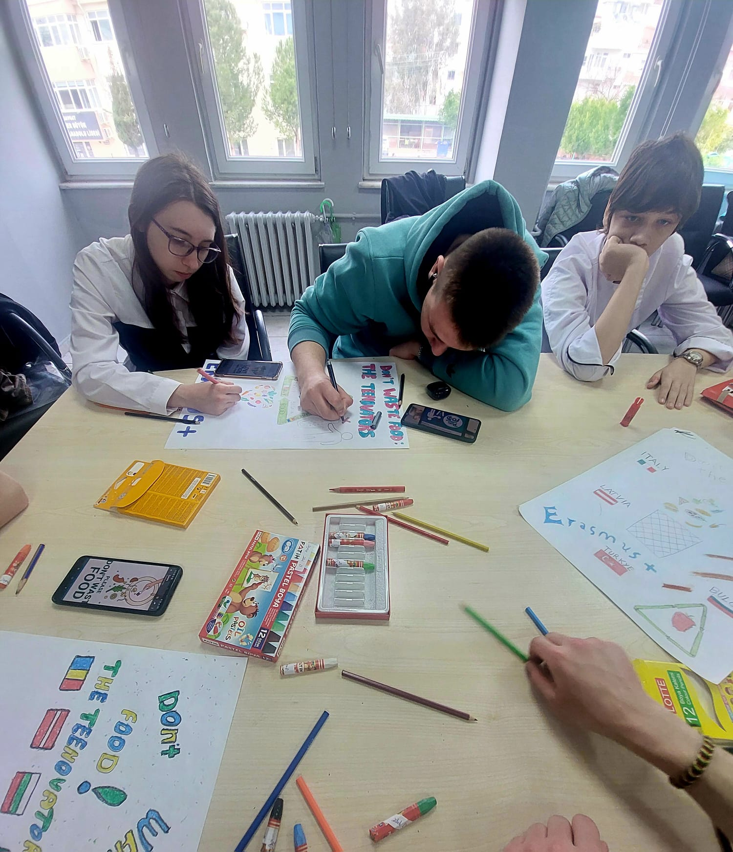
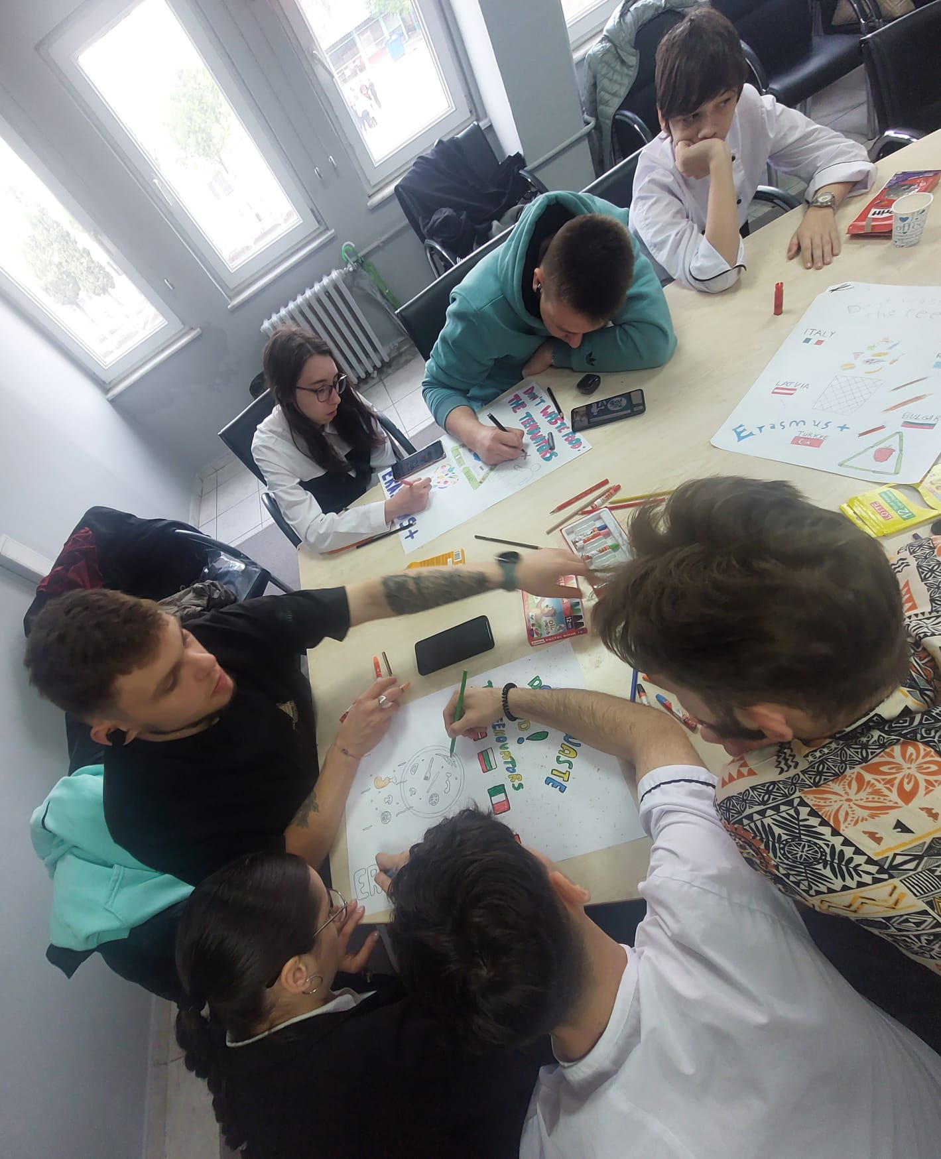
DON’T WASTE FOOD: OUR MANIFESTO

Slide 4
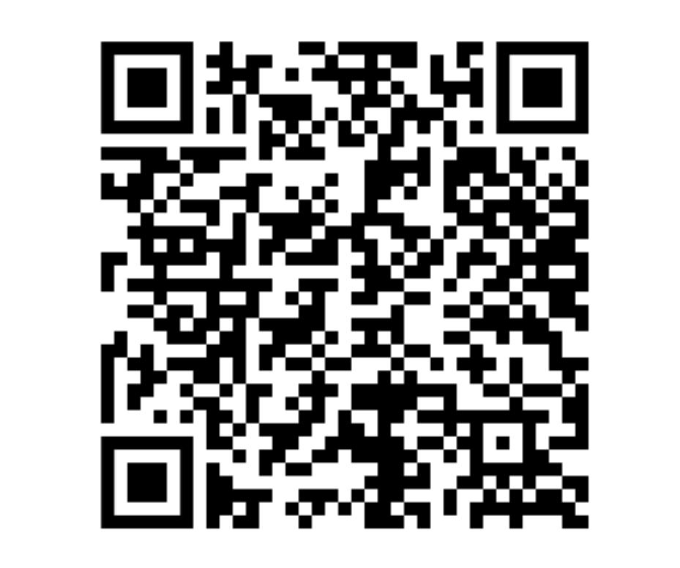

DON’T WASTE FOOD:
This is the best Manifesto

Slide 5
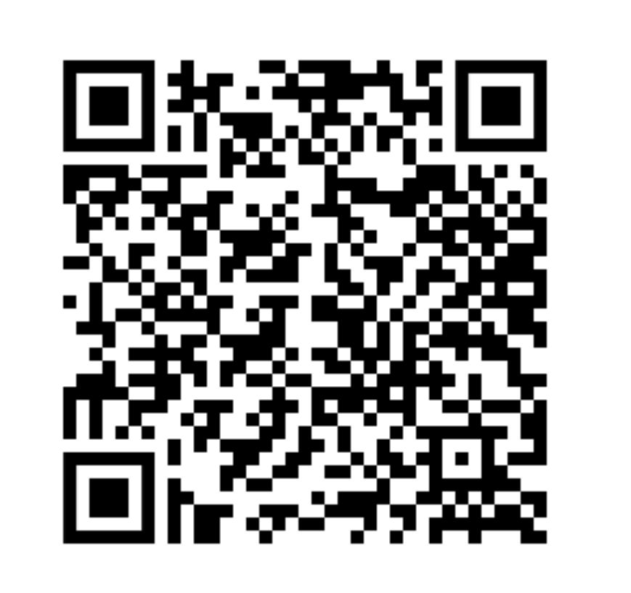
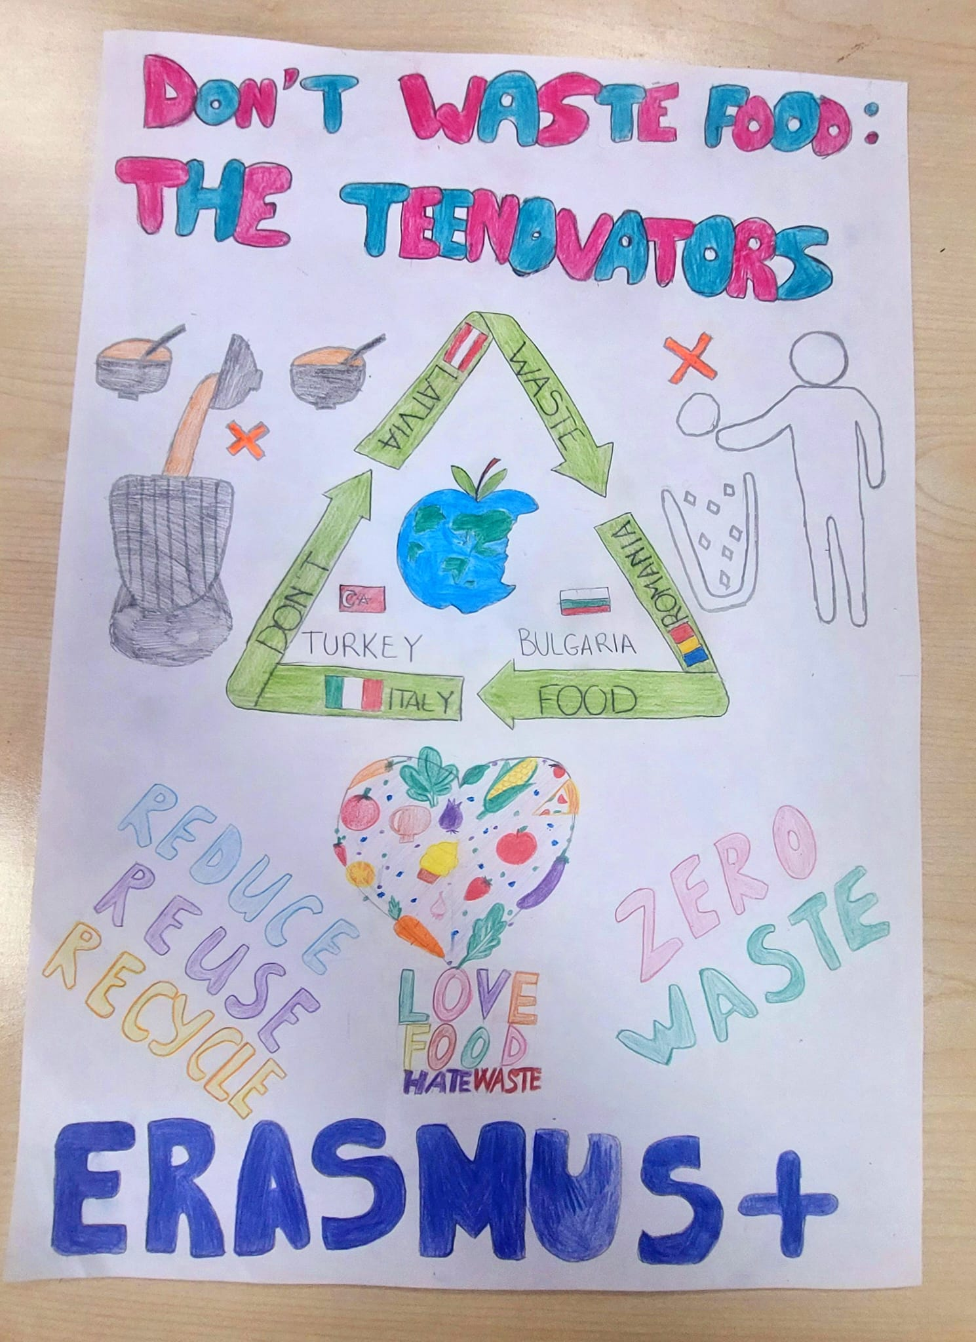
DON’T WASTE FOOD

Slide 6
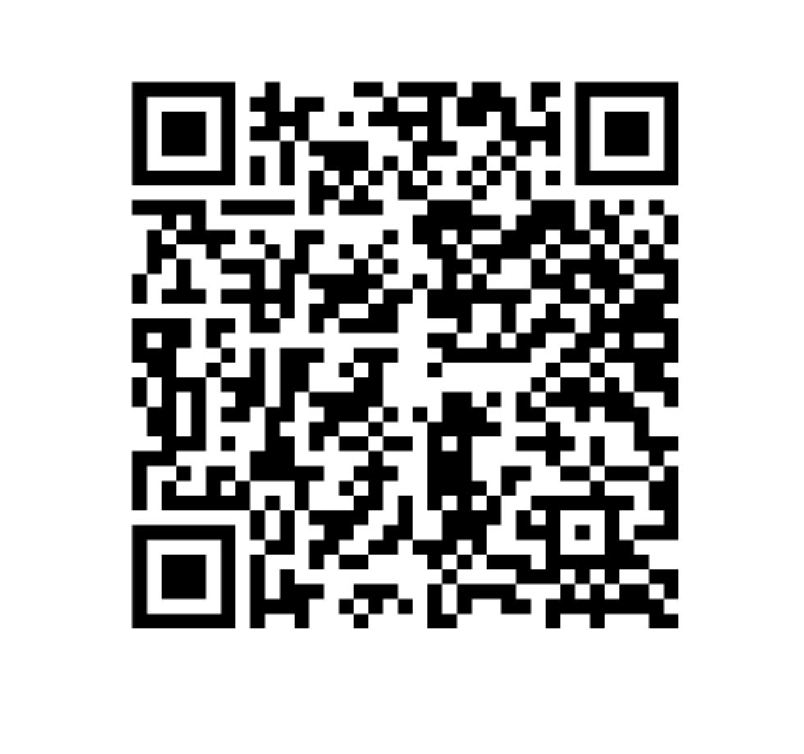
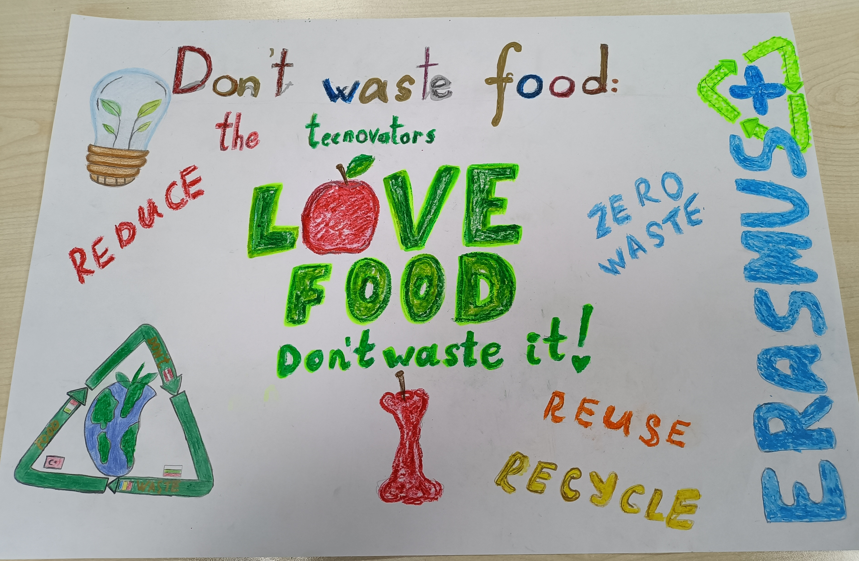
DON’T WASTE FOOD

Slide 7
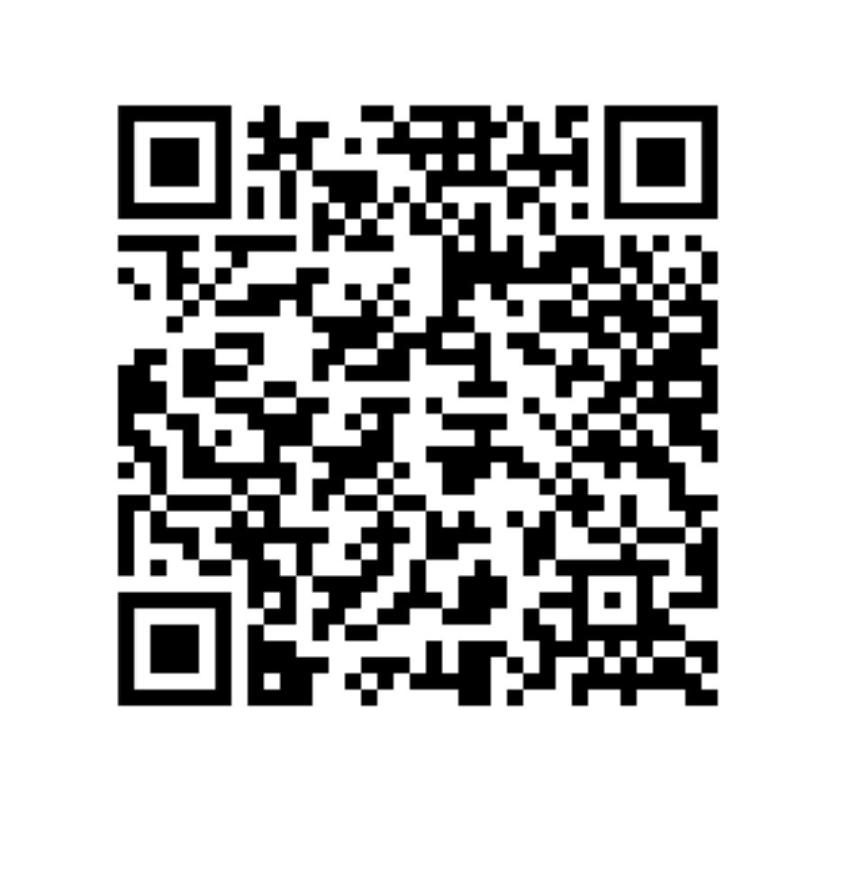
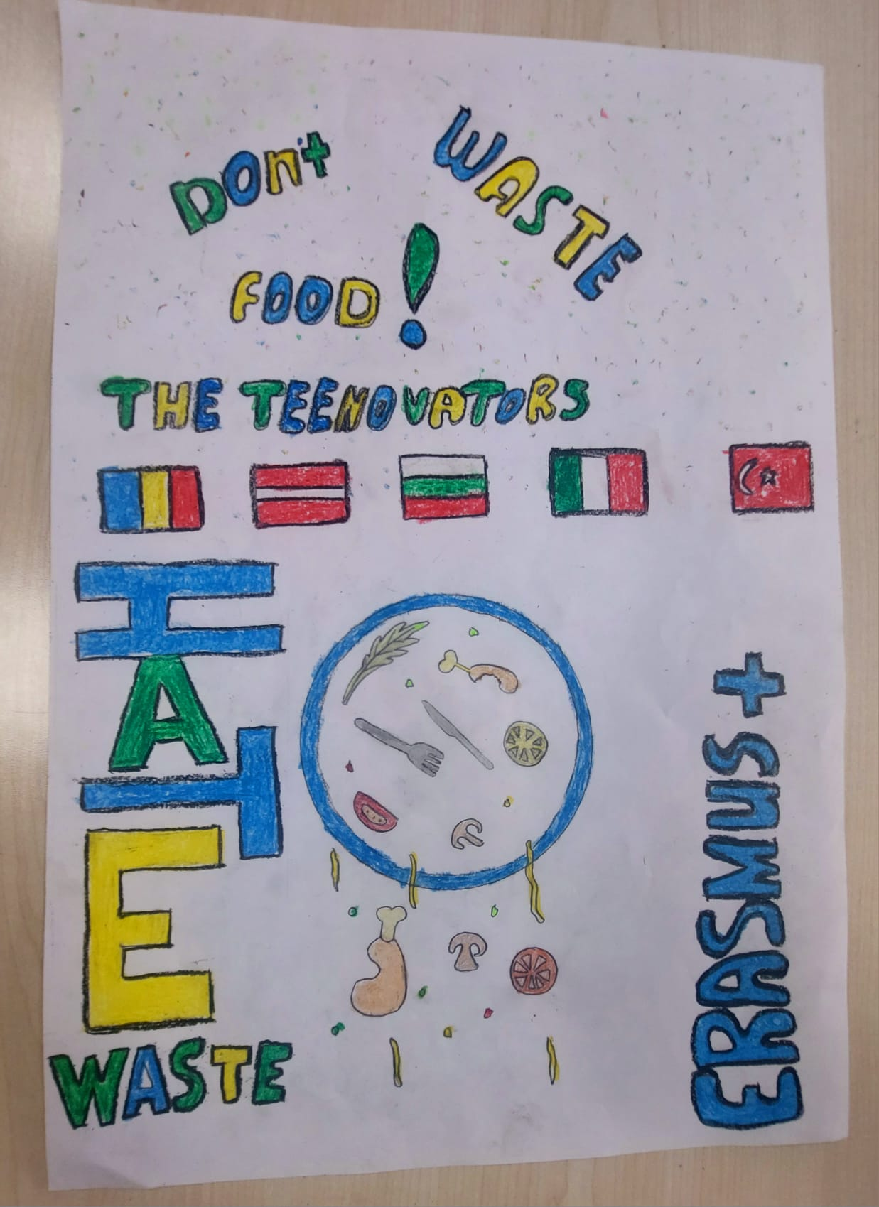
DON’T WASTE FOOD

Slide 8
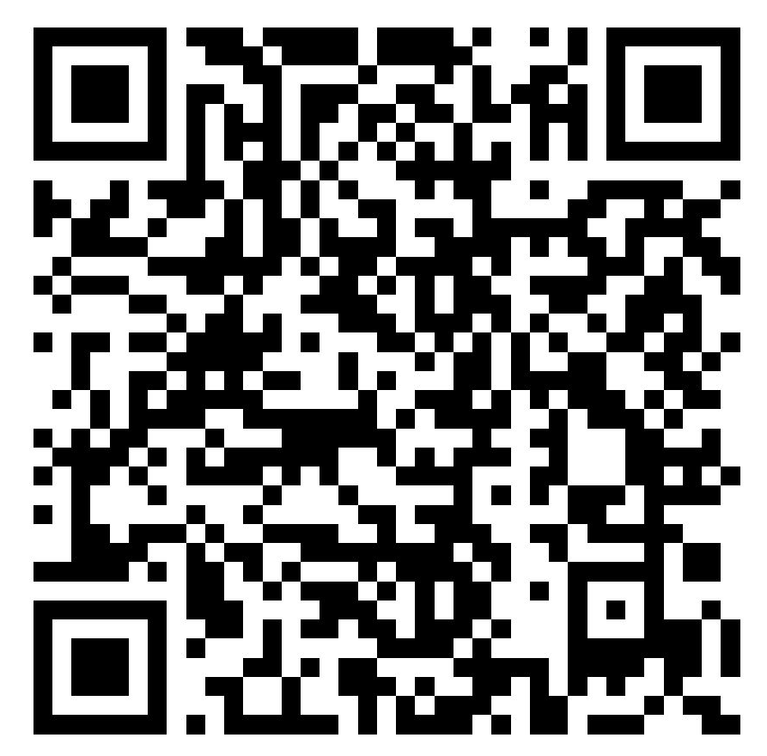

DON’T WASTE FOOD

Slide 9
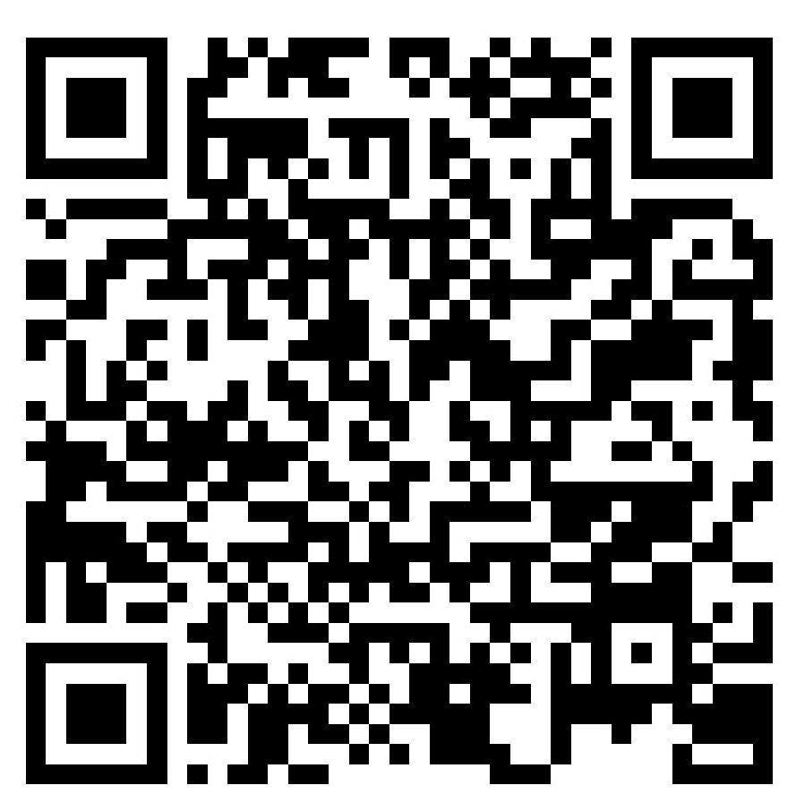

DON’T WASTE FOOD

