Slide 1
Reusing, Reducing, Recycling

Slide 2
CONTENTS
-Establishing the correct portions of food
-Identifying healthy and unhealthy food

Slide 3
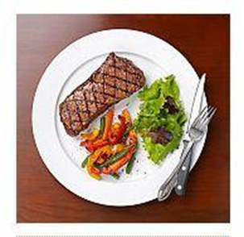
Understanding exactly what a normal and healthy portion of food means makes the difference between maintaining an ideal weight and being overweight or obese. A practical guide to estimate the recommended portions for each food is a real help in developing healthy eating habits, which guarantee a long life without health complications.
A good control of food portions is very important for the correct management of body weight, which depends on the number of calories ingested through food.

Slide 4
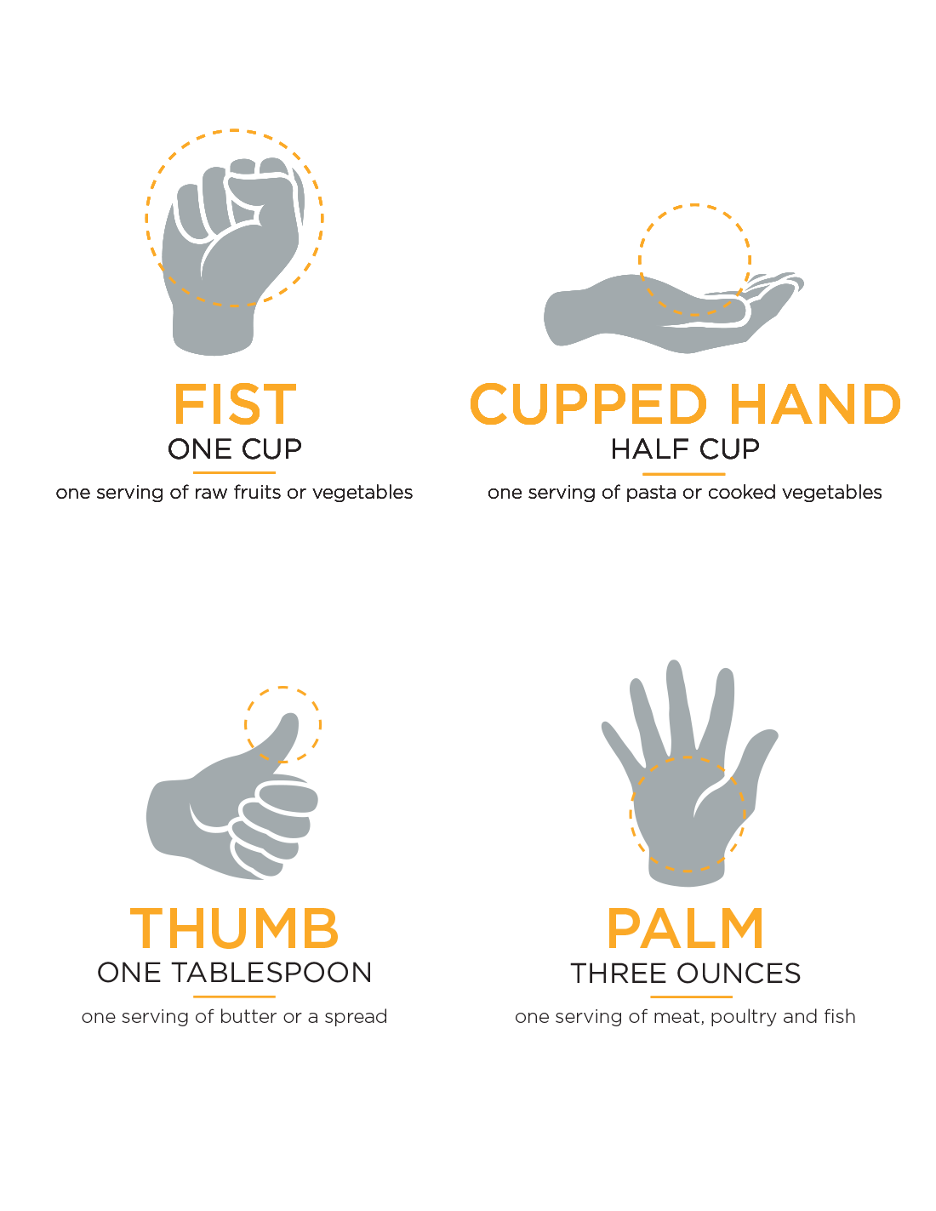
Stabilirea portiilor corecte de mancare
On food labels there are two terms used to refer to this, serving size and portion.
Serving size varies from one product to another, being the amount of food shown on the label of a product (the nutritional values ​​of the serving size are suggested by the manufacturer on the packaging).
Portion represents the actual amount you eat/choose to consume at once, being 100% under your control (in a restaurant, takeout or at home).

Slide 5
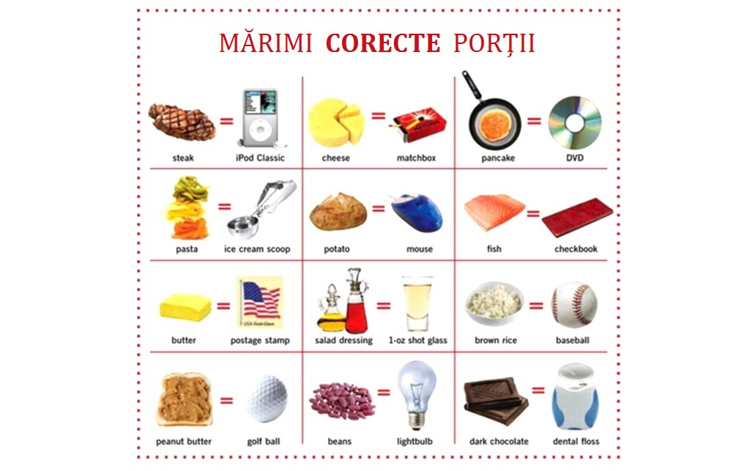
The serving size for different food groups

Slide 6
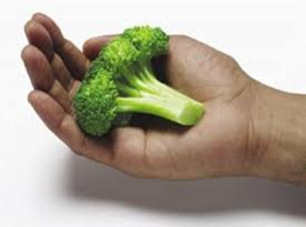
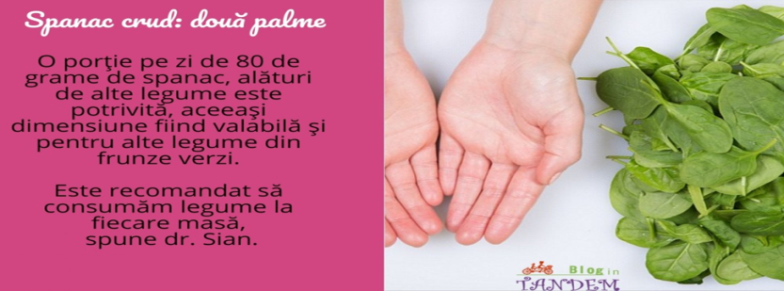
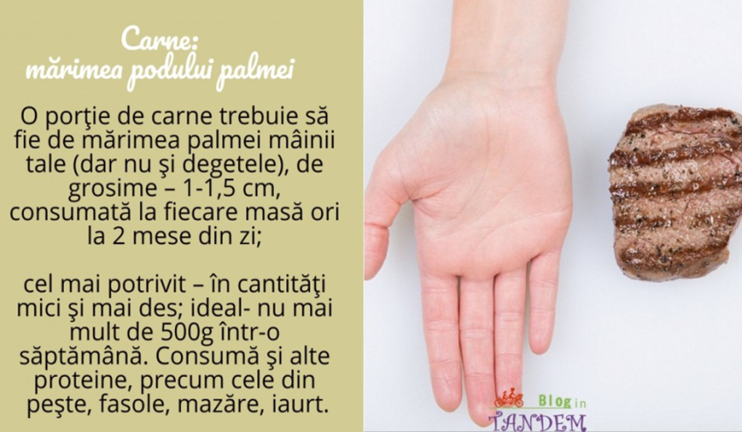
- 1 portion of raw broccoli = 90 grams = a tight fist; - 1 portion of fresh spinach = 55 grams = a classic bulb;
- 1 portion of raw rice = 50 grams = a form for muffins;
- 1 serving of fruit = 115 grams = a baseball;
- 1 portion of fish fillet = 85 grams = a notebook;

Slide 7
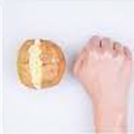
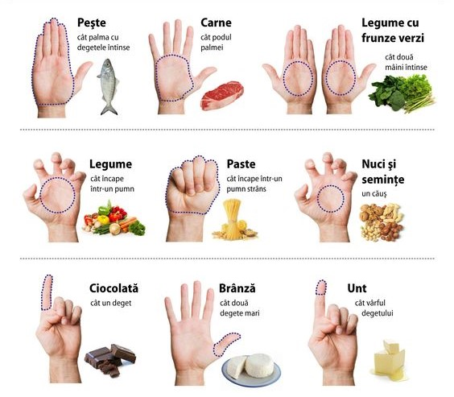
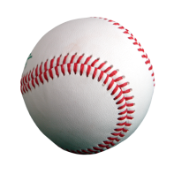
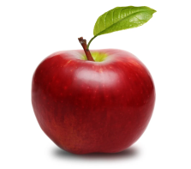
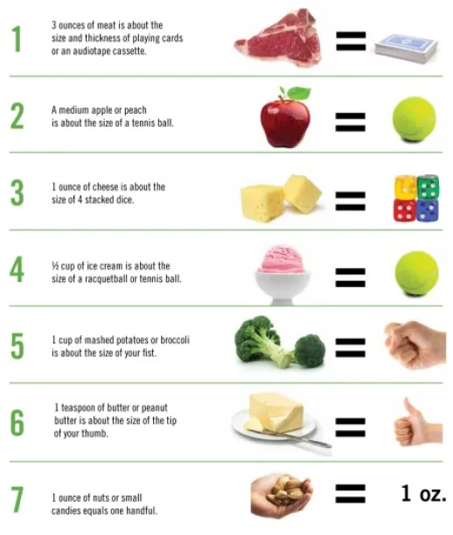
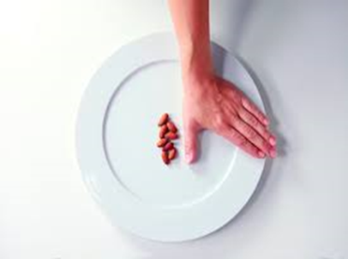
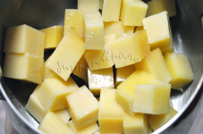
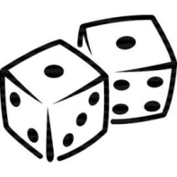
- 1 red apple = 115 grams = a baseball;
- 1 portion of orange juice = 150 ml = a cup of tea; - 1 portion of cheese = 28 grams = two large dice;
- 1 portion of tuna in its own juice = 12 cans = a tennis ball;
- 1 portion of milk = 250 ml = a normal cup;
- 1 portion of bread = 85 grams = a computer mouse;
- 1 portion of chips = 28 grams = a small cup of tea;
- 1 portion of butter = 1 teaspoon = the size of the index fingerprint of a large dice;
- 1 portion of cashew nuts = 1 spoon = the size of the thumbprint;
- 1 portion of cereal = 55 grams = a tight fist;
- 1 portion of cooked potatoes = 60 grams = 12 baseballs;
- 1 portion of cheese = 58 grams = 4 dice;
- 1 portion of fish fillet = 85 grams = a notebook;
- 1 serving of peanut butter = 2 tablespoons = 1 ping-pong ball;

Slide 8
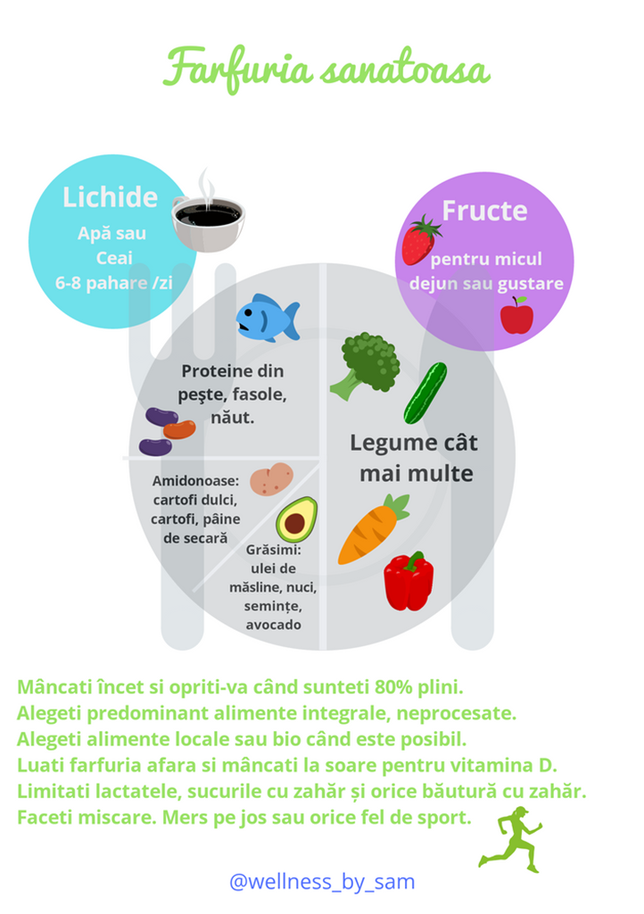
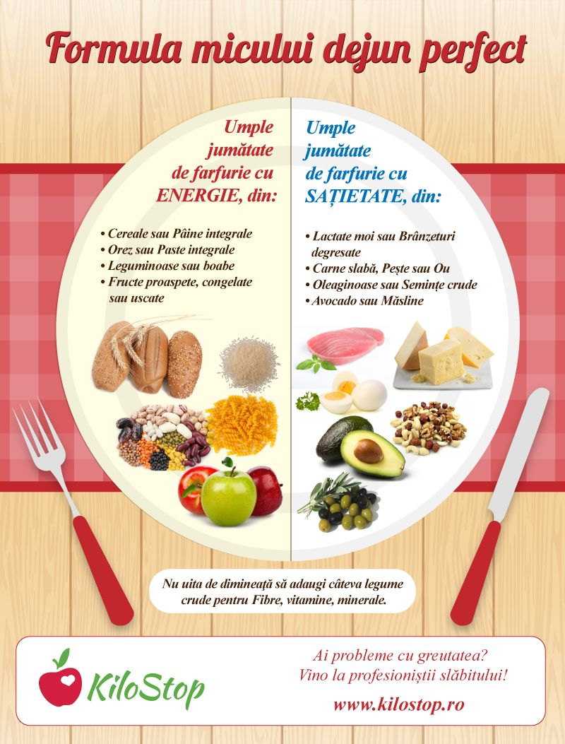
Create a plate for breakfast

Slide 9
Useful methods to reduce food portions For many people, the portions of food recommended by nutritionists seem much too small to satisfy the usual food appetite. In reality, the secret lies in getting the body used to a normal amount of food, through some useful methods to reduce the portions gradually, which lead to minor changes with a major impact on health.
- Control the portions consumed at the restaurant. Many restaurants offer much larger portions of food than a human would need. Therefore, share the food on the plate with your lunch/dinner partner or propose to eat only half of the portion, to take the rest as a package.
- Control the portions consumed at home. To avoid the major temptation to eat a second or third portion, put the food from the beginning in separate plates and keep the pot/bowl with the extra food at a distance, so that it is inaccessible during the meal.
- Control the portions of snacks consumed in front of the TV. Put the chips, nuts, seeds, etc. in a small bowl, if you want to enjoy a snack in front of the TV. When you eat them directly from the package, it is very easy to overeat, paying attention to your favorite movie or show.
- Don't skip healthy snacks. The rule imposed by parents in childhood to not eat an apple, because it spoils your appetite, can be forgotten in adulthood. Eat a healthy snack between meals (a piece of fruit, a low-fat yogurt, a few roasted peanuts without salt, etc.), as you will have a reduced tendency to consume excess food during the main meals.
- Keep culinary temptations at a distance. People tend to consume more food if they have direct access to it. Replace the candy box with a fruit bowl, store cookies, chips or ice cream out of sight, such as the top shelf in the pantry/freezer. Move healthy foods as close as possible, so that they are always within reach.

Slide 10
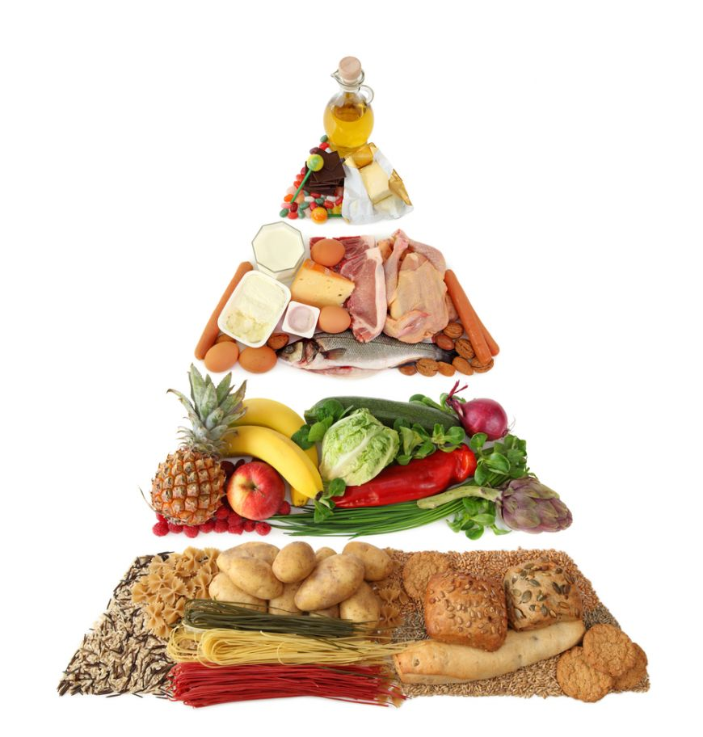

Slide 11
GAME -FLIPCHART Each student will say a letter and give an example of a food BEGINNING WITH THAT LETTER that they will place in the appropriate column
HEALTHY FOOD | UNHEALTHY FOOD

Slide 12
LINK-URI JOCURI DIDACTICE
https://wordwall.net/ro-ro/community/alimente
https://wordwall.net/ro/resource/3239543/alimente
https://wordwall.net/ro/resource/2651816/alimente
https://wordwall.net/ro/resource/27521335/alimente
https://wordwall.net/ro/resource/23672337/alimente
https://wordwall.net/ro/resource/11306686/alimente-proaspte-alimente-alterate
https://wordwall.net/ro/resource/14320025/alimente-sanatoase

